Slide 1






















Bragg Diffraction Based Imaging Techniques
Dec 5th 2017, Annecy
Tobias Schülli,
ESRF Head of the X-ray Nanoprobe group
Scientist in charge of Beamline ID01
The European Synchrotron ESRF
Notes:
Who is a spectroscopist, diffraction ? Material scientist ? Good at QM ?

Slide 2
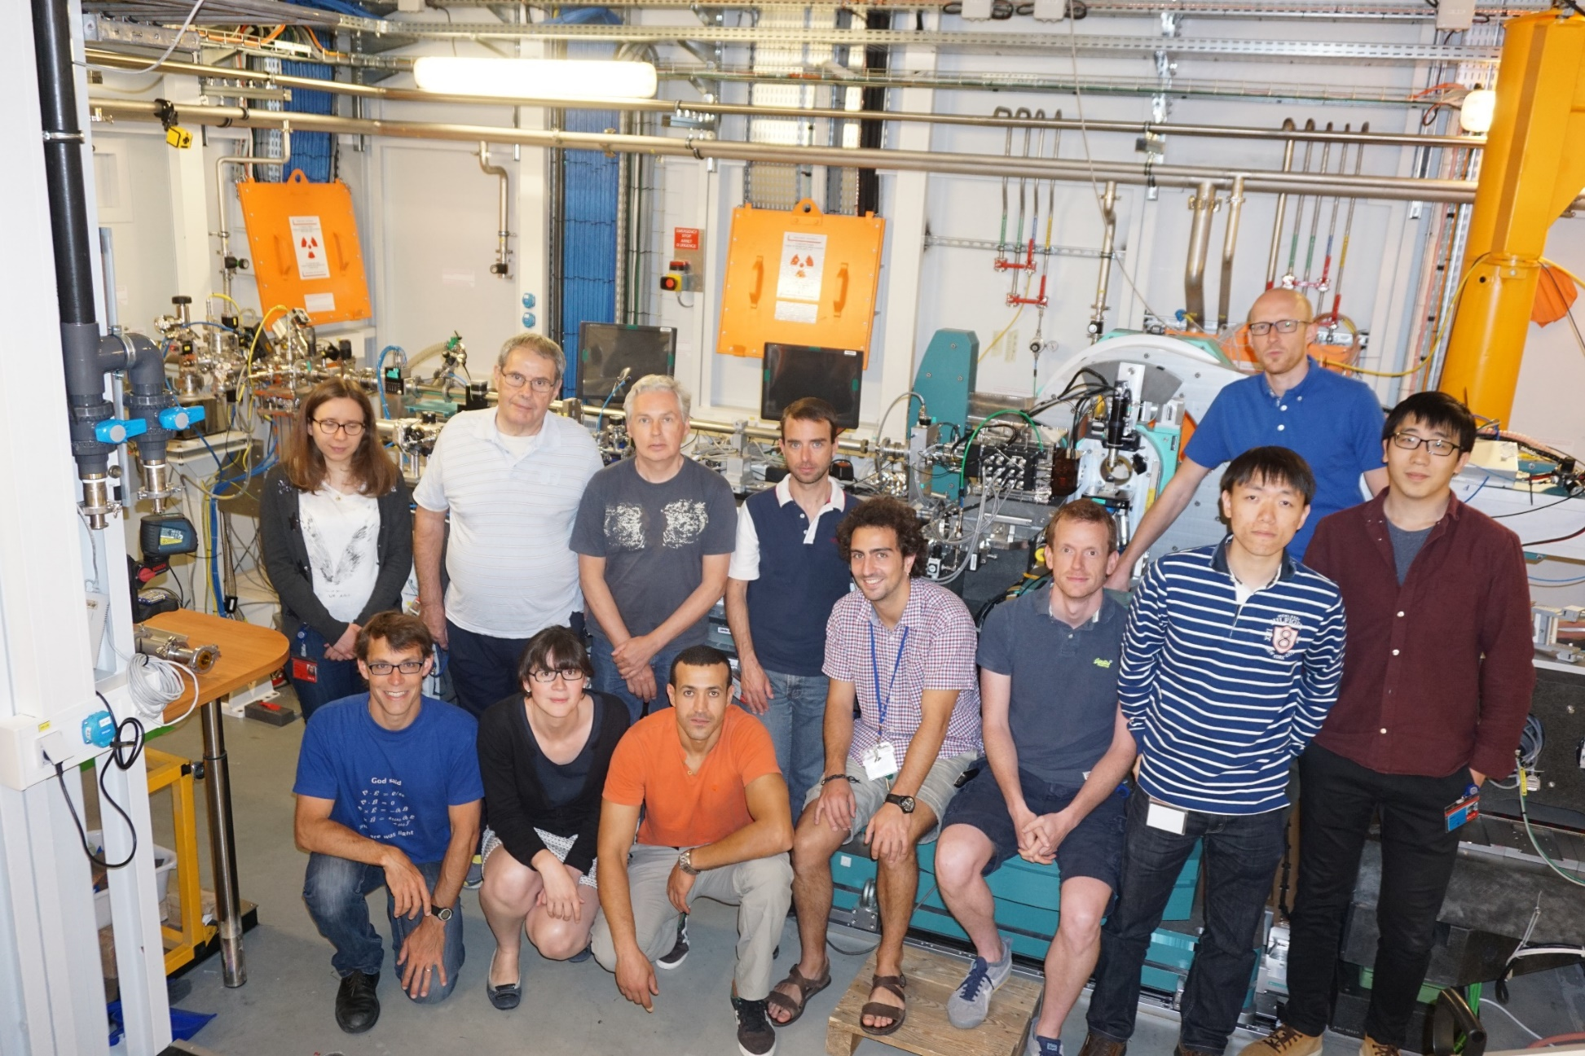
ESRF/ ID01 team

Slide 3

The European Synchrotron ESRF
ESRF Upgrade phase I: 2009-2015: construction of new beamlines
ESRF Upgrade phase II (EBS): Extremely Brilliant Source upgrade (40-100 times more brilliance)
operational in 2020
Things you should know after this lecture:
-What a Lorentz contraction is
-Why lenses cannot simply be replaced by computers
-Why there are no good x-ray optics
-What Joan Baez’ ties to x-ray science are
-That continents are drifting
-The age of the universe
-How to make the difference between a star and a planet
Science with x-rays at the heart of the French Alps, at the eSRF in Grenoble, France

Slide 4
ouTline
-The brilliance of synchroton light sources
-Nano focused x-rays: rapidly evolving tools for (nano) science
-State of the art nano (diffraction) imaging at the ESRF
-Outlook: tomorrows’ light-sources

Slide 5
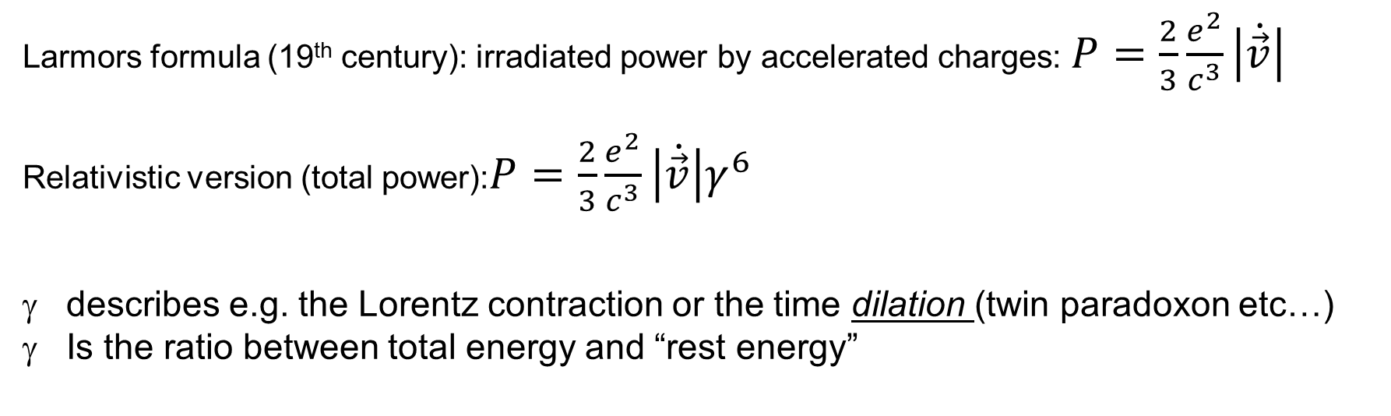


Light emission by accelerated charges
Larmors formula (19th century): irradiated power by accelerated charges: $P=\frac{2}{3}\frac{e^{2}}{c^{3}}\left|\dot{\vec{v}}\right|$
Relativistic version (total power):$P=\frac{2}{3}\frac{e^{2}}{c^{3}}\left|\dot{\vec{v}}\right|γ^{6}$
describes e.g. the Lorentz contraction or the time dilation (twin paradoxon etc…)
Is the ratio between total energy and “rest energy”
$$γ=\frac{1}{\sqrt{1−\frac{v^{2}}{c^{2}}}}=\frac{1}{\sqrt{1−β^{2}}}=\frac{E}{mc^{2}}$$
$$classical consideration β=0; γ=1$$
60 kV (Lab source electron gun): $γ≈$1.05…1.2
ESRF (6 GeV): $γ=$11750 ~ 10⁴

Slide 6
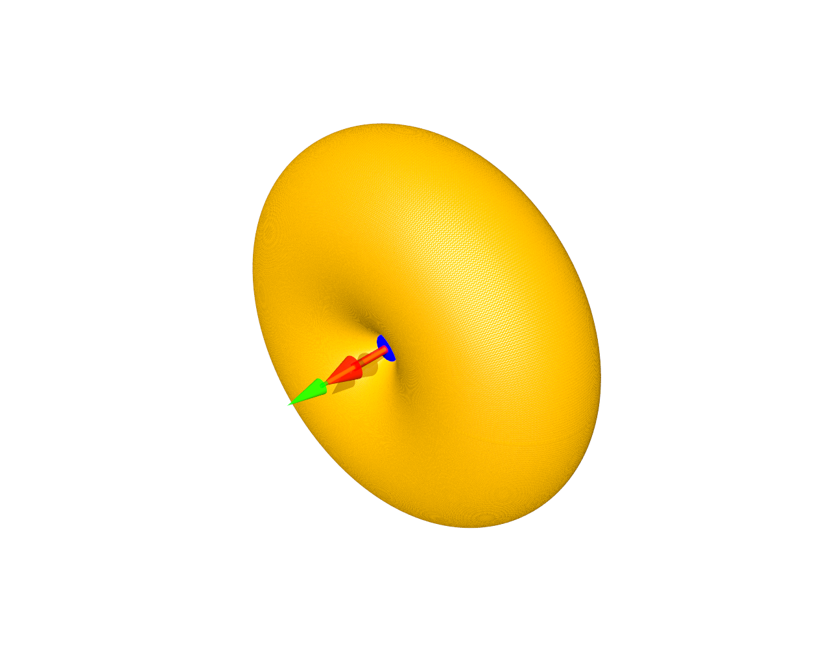
Light emission by accelerated charges
Directional emission characteristics by an accelerated charge (dipole)
Classical result (Linear acceleration ):
Propagation
Acceleration
Notes:
10 mins at the end

Slide 7
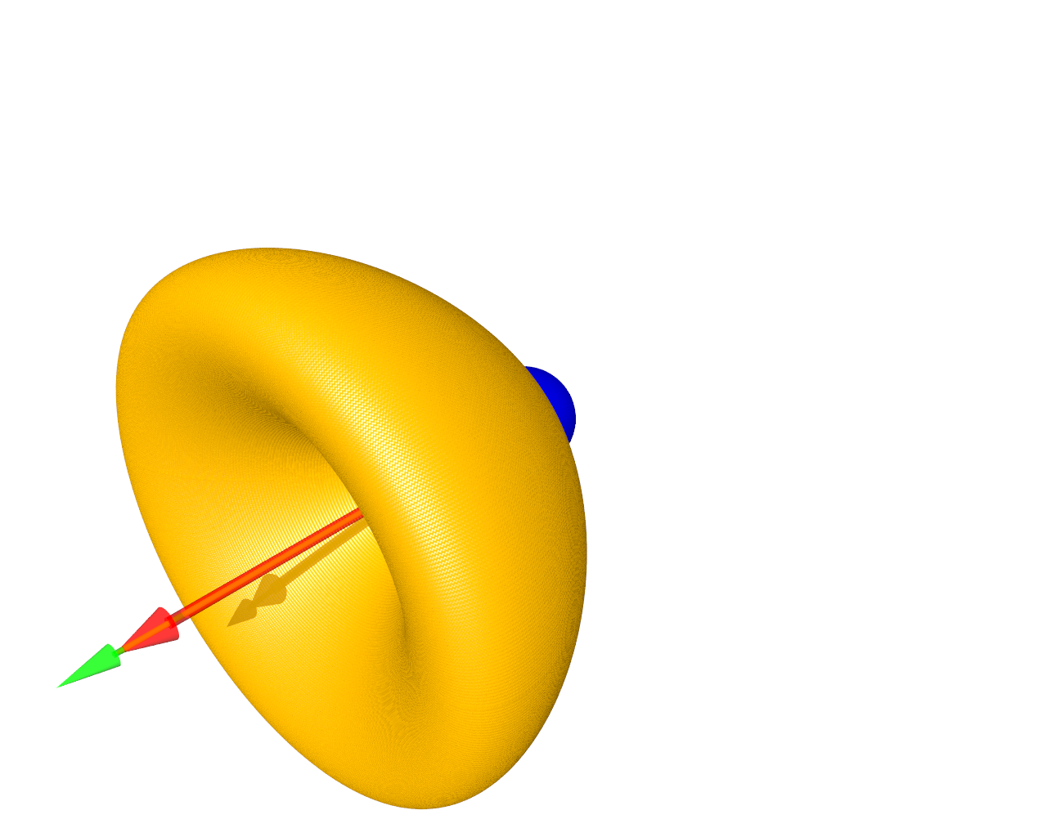
Light emission by accelerated charges
Directional emission characteristics by an accelerated charge (dipole)
Relativitic (X-ray tube, Cathodic tube):
Propagation
Acceleration
Notes:
10 mins at the end

Slide 8
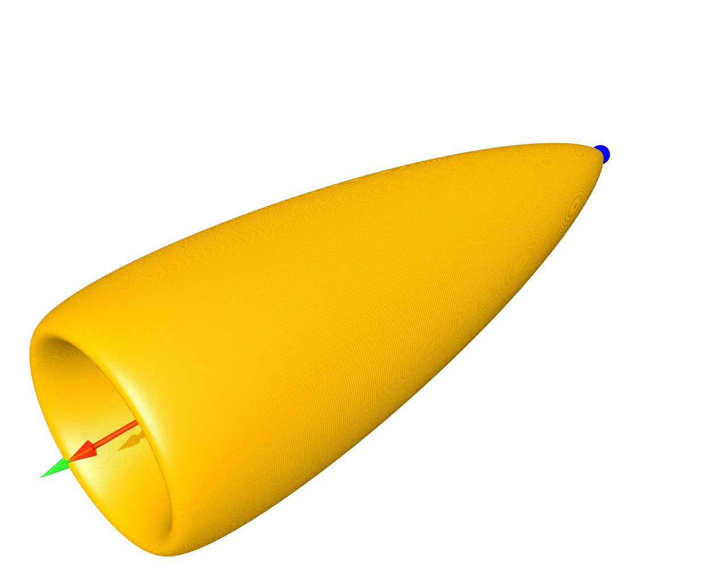
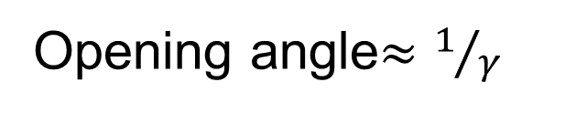
Light emission by accelerated charges
Directional emission characteristics by an accelerated charge (dipole)
Highly relativistic case
Opening angle$≈1/γ$
Propagation
Acceleration
Notes:
10 mins at the end

Slide 9
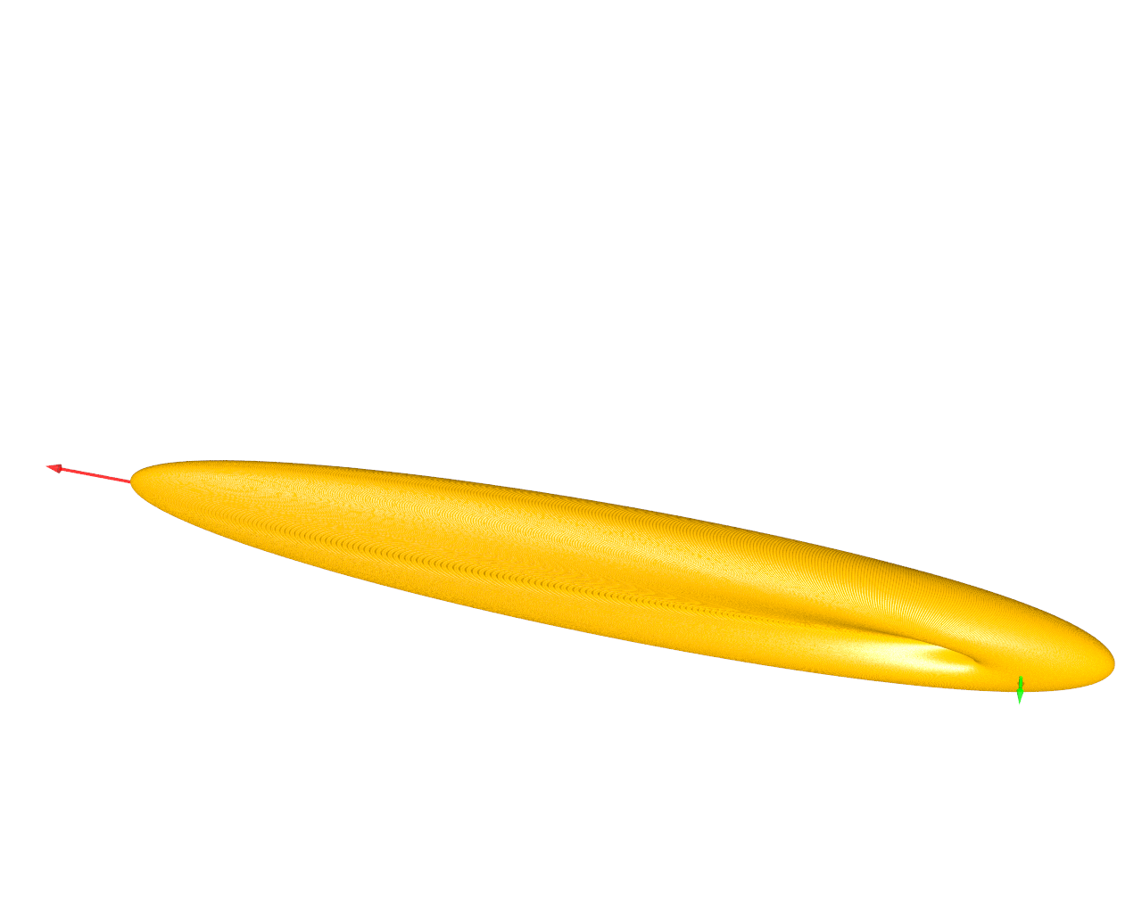
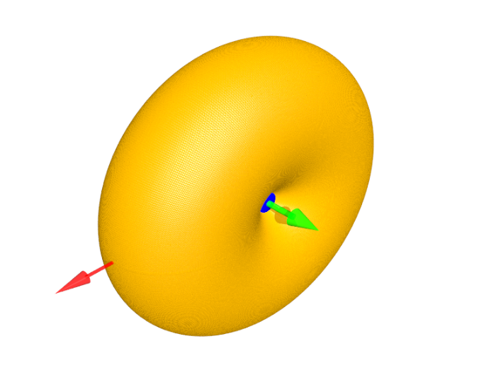
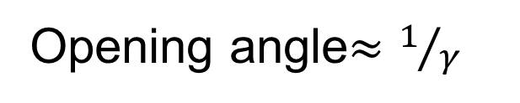
Light emission by accelerated charges
Directional emission characteristics by an accelerated charge (dipole)
Highly relativistic case & circular motion
Opening angle$≈1/γ$
Propagation
Acceleration
Notes:
10 mins at the end

Slide 10
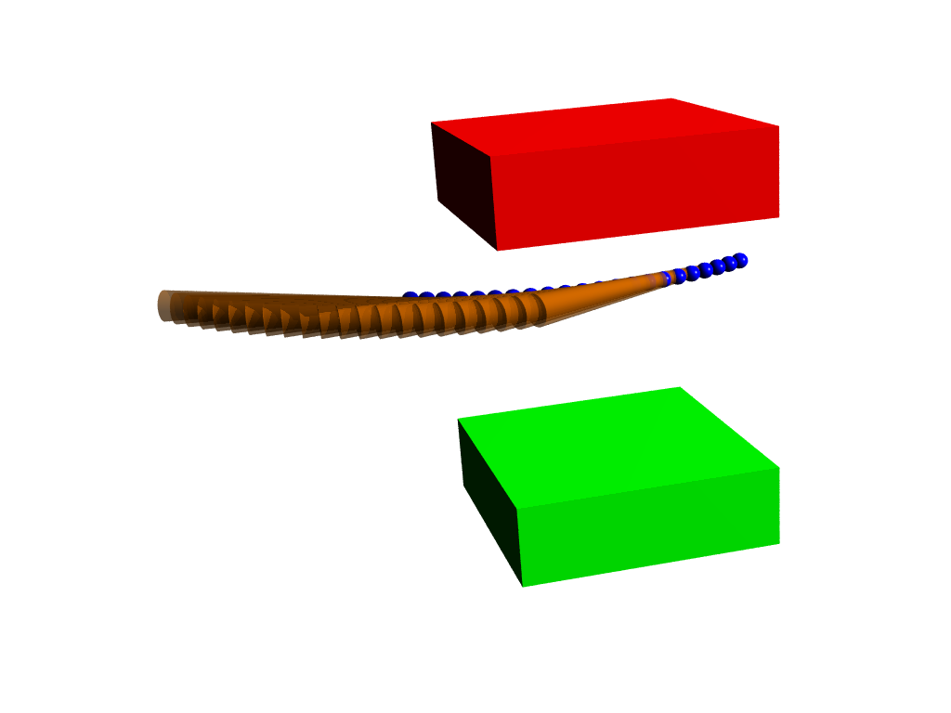

Light emission in a Synchrotron: circular motion
Highly relativistic case & circular motion
“Flash” every time an electron is passing by:
“ Bending magnet radiation
Notes:
10 mins at the end

Slide 11
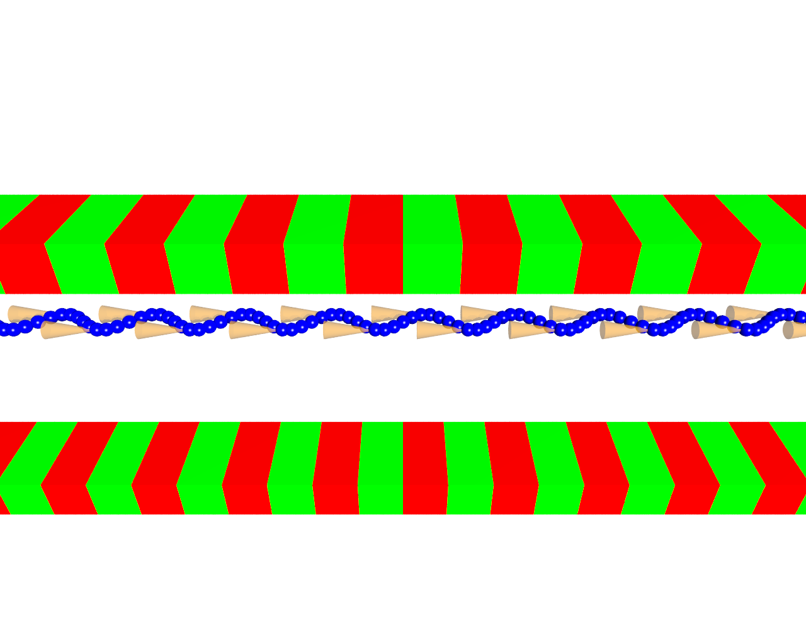
Wigglers: magnetic multipoles: “many bending magnets”
Wigglers: sum of N bending magnets: gain = N
Notes:
10 mins at the end

Slide 12
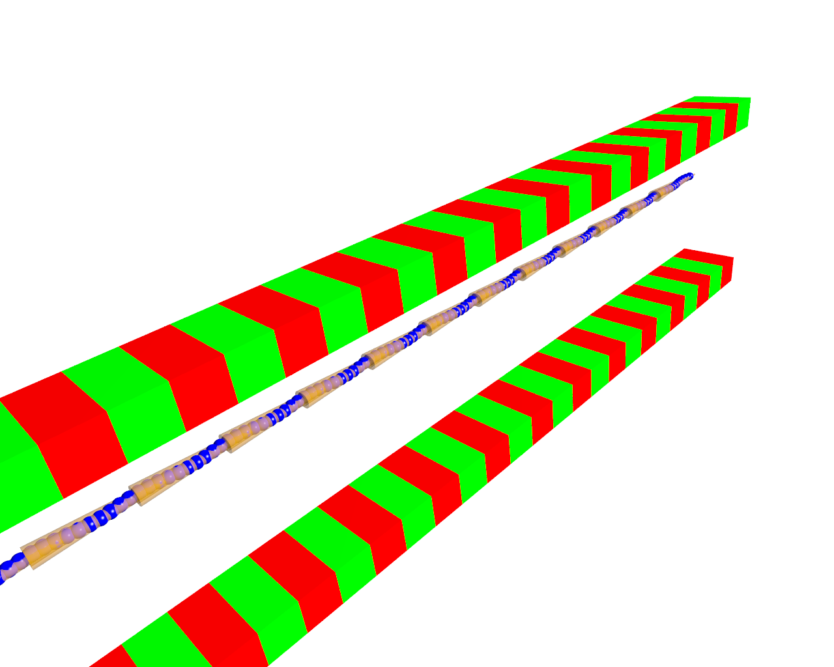
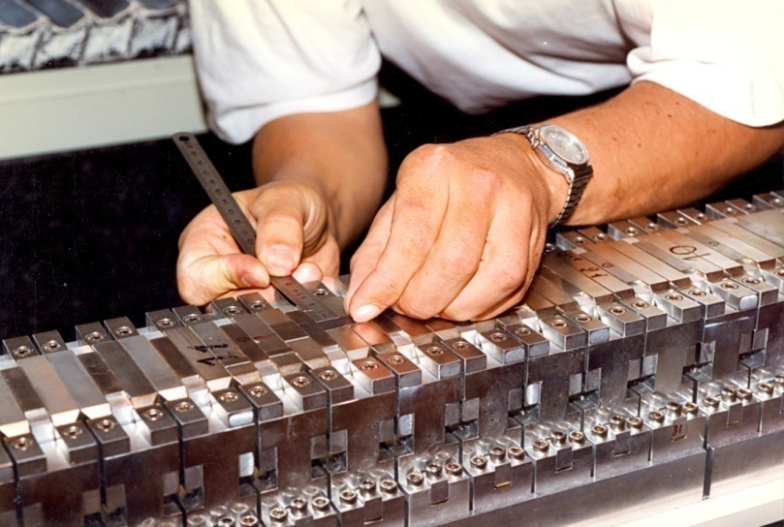
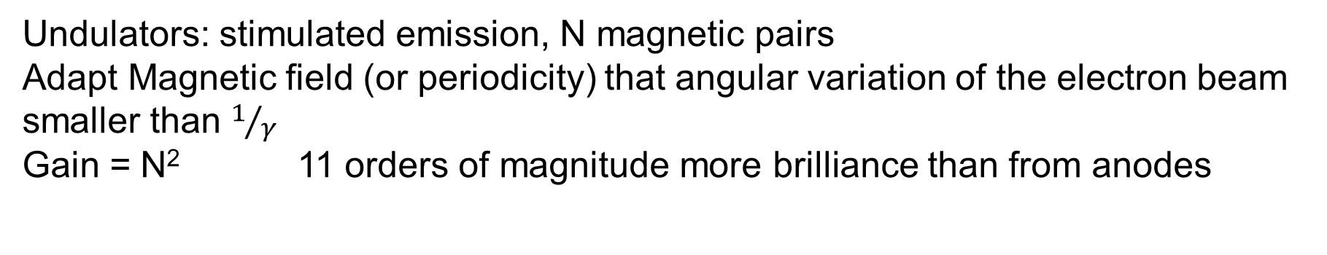
Undulators: ”Resonators”
Undulators: stimulated emission, N magnetic pairs
Adapt Magnetic field (or periodicity) that angular variation of the electron beam smaller than $1/γ$
Gain = N² 11 orders of magnitude more brilliance than from anodes
Supplies a self collimated line spectrum
Wavelength ?
1 cm (10⁻² m), Lorentz contraction γ = 10⁴
For the electrons it becomes 1 μm (10⁻⁶ m) -> Infrared
Sample is standing still with respect to electrons
-> Lorentz contraction (“blue shift”) 10⁻⁶ m ->10⁻¹⁰ m = X-rays
Notes:
10 mins at the end

Slide 13
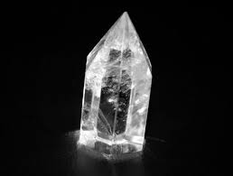

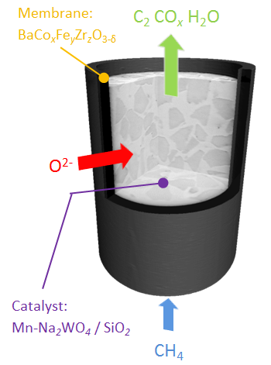
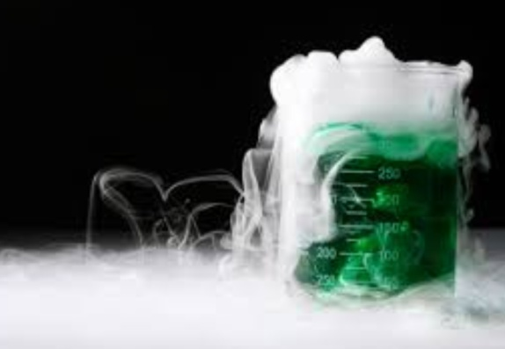
Synchrotrons supply new experimental tools
Crystals, systems in their ground state, static systems
“Easy” to study systems
Where are new metrology tools needed ?
Systems far from equilibrium (dynamic systems, metastable and transient states)
Time resolution
Challenging systems:
Complex systems as fully processed microelectronic devices, functional nano-materials, life
Spatial resolution
Notes:
10 mins at the end

Slide 14
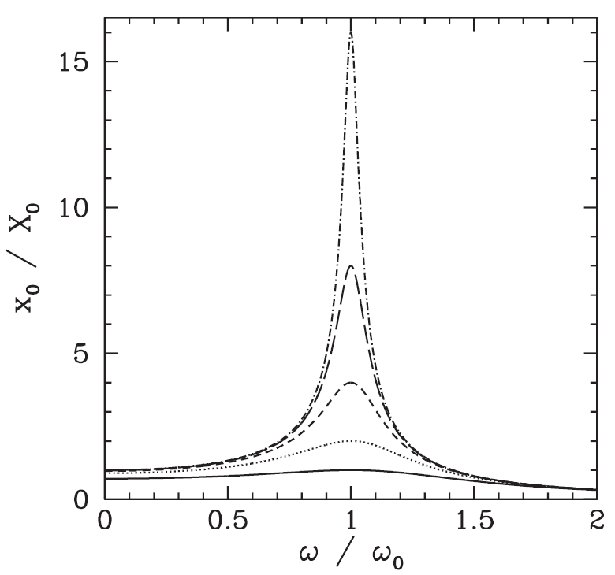
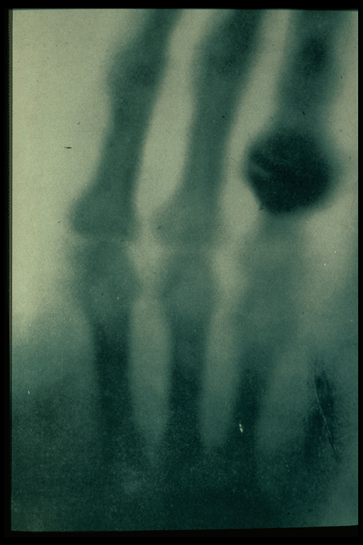
The dilemma of x-ray optics
The refractive index is expressed as n
χ=polarizability
Polarized electron clouds=driven harmonic oscillators
Polarization P=χ∗E
Amplitude
For ω<<ω₀: P=const. (does hardly vary with ω)
eyeglasses work for all colours,
In this regime, refraction is almost achromatic
For ω>>ω₀: P~1/ω², thus P-> 0
Refraction in the x-ray regime is very weak and highly chromatic!!,
n 0.99999..

Slide 15
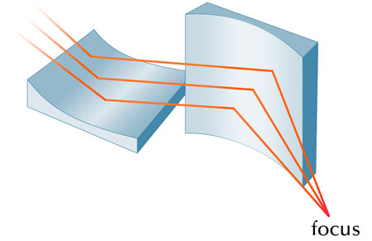
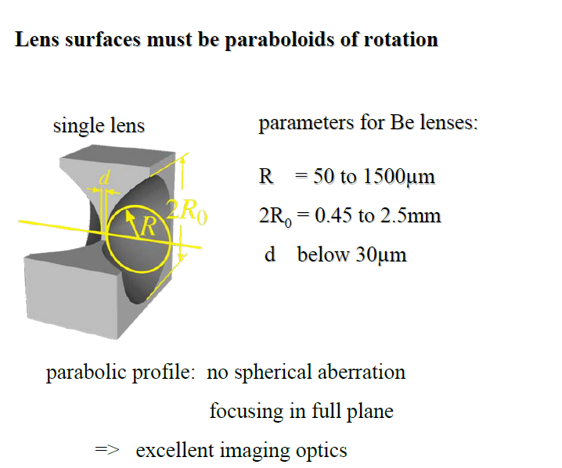

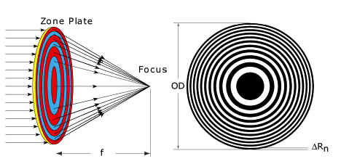
Development of x-ray optics
Mirrors:
P. Kirkpatrick (1894-1992)
Baez (1912-2007)
Can only be used for focusing
Refractive lenses:
Excellent imaging devices
Diffractive optics: Fresnel zone plates
Excellent focusing devices
All x-ray optics have poor numerical apertures !
Resolution limit of typical x-ray optics hardly better than 50 nm,
Much worse than the potential offered by the x-ray wavelength of <0.1 nm

Slide 16
X-rays and spatial resolution
Straightforward approach: focused X-ray beams (~ 20 nm to few 100 nm today)
Powerful scanning probe techniques.
Diffraction and scattering (atomic structure)
Focussed X-ray beam
Spectroscopic information (fluorescence, photoemission,..)
Absorbtion contrast, phase contrast (imaging)
EXAFS spectrum

Slide 17

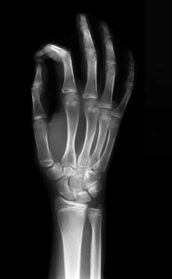
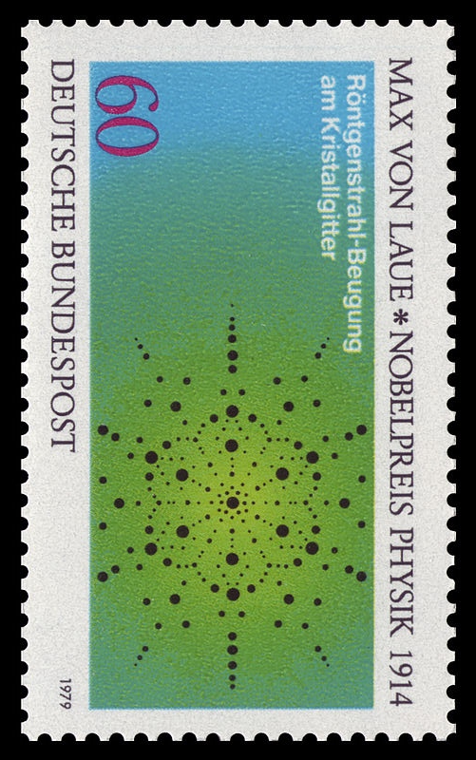
Diffraction (and) imaging techniques
X-ray imaging:
1st application of x-rays, applied in hospitals less than one year after their discovery 1896. 1st nobel price in physics (Röntgen)
Diffraction
Proof of the wave nature of x-rays and the atomic structure of matter: Nobel prices 1914 (Laue) &1915 (Bragg)
….seeing is believing…
Imaging: spatial resolution ~sub mm (traditional sources)
Diffraction : spatial resolution traded in for angular resolutions

Slide 18
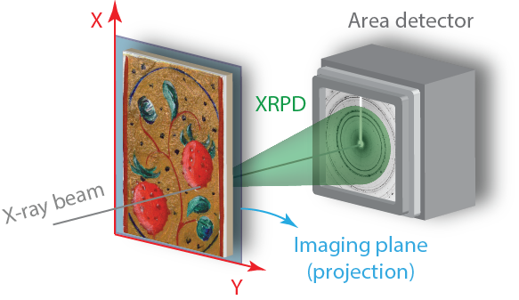
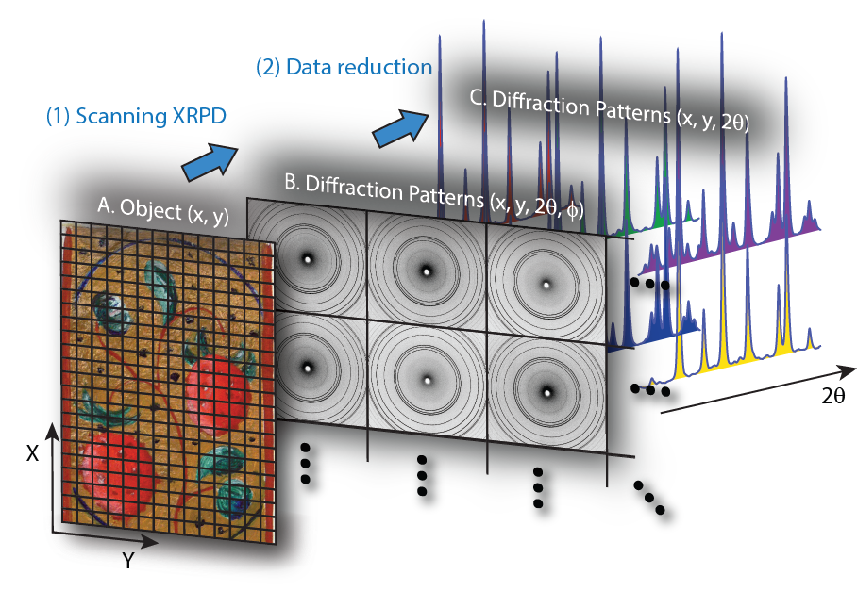
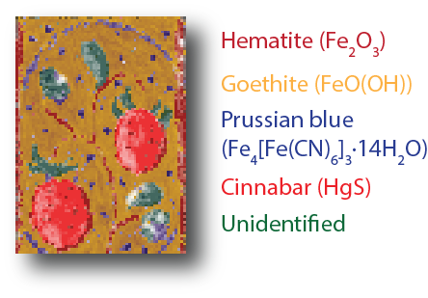
Scanning Probe techniques
Object: a flat two dimensional powder…
Slide courtesy: W. De Nolf, M. Cotte (ESRF, ID21)

Slide 19

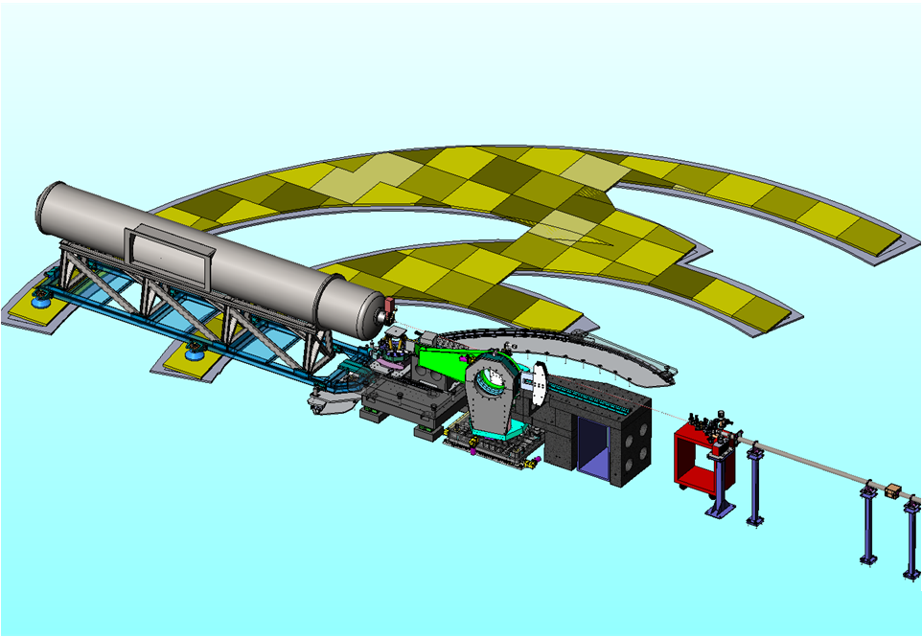
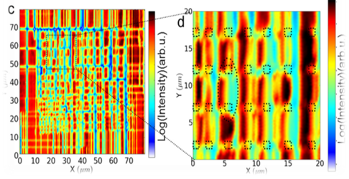
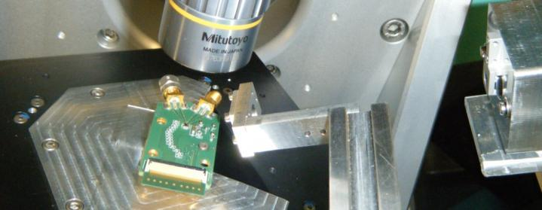
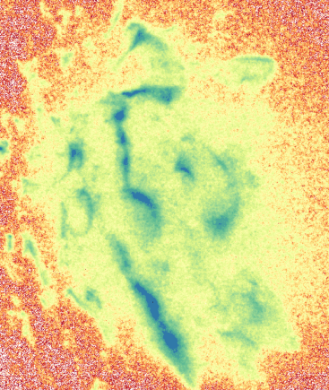
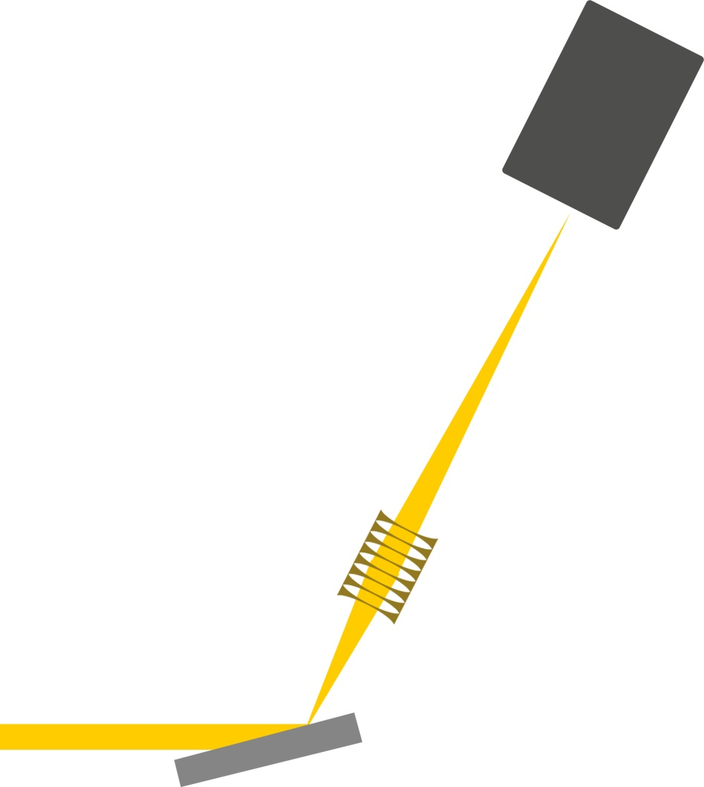
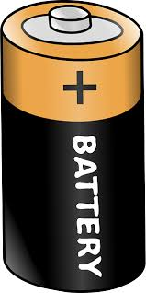
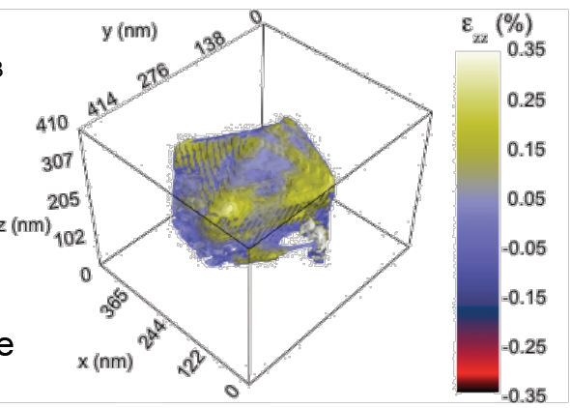
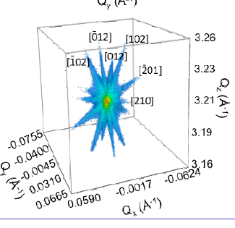
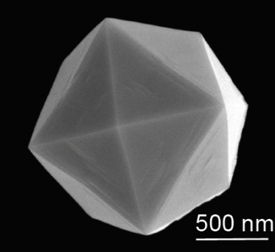
Bragg Diffraction imaging (ID01 beamline ESRF built 2013-2015)
60 nm
100 nm
Scanning techniques
Coherent reconstruction techniques
Full field techniques
5 nm

Slide 20

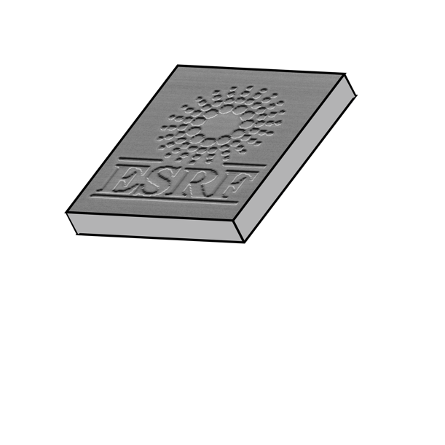

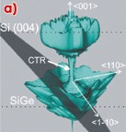
Nanodiffraction (K-MAPPING)
Area Detector
Area Detector
δ2θ
δtilt
rotate
3D reciprocal space information from 2D surface
Big data (few 100 images/s, TB in hours)

Slide 21
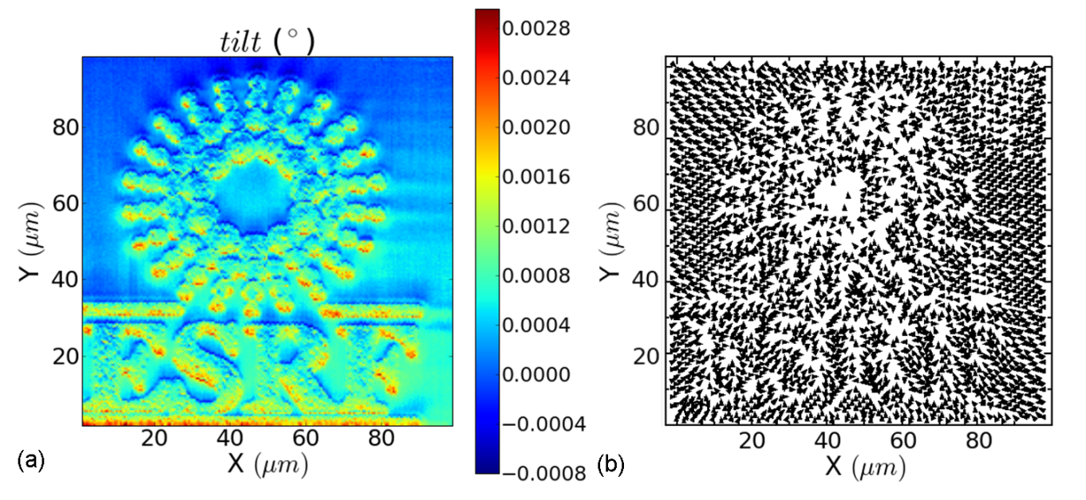
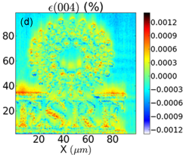
Mapping of orientation and strain in functional layers
Tilt < 10^{-3 °}
Δd/d < 10⁻⁵
Relative strain levels of Δa/a 10⁻⁶ can trace a landscape
= we can “see” a ΔT of a few K potentially in buried systems (working devices)
Spatial resolution: 50-100 nm (today)
3D Reciprocal Map in each pixel
G. A. Chahine, et al., J. Appl. Cryst. (2014)

Slide 22
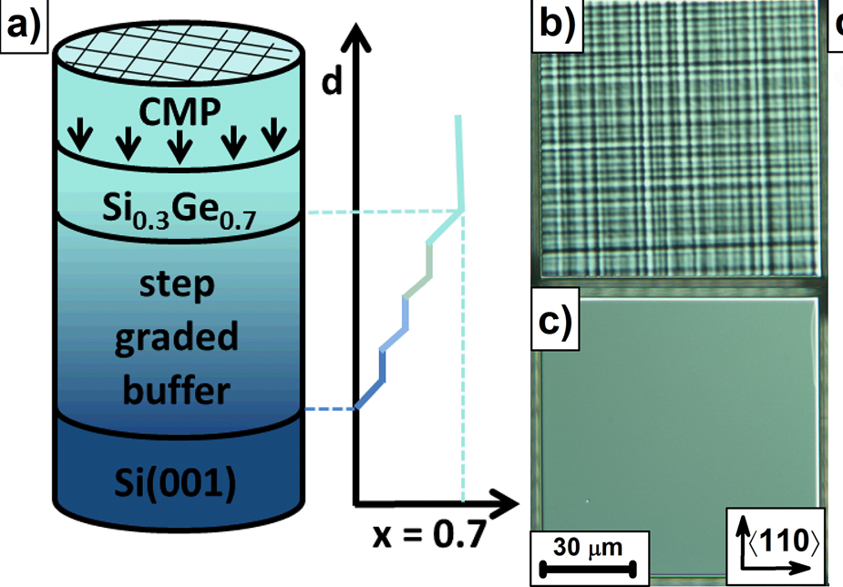
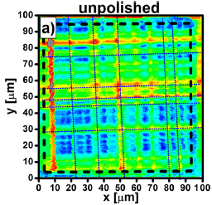
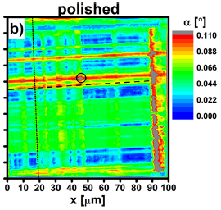


Diffraction imaging: cross hatches in graded buffers
Light interference microscopy
Scanning x-ray diffraction microscopy: Tilt maps
After growth
After polishing
Surface roughness
Zöllner, et al.:
Appl. Mat.&Interf. 2015
Lattice undulations

Slide 23
Diffraction imaging: full field
Full field technique
Resolution ultimately limited by numerical aperture of the
Imaging optics
Sub 100 nm within reach
Detector
Diffracted signal

Slide 24
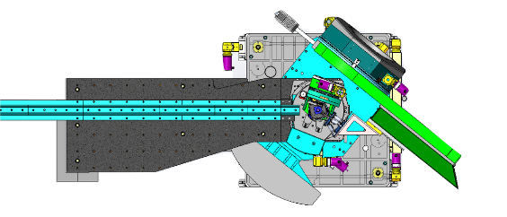
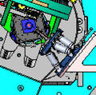
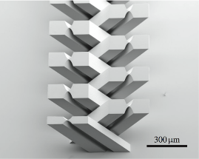
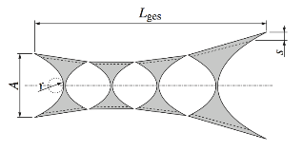

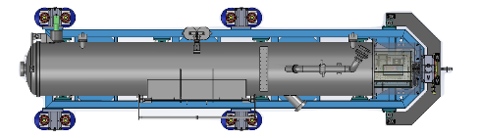
FULL FIELD DIFFRACTION MICROSCOPY (USERS SINCE APRIL 2017)
Source: Felix Marschall (2014)
Incoming X-rays
FFXDM:
in situ
sample-detector distance: 6.5 m
T. Zhou et al.

Slide 25
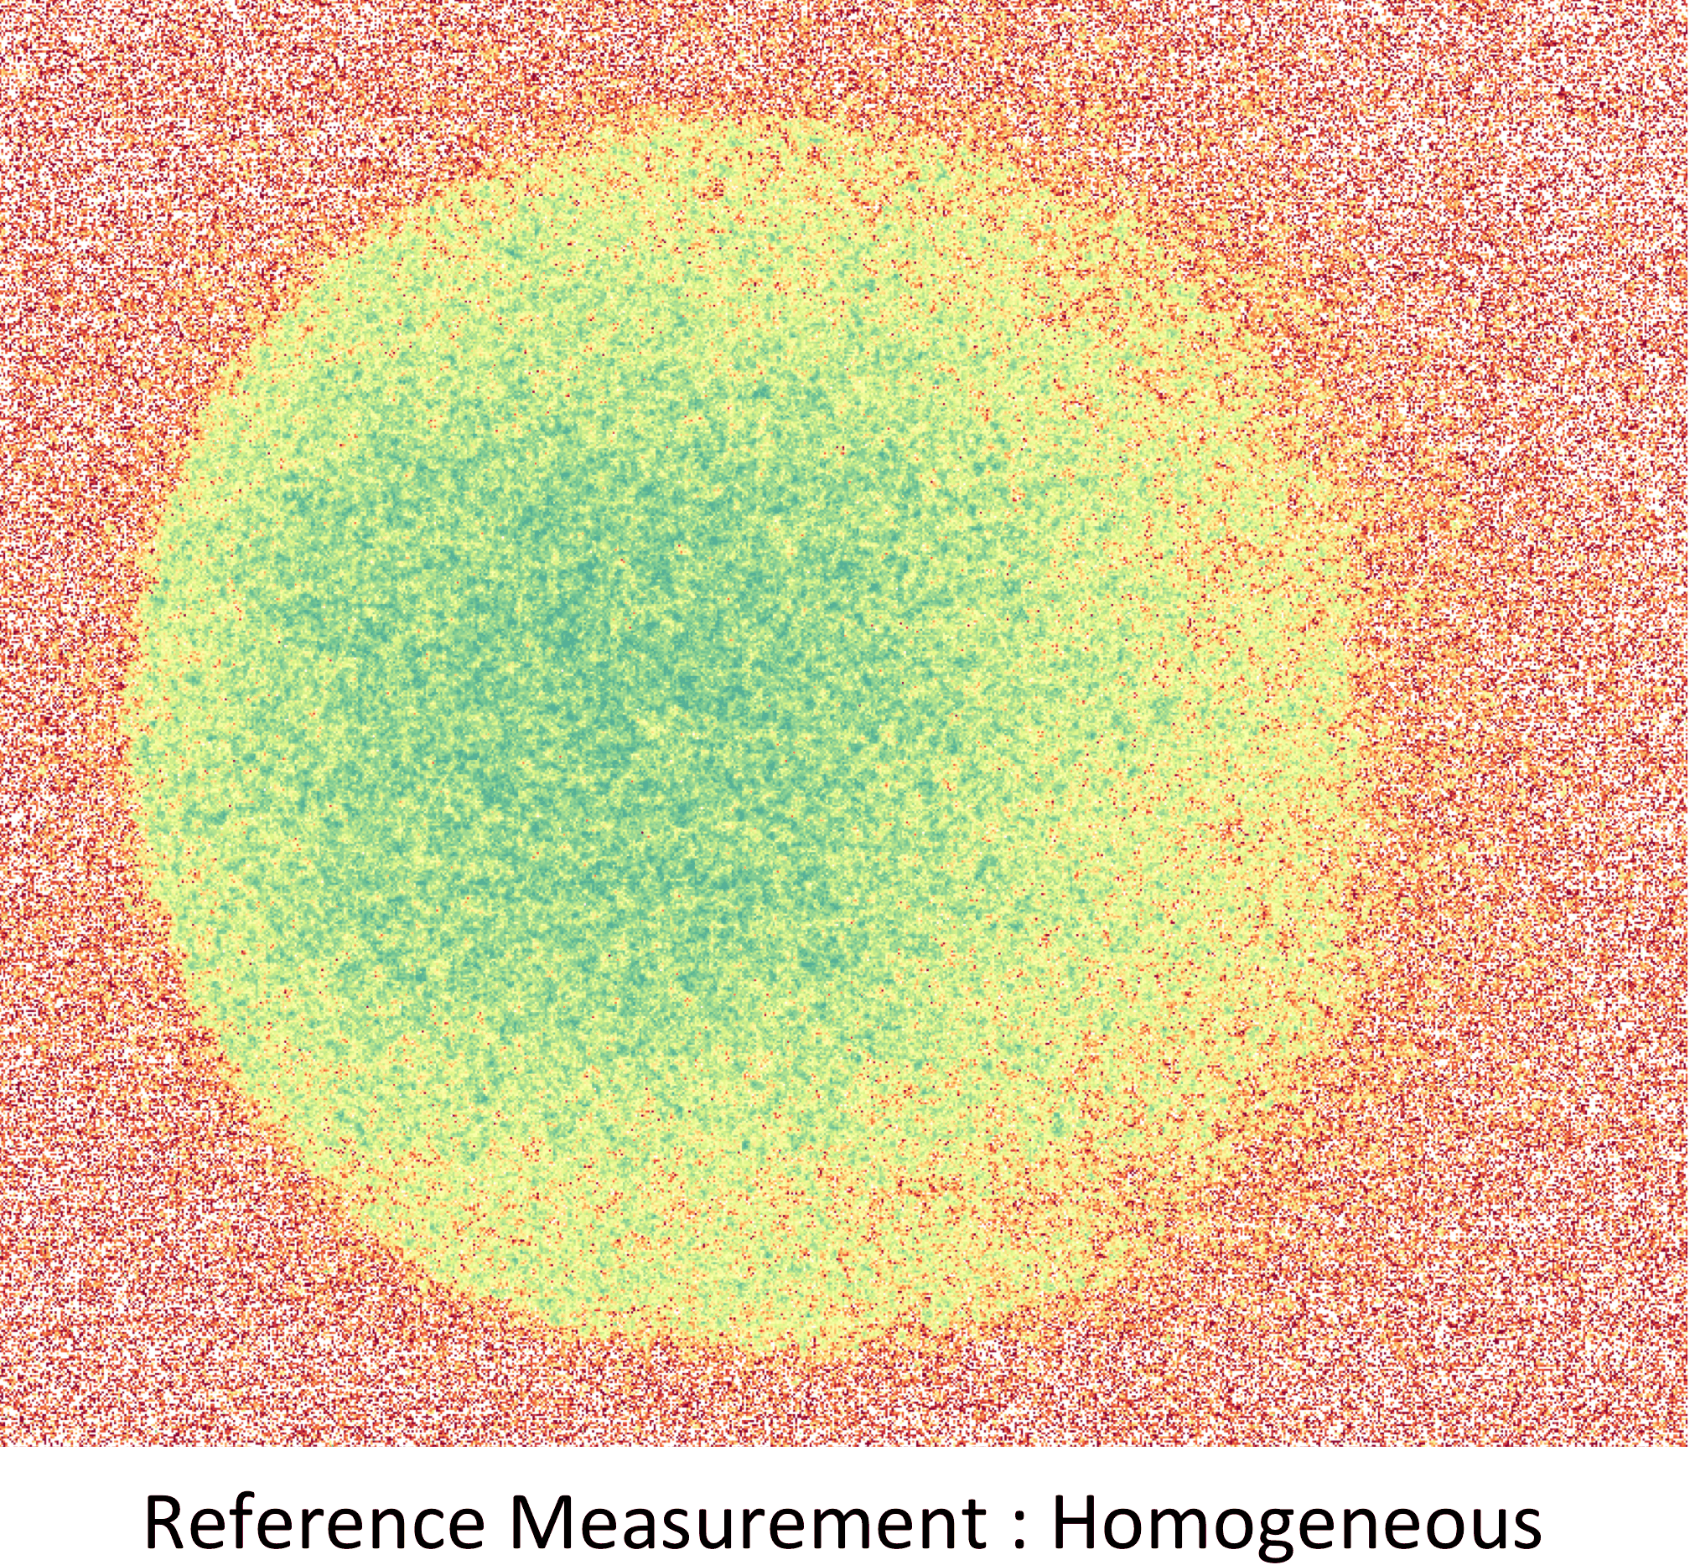
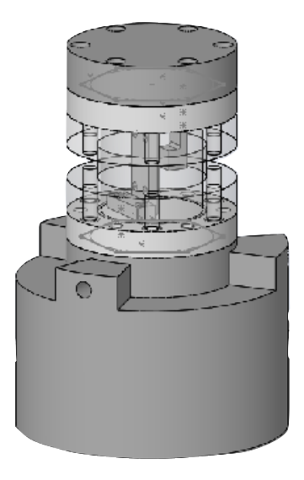
Operando cycling of a Si-Li battery
Stress evolution on the electrode during lithiation:
Image contrast produced
by lattice strain on the
Si electrode
100 μm
V
Si
Li
FFXDM:
in situ
sample-detector distance: 6.5 m
T. Zhou et al.
Time resolution today: sub second
Spatial resolution: 100nm (30 nm tested)

Slide 26


Full field strain imaging
Strain pattern in a “homogenous” thin film
Strain in Si device (caused by Cu/Si interfaces) :
More examples in the Talks of T. Zhou and P. Reiss

Slide 27

From full field to coherent diffraction imaging (CDI)
Full field technique
Resolution ultimately limited by numerical aperture of the imaging optics:
Sub 100 nm within reach
Detector
What we have
What we want
Δx=

Slide 28

Coherent Diffraction imaging (CDI)
Coherent Diffraction Imaging:
Detector
Theory of optics is very well known.
-> Measure all emitted rays from the sample and replace the lens by a computer to calculate the image
What we can do
The physics of resolution remains the same
Abbé limit Δx=
2α
Instead of the lens we need a detector with a large opening angle.

Slide 29


Coherent Diffraction imaging (CDI)
Another Problem : Waves have amplitudes and phases: they interfere to form an image;
Refraction (as in a real lens) preserves the phase information, crucial for the image
Detection measures only the intensity (number of photons) and not their phase
From a quantum mechanical point of view, refraction (preserves Δp) by a lens cannot be replaced by detection (destroys Δp): Equivalence between Abbé and Heisenberg.
Detector
The loss of phase information cannot be recovered by a computer.
We have thus to know the phase beforehand.
The sample has to be illuminated with photons that are all in phase with each other
This is the definition of a coherent beam

Slide 30

Coherence length of a source
Source size S
S
Distance D of observer

Slide 31
Coherence length of a source
Source size S
S
Distance D of observer
Transverse Coherence length L
Wavelength λ
Coherence length: L~λ*D/(2*S)

Slide 32

Coherence length of a source
Transverse coherence length of a source: L~Dλ/S, with S= source size, D=distance from the source,
Distance Planet Mars: 4exp12 m
λ light: 5exp-7m
Diameter mars:6exp6 m
->coherence length L(Mars)=0.16 m
Distance typical star: 100 light years = 5e17 m
λ light: 5e-7 m
Diameter star (sun):1e9 m
-> coherence length L(star)=125 m

Slide 33
Coherent flux of a source
Flux available for “normal” light imaging and coherent diffraction x-ray imaging:
5 Watt LED: 10¹⁹ photons/second (incoherent but with optics we can use them all)
ESRF coherent flux: 10¹¹ photons/second (@ 8keV ) -> 10¹⁹ photons in 1 year
X-ray tube coh. flux: few photons/second,10¹⁹ photons in 10¹⁰ years (the age of this world)
Coherent fraction @ ESRF today @ 8 keV: 0.3 %

Slide 34
Coherent beams, preparation
100 m
0.1-0.3 m
Source
Coherent beam
Aperture corresponding to coherence length
Coherent spot
Light beam
optics
Coherence length: L~λ*D/(2*S)
Coherent fraction @ ESRF today @ 8 keV: 0.3 %
Example for X-rays (ESRF): Source size: 20 μm x130 μm, wavelength 0.1 nm, means:
At 100 m from the source L= 0.4 mm 0.07 mm
The ideal coherent diffraction imaging beamline must first of all be a very stable ~100 m long optical bench
Drift stability of focused beam (ID01): 10⁻⁹-10⁻⁸ m / hour (Europe: few 10⁻⁶ m/h)

Slide 35

Examples for coherent reconstruction
Thanks to V. Favre-Nicolin and S. Leake, wave font analysis is now “press the button”

Slide 36


Examples for coherent reconstruction
Reconstruction of siemens star and later biological samples
Beamsize 150x350 nm
100 nm

Slide 37




BRAGG CDI : REAL SPACE RECONSTRUCTIONS
Au particles:
M. Dupraz et al., Nano Letters Oct 2017

Slide 38



CDI under Bragg conditions from catalytic nanoparticles
SEM image of a single Pt nanoparticle
Coherent reciprocal space image
Iso-surface showing the strain
distribution inside the particle
S. Fernandez et al., submitted (2017).
More in the Talk of M.-I. Richard
Spatial resolution: 10-20 nm, time resolution: many minutes..

Slide 39

New sources for new challenges: the ESRF upgrade to an extremely brilliant source (EBS)
Increase of Brilliance: x40 (operational in 2020)

Slide 40


Evolution of (DC-)Brilliance of Synchrotrons
Brilliance of Future ESRF will do 12 orders of magnitude better than current laboratory sources.
Power consumption:
100 KW per beamline
ESRF 2020 (10 % coherent)
0.1-10 KW per X-ray anode source
Light sources: 12 orders of magnitude in 35 years

Slide 41


ESRF EBS: An ambitious new standard for synchrotron storage rings
Synchrotron X-rays
Ultimate synchrotron
ESRF Extremely Brilliant Source
ESRF-EBS – 150 M€ (2015-2022)
10²⁴
10²³
10²²
10²¹
10²⁰
10¹⁹
10¹⁸
10¹⁷
10¹⁶
10¹⁵
10¹⁴
10¹³
10¹²
10¹¹
10¹⁰
10⁹
10⁸
10⁷
10⁶
ESRF-EBS (2020)
ESRF (2014)
Third
generation
ESRF (1994)
Synchrotron Radiation
The ESRF will operate until December 2018 and come back to user operation early/mid 2020
revolutionary design
for a new generation of synchrotron
source storage rings: ~100 times more brilliant and coherent X-rays
Programme to exploit the qualities of this new and unique extremely brilliant X-ray source:
- Creation of new beamlines
- Innovative detector programme
- « Data as a Service » strategy
Second generation
Brilliance (photons/s/mm²/mrad²/0.1%BW)
First generation
Thank you for your attention!!
X-ray tubes
1900 1920 1940 1960 1980 2000 2020

Slide 42


OPERANDO STUDIES WITH FFXDM: SYNTHESIS OF M-O SOLAR CELL
SEM Cross section
Annealing of a solvent deposited
metal organic perovskite solar cell during annealing at 115 °C
CTO
TiO₂
MAPICl
Prominence of the (001) out of plane orientation during annealing
Zhou, Reiss, et al

Slide 43


Scanning probe spectroscopy in complex systems
Nanoparticles of Ag (medicine), ZnO and TiO2 (sun-screen) are very commonly used. Where do they end up ?
Biopsies were obtained from the same patient during treatment (day 3, 6, 9 and 12)
ID21 , M. Cotte, coll. University Ca’ Foscari, Venezia, M. Roman, W. Cairns and C. Rigo

Slide 44





In Europe 55% of this sewage sludge is applied on agricultural soils as a fertilizer
Ag NPs Release from consumer products
90% retained in the sludge most likely as Ag₂S
Leaf surface
.
stomata
What are the properties of this nano Ag₂S
in the environment?
Impact on soil quality/crops production ?
Transfer to the food chain ?
.
stomata
100 µm
20 µm
Leaf cross-section
Leaf cross-section
Uptake of Ag and Ag NPs in food crops
Pradas de Real et al., Env. Sci Technol., 2017
parenchyma
parenchyma
stomata
epidermis
epidermis
Larue et al. J Hazard Mater 264 (2014)
.
20 µm
2
0 µm

Slide 45


NEW TOOLS for new challenges
Blue dots: surface to cover twice the worlds primary energy demand by 15% efficiency photovoltaics
Brazil: 15 t of sugar per hectare (6 kWh/m²
Annual yield 4 t of ethanol~ 3 kWh/m²)
Photovoltaic panel with 15 % efficiency: Annual yield of 300 kWh/m²
Needs:
-Improving power generation from non-fossil sources
-Power storage and management (conversion or batteries):
A vast field covering photocatalysis, electrocatalysis
and electrochemistry.
Wheat production per hectare land
Notes:
Burning what we eat can only be a temporary solution… Technologies have to overcome the other problems

Slide 46
Beamlines of 2025+
Optics that adapt longitudinal coherence length to experiment.
Horizontal geometry for coherent Bragg diffraction may also work well at “higher energies”
Careful with high energies (even though tempting) “λ⁴ -λ⁷ law”:
Coh. flux ~B*λ²; Beyond diff limit: “B~λ”. Detector efficiency “~λ”
Contraction of rec. space (malus or bonus) I_{int}~ λ³
Enabling technologies:
Detectors and focusing optics (CMOS based detectors….)
Multilayer Laue lenses, diamond CRLs, …
Is that all ?

Slide 47





CDI MAGING OF DEFECTS IN SINGLE NANOWIRES
MOTIVATION
Pixel size : 16 nm X 8 nm
(Q_{x},Q_{y}) cut: 004 GaN
Displacement between domains:
out-of-plane: (c/2+8 pm)
in-plane: 0 pm
Etching revealed inversion domain boundaries (IDBs) separating domains with Ga- or N-polarity.
2 µm
S. Labat, M.I. Richard, M. Dupraz, et al., ACS Nano 9, 9210 (2015)
Notes:
Displacements can be measured in picometers

Slide 48





Strain imaging
Bragg Intensity from GaN
Total strain variance:
1exp-3
Rotational variance (Tilt)
GaN grown on pre-patterned sapphire
GaN
Data Courtesy: M. Nemoz, P. de Mierry, CRHEA/CNRS Antibes
Sapphire
Notes:
Nucl.& trans. Layers, sounds easy but that’s where all the miracles have to happen.

Slide 49


Scanning microdiffraction from Strained Ge Laser structure
Relaxation of the surrounding area as Ge is free to expand in the in-plane direction.
Compressive in plane and Tensile out-of-plane strain at the corners (0.032%).
SEM
10 µm
2 µm
Maximum Tensile out-of-plane strain on the bridge (0.1%).
Chahine et al. Appl. Phys. Lett 2015

Slide 50

K-MAP& XSOCS: FROM EXPERIMENTS TO MEASUREMENTS
K-map:
The 1st ID01 workhorse
One command line starts a 1-3 hours K-Map (complete 5 D dataset)
D. Naudet, G. Chahine, S. Leake, M.I.-Richard, C. Richter
T = 25°C
T = 400°C
Strain distribution in a Si device in the vicinity of a copper via
(Vianne et al. Appl. Phys. Lett 2015)
Examples:
Ristanovic Z., Angewandte Chem. 52, (2013)
Chahine G.A. et al. J. of Appl. Cryst. 47, (2014)
Richard M.-I. et al. ACS Appl. Mat. & Interf. 7, (2015)
Filippelli E J. Appl. Cryst. 49, (2016)
10 μm

Slide 51



THE K-MAP FAST SCANNING TOOL
Velocity: few hundred images/s
Limited by
-available flux
-mechanical limit of the stage/ trajectory
Real Space (2D)
Reciprocal space (3D)

Slide 52







Tomorrows sources: what are the challenges ?
The energy produced by the atom is a very poor kind of thing. Anyone who expects a source of power from the transformation of these atoms is talking moonshine.
Ernest Rutherford 1933
The inventers
If we have learned one thing from the history of invention and discovery, it is that, in the long run — and often in the short one — the most daring prophecies seem laughably conservative
A. C. Clarke
«in five years nobody will talk about the automobile anymore, I believe in the horse »
Wilhelm II. (1859-1941)
The deciders
«airplanes are toys without any military value »
Marechal Foch (1851-1929)
The users

Slide 53




BRAGG CDI : TOWARDS OPERANDO STUDIES
Before reaction
After (CO + H₂)
reaction
Modification of Pt-Cu core shell Nanoparticles during reaction.
M.-I. Richard (ANR project CHARLINE)

Slide 54



Local diffraction: advantages
Bragg diffraction -> picometer precision
Small beams -> 100 nm spatial resolution
X-ray diffraction micrograph
Position 1: interatomic distance a
Position 2: interatomic distance b
Intensity variations=
Thickness variations of 0.5 nm in the Si QW.
Measured without sample preparation.
P. Evans et al. Adv. Mater (2012)
Page 54
Combining small x-ray beams with diffraction: hybrid information on two lengths scales

