Slide 2
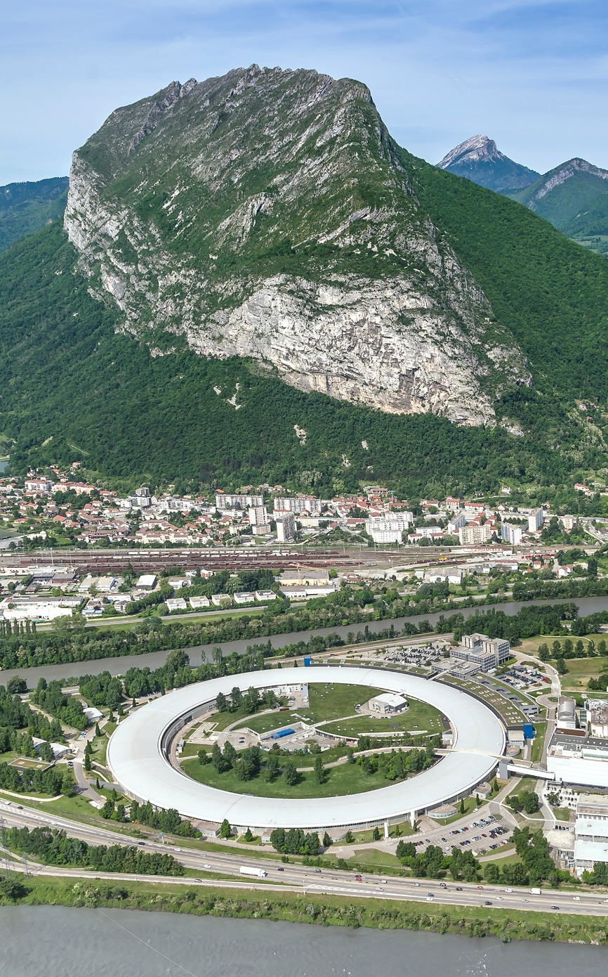
X-rays surface sensitive techniques: examples with organics and nano-crystals
Oleg Konovalov
ESRF-The European Synchrotron, France
ID10 - Soft Interfaces and Coherent Scattering Beamline.
konovalov@esrf.fr

Slide 3
Outlook
Introduction:
ID10 beamline,
Surface scattering techniques,
Theory and Applications
X-ray reflectivity
GISAXS
GID
X-ray standing waves (GI X-ray Fluorescence)
Conclusions
Notes:
The recently upgraded ID10 beamline at the ESRF has obtained significant improvement in the instrumentation for surface studies on bare or buried soft surfaces and interfaces. In the presentation the instrumental capabilities will be demonstrated with structural studies of two dimensional self assembly of several types of nano objects.
Bottom up self-assembly of functional materials at liquid surfaces and interfaces has recently emerged as method to design and produce novel 2D nanostructured membranes and devices with tailored properties. The optimization of the nanostructure and the follow-up of the assembly require nanometrically-resolved structural characterizations techniques. We apply grazing incidence x-ray scattering and X-ray reflectivity to investigate in-sity and in-real time the growth and structure of nano-particles films at oil-water and ethylene glycol interface. Example of the silica inter-particle distance tuning with the surfactants and ions concentration will be presented as well as an in situ study of the formation mechanism of two-dimensional superlattices from PbSe nanocrystals [1].
References
[1] Geuchies J.J., et al., Nature Materials 15, 1248-1254(2016)

Slide 4
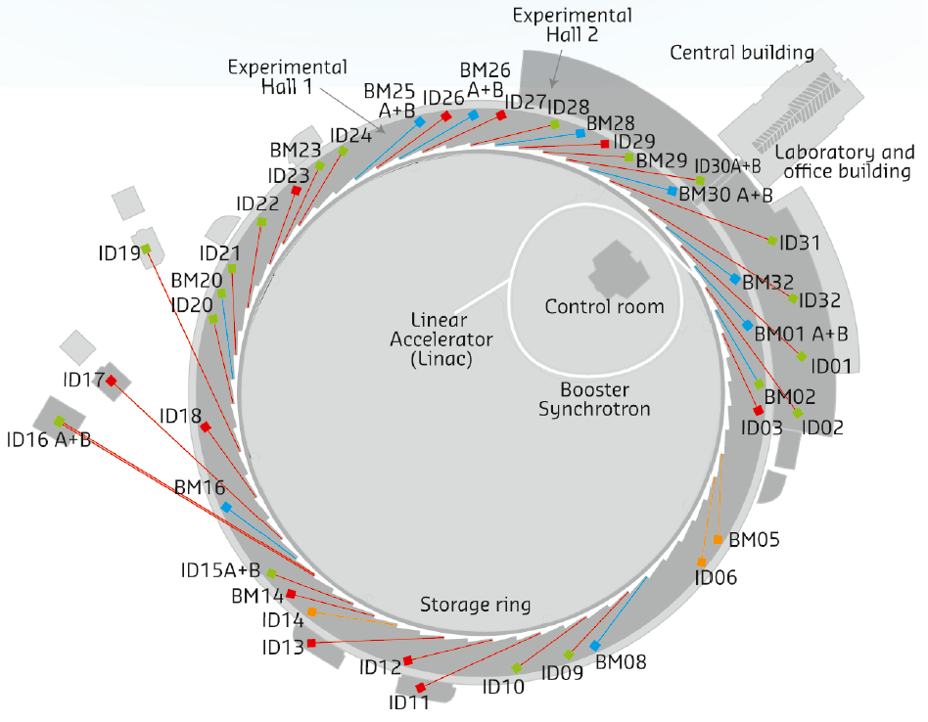
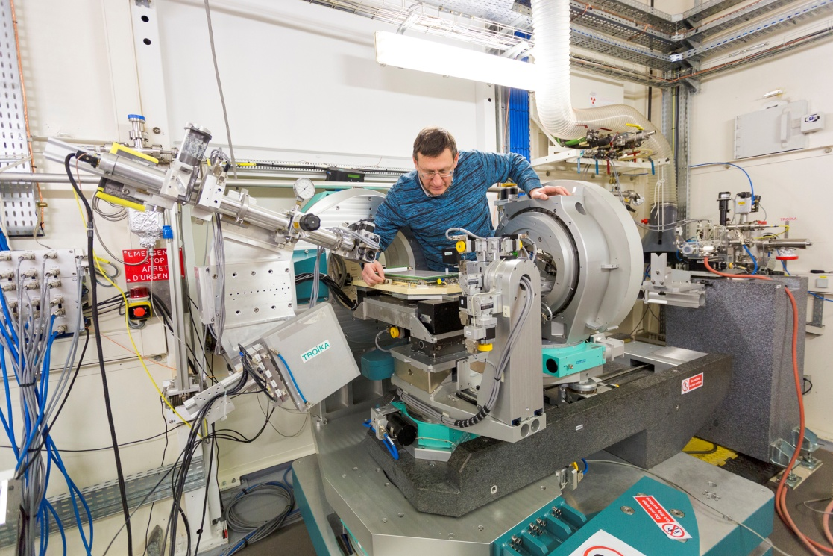
ID10: The Soft Interfaces and Coherent Scattering Beamline
The X Ray-Imaging group
Photo by Pierre Jayet
70m
65.7
61.5
60.4
56.5
52
44.5
39
36
32
29.9
26
0
EH2 (Coherent Scattering)
EH1 (Liquid Surfaces and Interfaces Scattering)

Slide 5
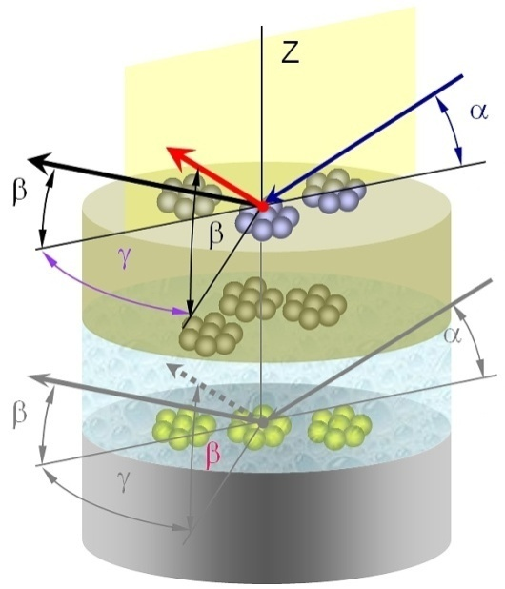
ID10: The Soft Interfaces and Coherent Scattering Beamline
The X Ray-Imaging group
Photo by Pierre Jayet
70m
65.7
61.5
60.4
56.5
52
44.5
39
36
32
29.9
26
0
gas-liquid
EH2 (Coherent Scattering)
liquid-liquid
EH1 (Liquid Surfaces and Interfaces Scattering)
liquid-solid

Slide 6
Id10 BEAMLINE
ID10: The Soft Interfaces and Coherent Scattering Beamline
ID10-SI
ID10-CS
Main Parameters
Flux: ~10¹³ ph/s @200 mA
Energy range: 7-30keV
Focusing (v): ~6 μm
Sample-Detector distance 4m
Anomalous option
Brilliance: B~10²⁰
(photons/s/mm²/mrad²/0.1%BW) λ=1 Å
Coherent flux: I_{c}= 8.0x10¹⁰ coh.ph./s/(10x10μm² )
Sample-Detector distance 7m
Techniques
X-ray Reflectivity (XRR)
organic and inorganic films structure,
complex fluids, polymers, “green” chemistry,
surfaces and interfaces
Grazing Incidence Diffraction (GID)
Langmuir films, membranes, macromolecules,
organic solar cells
GI Small-Angle X-ray Scattering (GISAXS)
2D organization of nano-scaled systems
GI X-ray Fluorescence (GIXF)
elements distribution at interfaces
X-ray photon correlation spectroscopy (XPCS)
(time window of 10⁻⁸ s < t < 10⁺³ s)
Study of dynamics in various condensed matter systems:
Colloidal suspensions, gels, supercooled liquids, polymers,
Atomic/molecular motion in glasses and alloys, critical fluctuations, aging behavior, dynamics of liquid surfaces.
Coherent X-ray Diffraction imaging (CXDI)
High resolution 2D and 3D imaging of non-crystalline isolated specimens, biological samples with nano-meters resolution

Slide 7

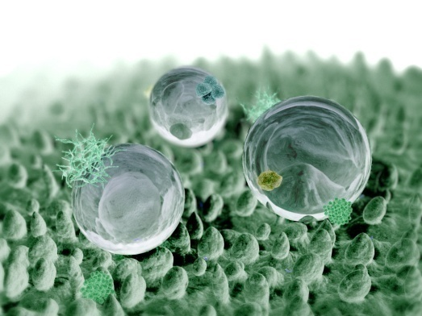


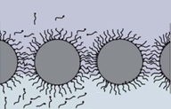
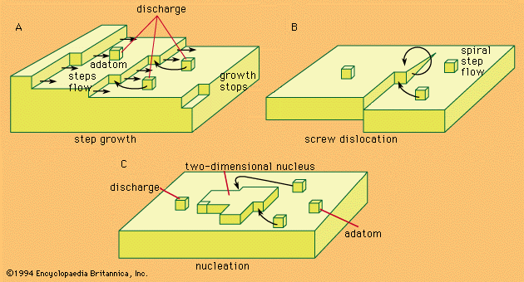
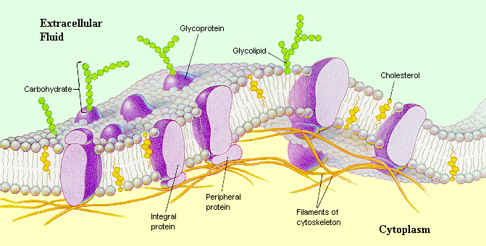
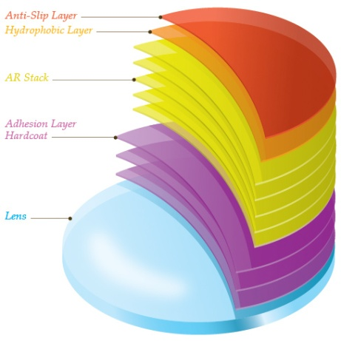
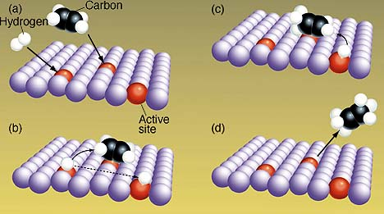
Why study surfaces, interfaces and thin films
phases boundary
crystal growth
chemical reaction on surfaces
⇨ catalysis
physics of 2D systems
thin films, membranes
….
Notes:
Surface science is the study of physical and chemical phenomena that occur at the interface of two phases, including solid–liquid interfaces, solid–gas interfaces, solid–vacuum interfaces, and liquid–gas interfaces. It includes the fields of surface chemistry and surface physics. Some related practical applications are classed as surface engineering. The science encompasses concepts such as heterogeneous catalysis, semiconductor device fabrication, fuel cells, self-assembled monolayers, and adhesives. Surface science is closely related to interface and colloid science. Interfacial chemistry and physics are common subjects for both. The methods are different. In addition, interface and colloid science studies macroscopic phenomena that occur in heterogeneous systems due to peculiarities of interfaces.
Self-Cleaning / Superhydrophobic Surfaces

Slide 8
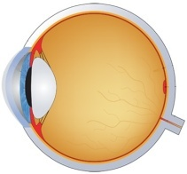
How to study surfaces and interfaces ?
Detector
X-rays
d_{S}
d_{B}

Slide 9
Surface Sensitivity
z
Wave and its derivative are continuous at z=0
k^{R}
n₁
k^{I}
α
α
x
n₂
α^{T}
Snell's law
k^{T}
For X-rays:
Intensity falls off with 1/e penetration depth Λ
- component

Slide 10
Surface Scattering Techniques
XR
X-ray Reflectivity (α=β, γ =0)
In-depth electron density profile – thickness, density and roughness of films
GISAXS
Grazing Incidence Small-Angle X-ray Scattering (α < α_{c}, γ ≥0, β ≥ 0)
Particle geometry, size distributions and spatial correlations on nanometer scale
q_{z}
α
β
q_{x}
γ
q_{y}
GID
Grazing Incidence Diffraction (α < α_{c}, γ ≥ 0, β ≥ 0)
Two dimensional crystals (lattice parameters, molecular structure, tilt angle of molecules, in-plain correlation lengths
GIXF
Grazing Incidence X-ray Fluorescence
(α < 3α_{c}, γ = 90°)
In-depth elemental distribution profile
Water @ λ=1.55 Å
surface
α_{i} ≅ 0.1˚
at 8 keV
Penetration depth Λ, Å
bulk
detector
α / α_{C}
β
α
Λ(ρ, α)
FILM
Δα_{i} < 0.1α_{i}
SUBSTRATE

Slide 11
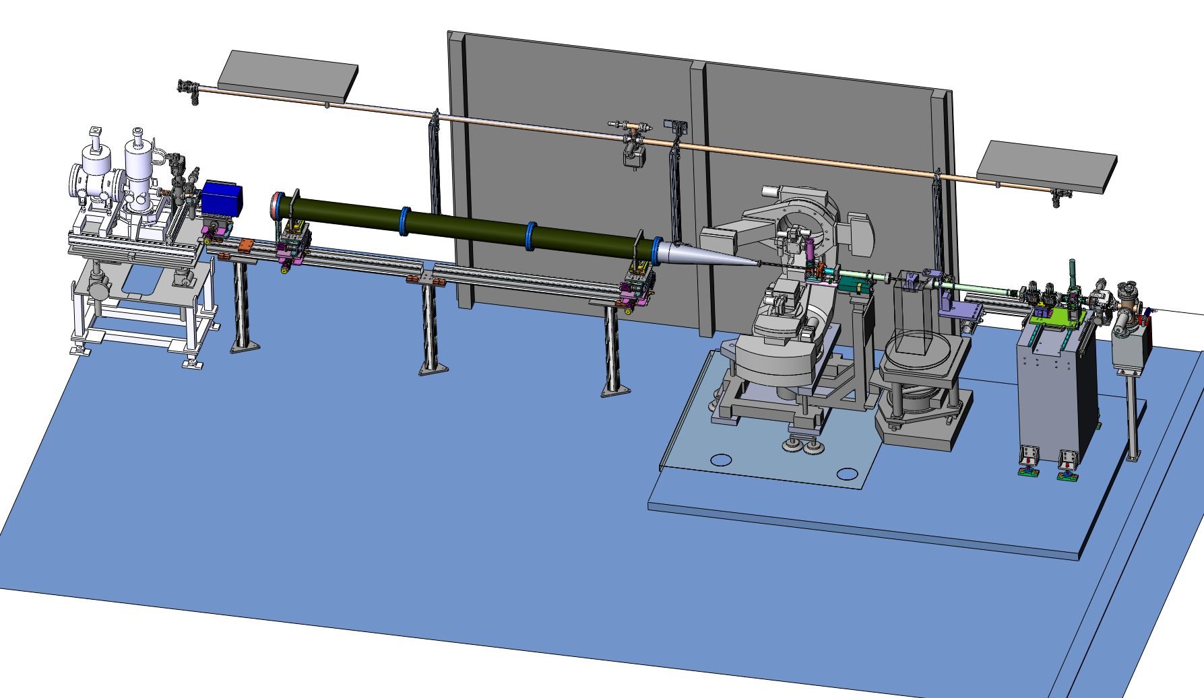
ID10-SI: simultaneous Multiple detection scheme
XRR
Fluorecence
XRS
GISAXS
4m maximum
GID/GIWAXS

Slide 12
X-Ray Reflectivity (XRR)
q_{Z}
I₀
incidence
beam
scattered
beam
I
α
β=α
σ

Slide 13
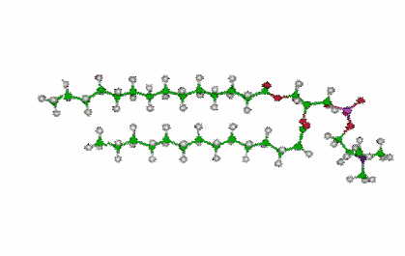
X-ray Reflectivity Principle
q_{x}
q_{Z}
Detector
I₀
incidence
beam
scattered
beam
I
α
β=α
σ
Subphase
σ
Asymptotic behaviour (q_{z}>3q_{c})
Z
Notes:
kinematic theory is derived from the dynamical theory by three approximations:
(1) No multiple reflections at the interfaces
(2) The effects of refraction can be neglected
(3) The reflection coefficient at each interface is proportional to the difference of electron density

Slide 14
XRR: Reflectivity calculation (Parratt version )
Reflectivity is I(q)=⏐R_{0,1}(q)⏐², where R_{0,1}(q) is calculated from recursive formula
R_{0,1}
Q
0: d₀, δ₀, β₀, σ₀
θ₀
1: d₁, δ₁, β₁, σ₁
T_{0,1}
T_{j-1,j}
R_{j,j+1}
R_{n,n+1}=a_{n}²×E_{n}^{R}/E_{n},
F_{n-1,n}=(η_{n-1}-η_{n})/(η_{n-1}+η_{n}), η_{n}=(N_{n}²+cos²(θ))1/2,
a_{n}=exp(-ikη_{n}d_{n}/2),
n=0,1,2,...,M; k=2π/λ,
λ- wave length,
E_{n} , E_{n}^{R} –amplitudes of transmitted and reflected fields in the layer n,
d_{n} – thickness of layer n, material index N_{n}=1-δ_{n}-i×β_{n};
n=M for substrate,
R_{M,M+1}=0.
j: d_{j}, δ_{j}, β_{j}, σ_{j-1,j}
θ_{j}
θ_{j+1}
j+1: d_{j+1}, δ_{j+1}, β_{j+1}, σ_{j,j+1}
R_{j+1,j+2}
T_{j,j+1}
M-1: d_{M-1}, δ_{M-1}, β_{M-1}, σ_{M-2,M-1}
M: d_{M}, δ_{M}, β_{M}, σ_{M-1,M}
Parratt L.G. Physical Review., 1954, v.95, p.359

Slide 15
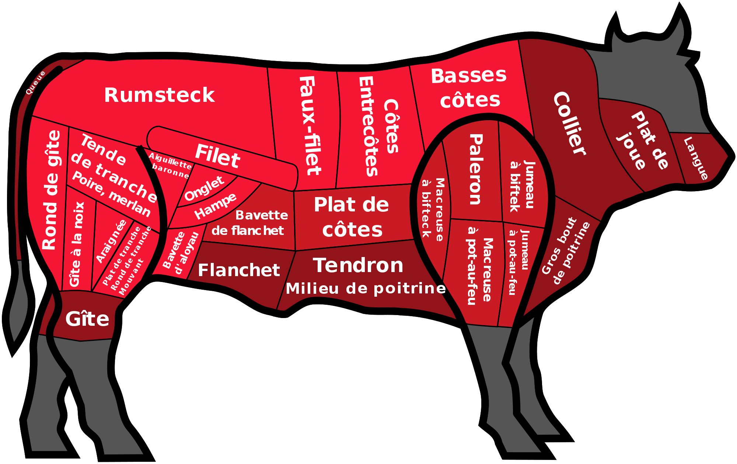
What is what in x-ray reflectivity

Slide 16
XRR: Typical Examples of Reflectivity Curves
Electron Density
Media 1: Q_{zc1}
Media 2: Q_{zc2}
Q_{zc}

Slide 17
XRR: Typical Examples of Reflectivity Curves
Ratio between imaginary and real part of the refraction index decrement
Media 1: n₁
Media 2: n₂

Slide 18
XRR: Typical Examples of Reflectivity Curves
Film thickness
d= 2π/ΔQ_{z}

Slide 19
XRR: Typical Examples of Reflectivity Curves
Film thickness: several layers
d₁=2 nm
d₂=8 nm

Slide 20
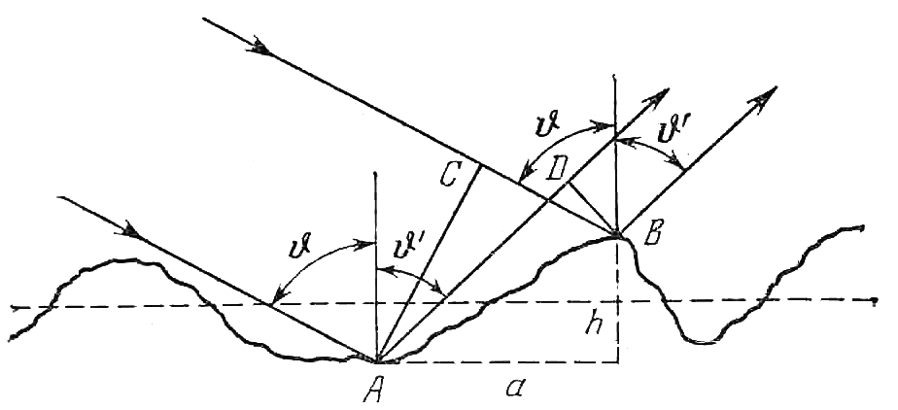
XRR: Typical Examples of Reflectivity Curves
Interfacial roughness
q_{z}
k_{i}
k_{f}
θ
σ
Notes:
root mean square (rms)

Slide 21
XRR: Typical Examples of Reflectivity Curves
Periodic structure: 1D crystal
d
N•d
½ d
½ d

Slide 22
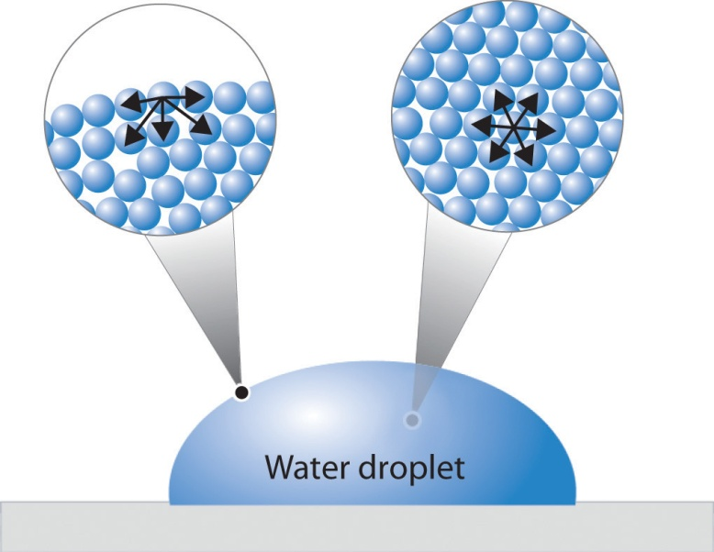
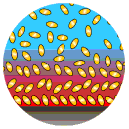
Vapour-Liquid Interface Structure ?
in 1893 by van der Waals
in 1965 by Buff, Lovett, Stillinger
How liquid is terminated ?
What interface brings to the molecules arraignment ?

Slide 23
XRR: Reflectivity on Air-Water Interface
Braslau at al., Phys.Rev.Lett., 54, 114 (1985)
Buff, Lovett, Stillinger, Phys.Rev.Lett., 15, 621 (1965)
Notes:
Roughness and specular reflectivity limitation

Slide 24
Examples

Slide 25
XRR: Buried interfaces
Decay of correlations in inhomogeneous fluids
Ludox SM-30 SiO₂ colloids:
Average diameter D₀ = 10.3 nm Polydispersity ΔD/D₀ = 0.21
Debye length κ⁻¹ = 3.4 nm
Bulk volume fraction ϕ = 0.18
the number density profile model
silica concentration profiles C(z)
fits with the stratified fluid model
D₀
z₀
d
 | d/D₀ wavelength | ξ/D₀ decay | z₀/D₀ position
air | 1.32 ± 0.03 | 0.99 | 1.19 ± 0.02
wh | 1.38 ± 0.07 | 0.99 | 1.46 ± 0.02
h | 1.39 ± 0.03 | 1.27 | 1.11 ± 0.02
bulk | 1.34 | 0.79
K. Nygård & O.Konovalov, Soft Matter 8, 5180 (2012)
Notes:
Nanoscale solid-liquid interfaces
Inhomogeneous fluids, whether fluids at single interfaces or fluids under spatial confinement, are known to exhibit ordering on the molecular/particle length scale. According to liquid-state theory, the asymptotic decay of this ordering is governed by the decay of the bulk pair correlations [R. Evans et al., J. Chem. Phys. 100, 591 (1994)]. Remarkably, this prediction has recently been observed in surface-force experiments on colloidal suspensions for slit widths as narrow as two particle diameters [S.H.L. Klapp et al., Phys. Rev. Lett. 100, 118303 (2008).].
In order to verify the observations of Klapp et al., we have studied the microscopic structure of a colloidal suspension using x-rays [3]. More specifically, we have studied the colloid in bulk using small-angle x-ray scattering (SAXS) and at the fluid-air and two different solid-fluid interfaces using x-ray reflectivity (XRR) (Fig.4.1-1). The decay of the fluid’s density profile can for all the studied interfaces be described by a characteristic wavelength and a decay length, both of which are independently determined from the bulk phase using SAXS. Our observations are consistent with the aforementioned theoretical predictions and recent surface-force experiments.

Slide 26
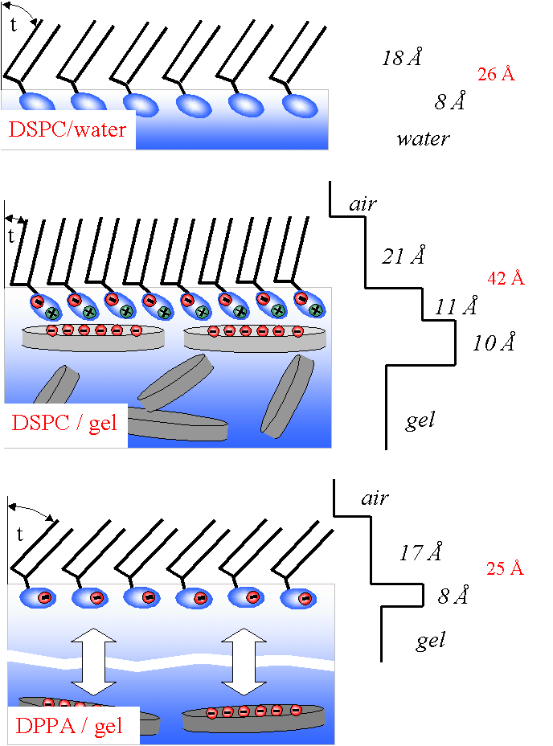
XRR: Lipid monolayers on water, sol and gel surface
Montmorillonite
Pure water sol and gel
⁺
⁺
~ 1 nm
⁺
⁺
⁺
DSPC layer at the water surface
~100 nm
DSPC layer at the sol surface
DSPC layer at the gel surface
Identical roughness of free water, sol and gel surfaces
Lipids form stable monolayers on water, sol and gel
Attractive electrostatic interactions between the anionic mineral particles and the zwitterionic lipid headgroup
These interactions influence the lateral lattice of the monolayer
Struth B., et.al. Phys. Rev. Let., 88, 25502, (2002)

Slide 27
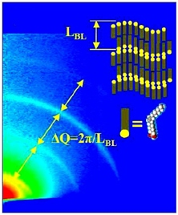
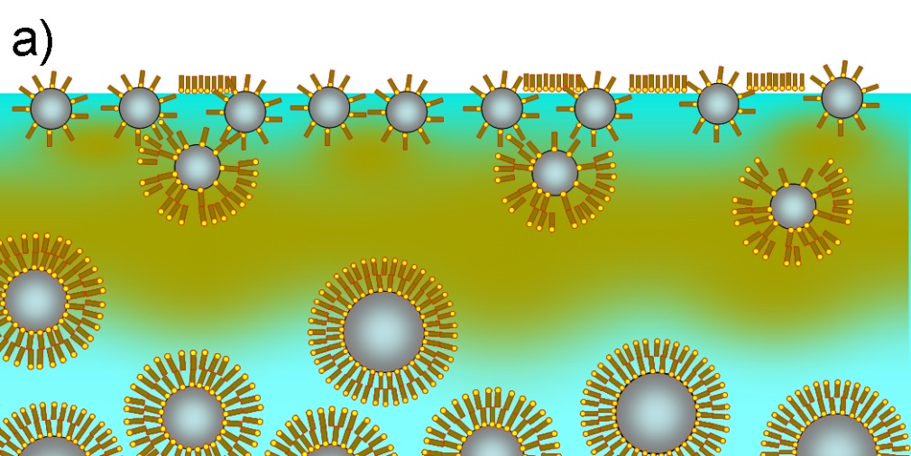
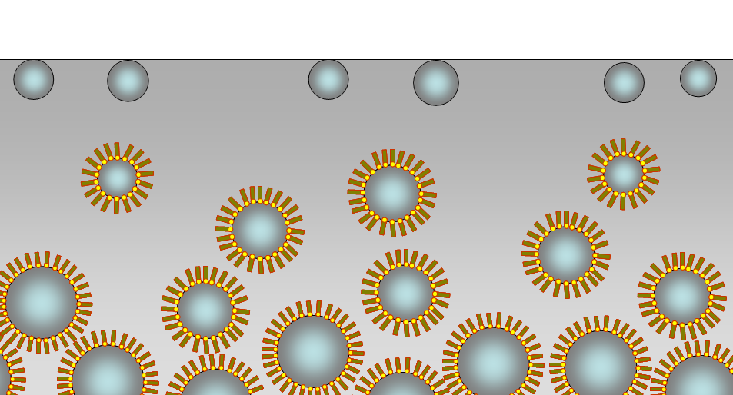
XRR, GISAXS, GID, Fluorecence
Surface structure of sterically-stabilised ferrofluids
Aqueous Ferrofluid
Oil-based Ferrofluid
GISAXS
Fluorescence
ρ_{BULK}
L_{BL}=5nm
Fe
ρ (10⁻⁶ Å⁻²)
SLD [10⁻⁶ Å⁻²]
magn. core Fe₃O₄ 40.5
surfactant C₁₈H₃₄O₂ 8.5
water H₂O 9.5
FF bulk 10.0
ρ_{OIL}
ρ (10⁻⁶ Å⁻²)
SLD [10⁻⁶ Å⁻²]
magn. core Fe₃O₄ 40.5
surfactant C₁₈H₃₄O₂ 8.5
liq. carrier C₁₄H₃₀ 7.5
Depth [Å]
Depth [Å]
Obtained model of the ferrofluid interface
2-2.5 nm
3-5 nm
3-6 nm
10 nm
interface
10-25 nm
30-40 nm
bulk
bulk
A. Vorobiev, et al., Phys. Rev. E 79, 031403 (2009)
Notes:
Thus we conclude that surface of oil ferrofluid also consist of three layers but they is not like in water ferrofluid. The gradient layer is thicker than in water ferrofluid, there is a layer of pure oil and no ordered surfactant. Concerning the topmost part, it’s probably Gibbs layer of free oleic acid.
The conclusion is that these structure can not be used for formation of the magnetic arrays having some practical meaning, but may be for something else. Particularly, observation of the depleted layer attracted some interest from theoreticians.
H2O-FF: surfactant multilamellar structure can be shrink or displaced by the magnetic field. Sodium oleate multilamellar structure

Slide 28
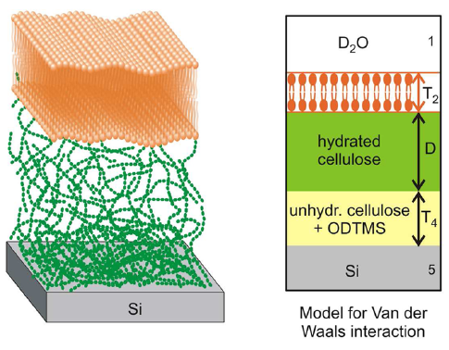
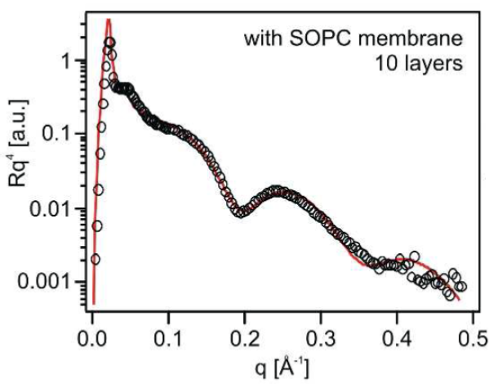
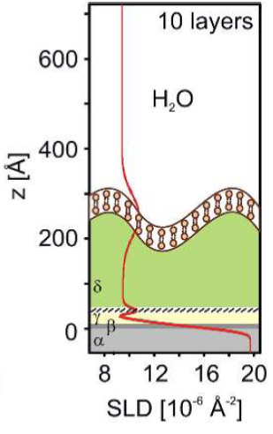
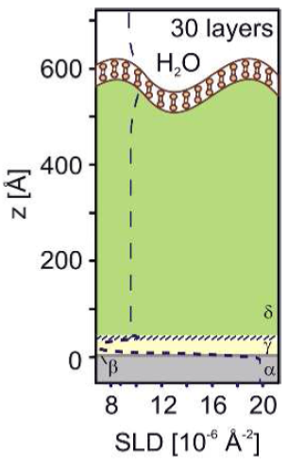
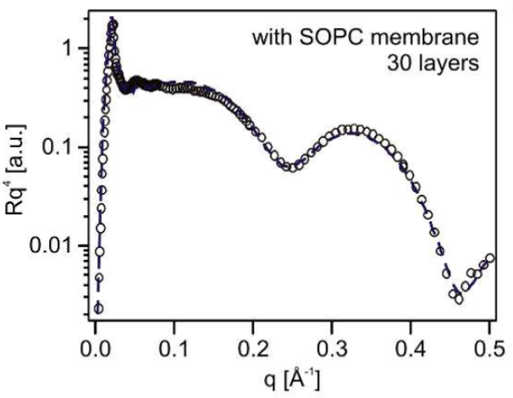
Fine Adjustment of Interfacial Interactions between Solid Substrates and Model Cell Membranes
The use of cellulose supports and zwitterionic phosphocholine membranes enabled focusing on three interfacial forces, i.e., van der Waals, hydration repulsion, and the thermal undulation force. The theoretically calculated membrane- substrate distance under equilibrium was validated by the systematic comparison with the experimentally determined membrane− substrate distance for polymer supports with different thicknesses.
F.F. Rossetti et al., Langmuir 31(2015)
Notes:
F.F. Rossetti et al., Langmuir, .31, p. 4473 2015

Slide 29
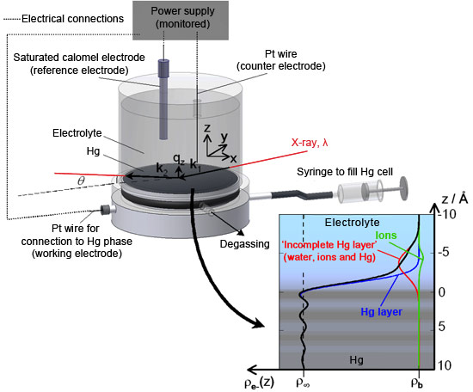
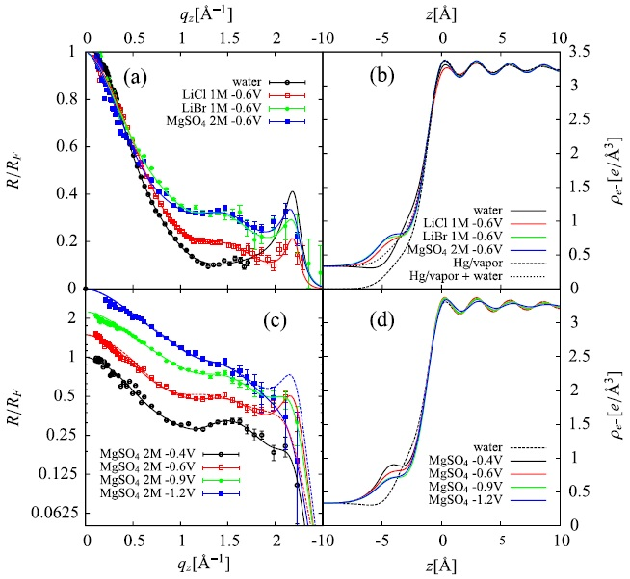
XRR: Buried interfaces
Ionic spatial distribution at polarised mercury surfaces
Reflectivity e-density profile
Electrolytes
LiBr, LiCl and MgSO₄
J.F.L. Duval et al., Phys. Rev. Lett. 108, 206102 (2012)
Notes:
measuring the ionic distributions at buried and polarised Hg-electrolyte solution interfaces with unprecedented accuracy. High-energy X-rays were used to detect the changes in reflectivity resulting from the presence of various ionic species at the mercury surface, with the mercury surface acting as a mirror for X-rays. Detailed analysis of the reflectivity data yielded information about the ionic profiles close to the interface with sub-angstrom spatial resolution
Fig. Sketch of the experimental setup used for reflectivity measurements at the polarised Hg/electrolyte solution interface. Quantities k₁, k₂, λ, q_{z}=k₂-k₁=(4π/λ)sinθ and θ describe the incident and reflected X-rays wavevectors, the X-ray wavelength, the surface normal wavevector transfer and the grazing incidence angle. ρ_{e-}(z) is the surface-normal electron density profile. The graph, bottom right, shows a typical example of spatial distribution for the three contributions (‘ions’, ‘incomplete Hg layer’ and Hg layer, see coloured lines) of ρ_{e-}(z) (black line).
The Hg/electrolyte interface has long been known to exhibit ion specific effects as its surface tension depends on both applied potential and ion nature, a feature classically treated on the basis of the Lippmann-Graham macroscopic thermodynamic description. By reconstructing the reflectivity profiles obtained from the Hg surface subjected to various applied potentials and exposed to molar concentrations of LiBr, LiCl and MgSO₄ electrolytes, it was possible to show that both the degree of polarisation of Hg and the anion nature significantly impact the liquid structure of the Hg close to the interface (Fig. ). In the case of the Hg/MgSO₄ electrolyte interface, the interfacial roughness obtained from X-ray reflectivity data was shown to concur with predictions from capillary wave theory. Conversely, the X-ray reflectivity-determined ion surface excess concentrations were found to be significantly larger than those yielded by macroscopic potential-dependent surface tension data (electrocapillary curve) for the same interface. The observed discrepancy can be assigned to the complex layered structure of the liquid Hg at the interface and to the presence of an incomplete Hg layer composed of water, ions and Hg atoms that gradually protrude from the mean Hg surface location, thus forming a diffuse liquid interphase. These results suggest that even the sign – not only the numerical value – of the ion surface excess determined from surface tension measurements might be incorrect. These findings have strong implications for the understanding of the composition and structure of metal/electrolyte interfaces, and clearly call for a re-examination of past theoretical modelling. Future models should in particular take into account all the fine details of the Hg surface in order to appropriately decipher ion-specific processes. In particular, potential- and ion-dependent electronic properties of the polarised Hg surface (incomplete Hg topmost layer and Hg layering) are important factors that have been omitted both in the traditional derivation of double layer ion composition from electrocapillary data and in their recent interpretation employing the anisotropic hypernetted chain (AHNC) theory.
Fig. Reflectivity measurements normalised to Fresnel reflectivity R_{F} (a,c) nd corresponding electron density profiles (b,d) for various electrolytes (indicated) and applied potentials versus saturated calomel electrode. In panel (b) the curve Hg vapour + water has been obtained by adding the electron density of water on the vapour side. For the sake of readability, reflectivity curves for MgSO₄ at -0.6V, -0.9V and -1.2V vs. saturated calomel electrode (panel c) are multiplied by 1.5, 2.25 and 3.375, respectively. For all reflectivity data reported here, a systematic analysis was carried out to find the best unique physical set of parameters that leads to full reconstruction of the q_{z}-dependence of R(q_{z})/R_{F}(q_{z}).
P. S. Pershan, Review of the highlights of X-ray studies of liquid metal surfaces, Journal of Applied Physics 116, 222201 (2014)

Slide 30
Diffuse scattering on liquid surface: Bending Rigidity (κ)
α
β
λ
δ
~q⁻²
λ
Capillary waves -> height correlation spectrum
determided by the surface energy (γ)
associated with the deformation modes (κ)
[Helfrich, Z. Naturforsch., 28c , 693, (1973)]
α_{i}=0.8·α_{c}
~q⁻⁴
I/I₀ – 10⁻¹¹
Feasible only with synchrotron !!!
conformal
roughness
k_{T} - the isothermal compressibility
C. Fradin et al., Nature, 403, 871-874, (2000)
Notes:
where gam is the surface tension and 2p/q is the wavelength of the capillary excitation of amplitude z and wave vector q.
Grazing insidence diffuse scattering measurements gives access to the surface energy (g) and the bending regidity (k) of monolayers at the air/liquid interface through the spectrum of height fluctuations.

Slide 31
Membrane Discrimination By Antimicrobial Peptides
Phospholipid monolayer at hexadecane-water interface
Bending Rigidity (k)
α_{i}=0,022°, α_{c}=0,0245° @ 22.5 keV
beam size 15 μm
q_{X}
oil
I₀
I
q_{Z}
β
α
○ DPPG , π=30mN/m
❐ DPPG+PGLa , π=30mN/m
❒ DPPG , π=40mN/m
DPPG+PGLa , π=50mN/m
γ = 55mN/m – π, c=10:1
water
Beam travel path 70 mm
transmission ~20% (22keV)
 | Rigidity κ (k_{b}T) @ π=30mN/m π < π_{c} | Rigidity κ (k_{b}T) @ π>40mN/m π > π_{c}
DPPG | 55 ± 5 | 145 ± 5
DPPG+PGLa | 27 ± 5 | 20 ± 5
Bending rigidity of the DPPG membrane decreses upon insertion of the antimicrobial peptide PGLa
E. Saint Martin et al., Thin Solid Films, v.515, p.5678, (2007)
Notes:
Antimicrobial frog skin peptide –Peptidyl-GlycylLeucine-carboxyamide (PGLa)
21 amino acid residues : H2N-GMASKAGAIAGKIAKVALKAL–COOH
PGLa: , Length ~ 3nm in a-helix conformation
4 résidus chargés positivement (Lysine), MW=1969 g/mol
A mammalian cell membrane was
mimicked with the zwitterionic lipid
DiPalmitoyl-PhosphatidylCholine (DPPC)
C₄₀H₈₀NO₈P, MW=734,1 g/mol.
A bacterial cytoplasmic cell membrane was
mimicked with the negatively charged lipids
DiPalmitoyl-PhosphatidylGlycerol (DPPG)
C₃₈H₇₅O₁₀PNH₃, MW=740 g/mol.

Slide 32
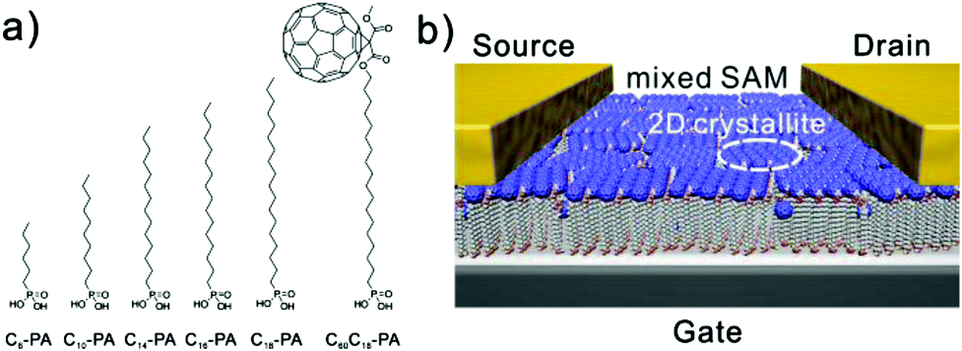
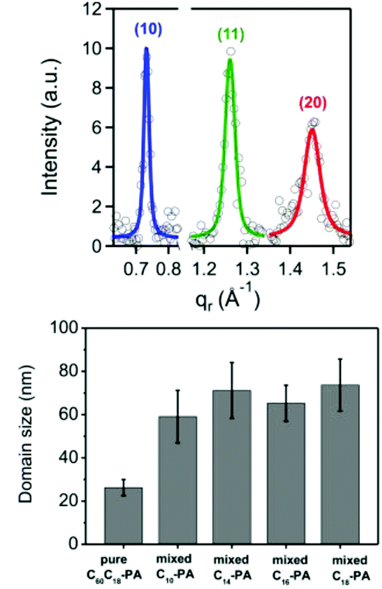
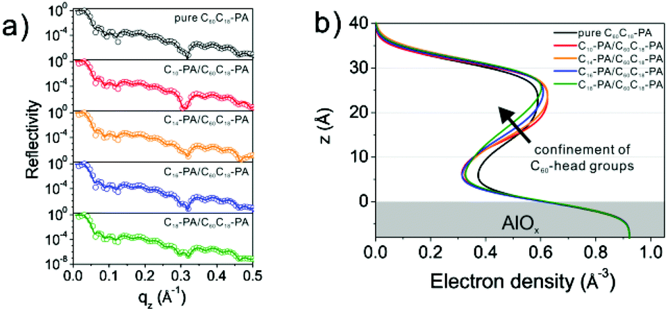
Tuning the molecular order of C60-based self-assembled monolayer in the field-effect transistor
GID
XRR
Insight on correlation between structure and electronic properties
Th.Schmaltz et al., Nanoscale, v.6, 13022, 2014
Notes:
The control of order in organic semiconductor systems is crucial to achieve desired properties in electronic devices. We have studied the order in fullerene functionalized self-assembled monolayers by mixing the active molecules with supporting alkyl phosphonic acids of different chain length. By adjusting the length of the molecules, structural modifications of the alignment of the C60 head groups within the SAM can be tuned in a controlled way. These changes on the sub-nanometre scale were analysed by grazing incidence X-ray diffraction and X-ray reflectivity. To study the electron transport properties across these layers, self-assembled monolayer field-effect transistors (SAMFETs) were fabricated containing only the single fullerene monolayer as semiconductor. Electrical measurements revealed that a high 2D crystalline order is not the only important aspect. If the fullerene head groups are too confined by the supporting alkyl phosphonic acid molecules, defects in the crystalline C60 film, such as grain boundaries, start to strongly limit the charge transport properties. By close interpretation of the results of structural investigations and correlating them to the results of electrical characterization, an optimum chain length of the supporting alkyl phosphonic acids in the range of C10 was determined. With this study we show that minor changes in the order on the sub-nanometre scale, can strongly influence electronic properties of functional self-assembled monolayers.

Slide 33
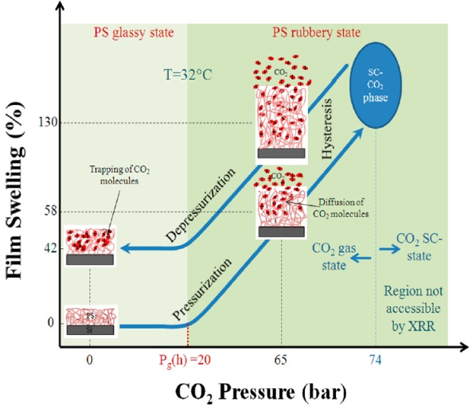
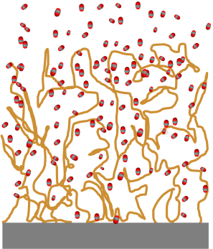

In-situ studies of materials in CO₂ atmosphere: Thin PS film
Thin polystyrene film 10nm
E= 22keV
Swellability=ΔL/L₀
The film swell when exposed
to CO₂ close to sc-state
The thinner film the larger
thickness change
Increase of free volume
Decrease of Polystyrene
electron density
CO₂
Increase of free volume
PS
Si
Macromolecules, 2012, 45, 6611

Slide 34
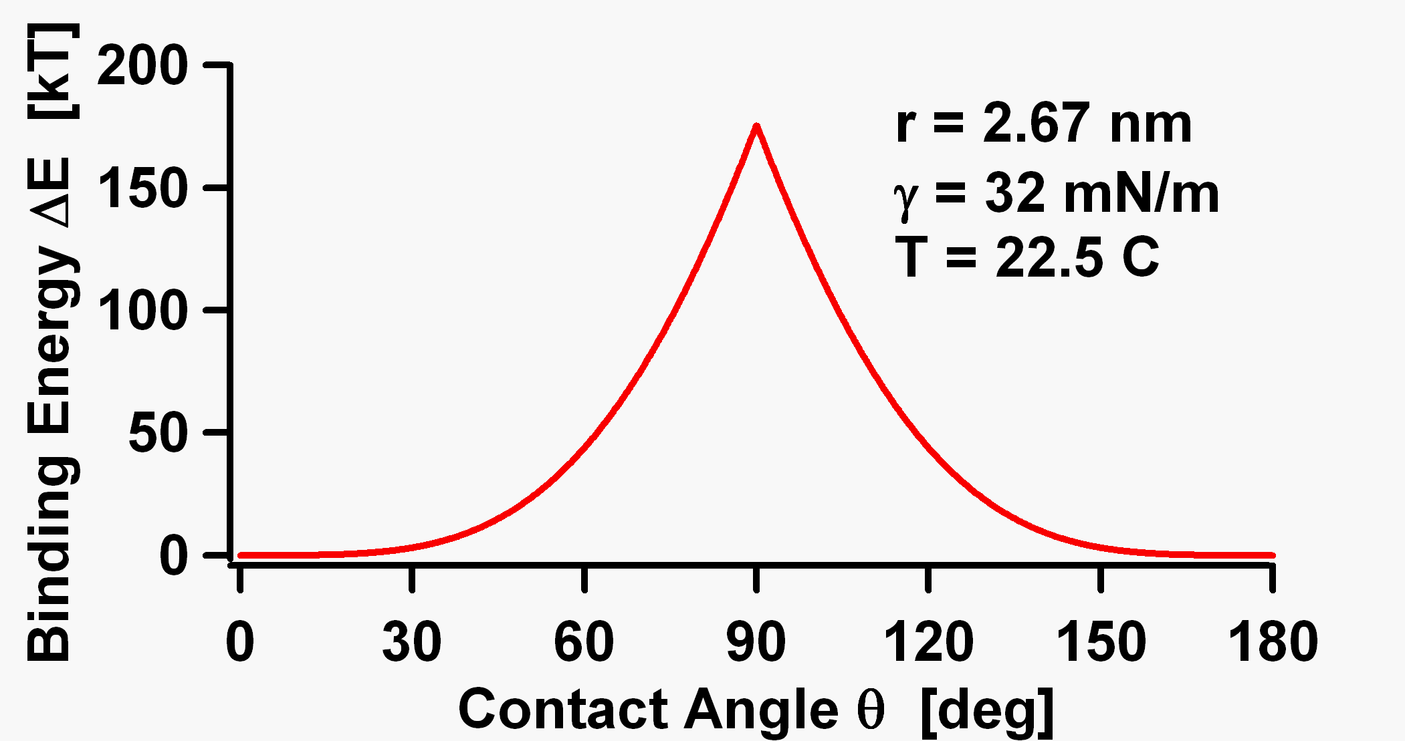
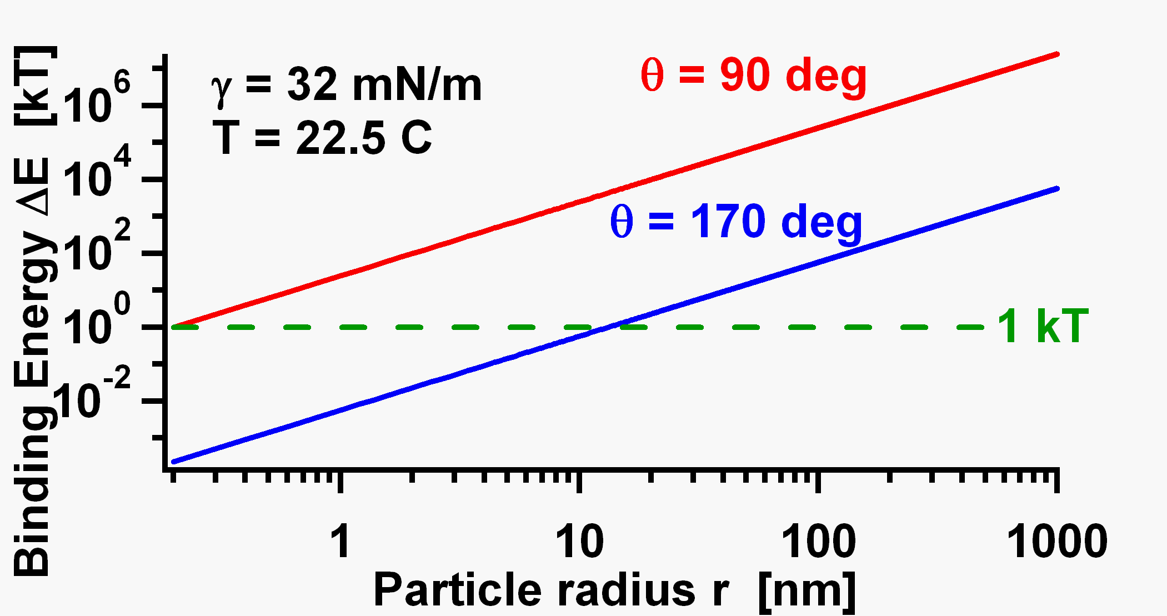
Nanoparticles as surfactants: contact angle & binding energy
γ_{so}
oil
γ_{ow}
Binding energy
r
θ
h
γ_{sw}
solid
water
Interparticle interactions and surfactants → Monolayer nanostructure ?
Notes:
ADSORPTION OF NANOPARTICLES AT LIQUID INTERFACES
Hydrophobic nanoparticles and surfactant-decorated hydrophilic nanoparticles adsorb at the interface to minimize the interface free energy.
Interparticle interactions, which affect both the stability and the nanostructure of the monolayer, are not considered.
Buried Interfaces
The liquid-liquid and liquid-solid interfaces play an important role in many physical, chemical and biological processes of everyday life. Its characterization would enhance our understanding of fundamental processes occurring in nature.
Molecular ordering of the liquids near and within LL interfaces
Surfactants and ions ordering at the LL interface
Bio-mimetic systems (model membranes at LL and LS interfaces)
Bio-mineralization
Emulsion (fundamental aspects and applications: food industry, paints,
hydrometallurgy ...)
Studies of reactions, interfacial synthesis
Growth and ordering of nano particles
Electrochemical processes
Photochemistry at LL Interfaces
….
The structure analysis of interfacial species at a molecular level is crucial to understand mass-transfer, adsorption, and heterogeneous reaction mechanisms at the interface.
The liquid/liquid interface is a very general subject of interest both to pure and industrial chemists, especially those engaged in research on solvent extraction of metal ion and organic compounds, interfacial synthesis, and micro-scale analysis.
Second Harmonic Generation at Liquid/Liquid Interfaces.- Vibrational-Sum Frequency Spectroscopic Investigations of Molecular Interactions at Liquid/Liquid Interfaces.- Observation of Dynamic Molecular Behaviour at Liquid/Liquid Interfaces by Using the Time-Resolved Quasi-Elastic Laser Scattering Method.- Direct Force Measurement at Liquid/Liquid Interfaces.- A Molecular Theory of Solutions at Liquid Interfaces.- Electrochemical Processes at Aqueous/Organic Solution or Aqueous/Membrane Interfaces.- Electrochemical Instability at Liquid/Liquid Interfaces.- Electron Transfer at Liquid/Liquid Interfaces.- Mass Transfer and Reaction Rate in the Nano-Region of Microdroplet/Solution Interfaces.- Single Molecule Diffusion and Metal Complex Formation at Liquid/Liquid Interfaces.- Molecular Recognition of Ions at Liquid/Liquid Interfaces.- Photochemistry at Liquid/Liquid Interfaces.- Development of Surfactant-Type Catalysts for Organic Synthesis in Water.- Bioseparation through Liquid/Liquid Interfaces.

Slide 35
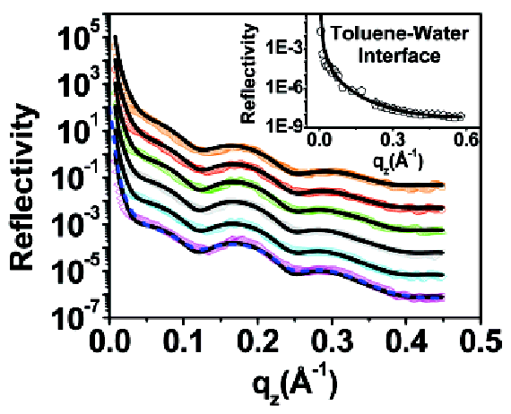
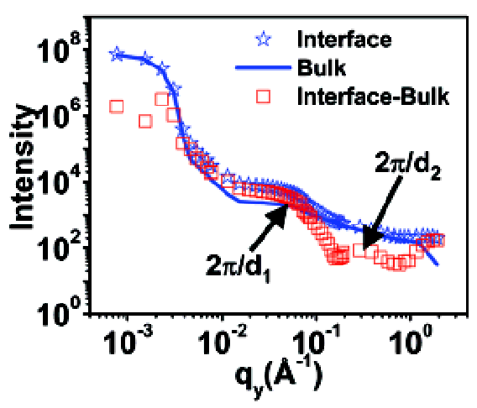
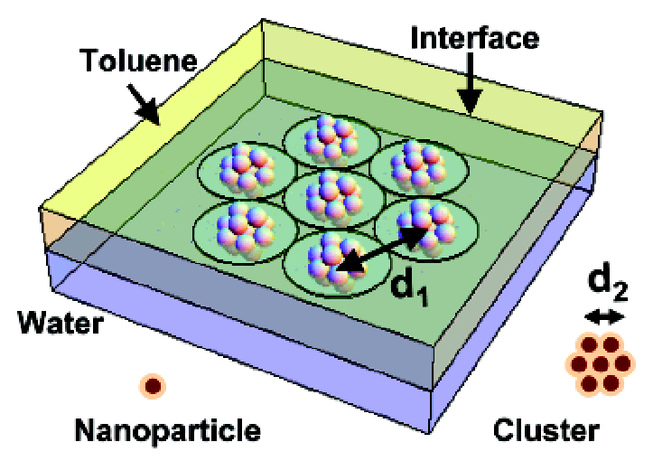
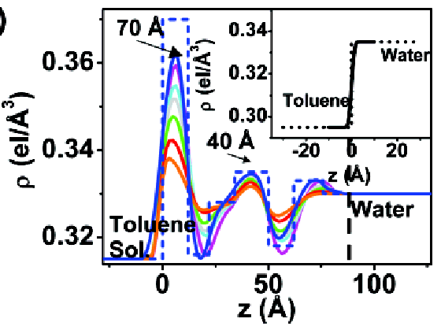
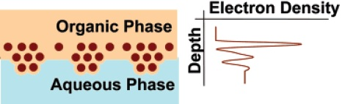
Buried interfaces
Formation and Ordering of Au-NPs at the Toluene-Water Interface
(chemical reactivity at the liquid-liquid interface)
XRR
GISAXS
Triphenylphosphine gold chloride
in the toluene
&
Tetrakishydroxymethylphosphonium
chloride in the water
Time after reaction initiation
6.1 h
5.2 h
4.7 h
4.2 h
3.7 h
3.2 h
cluster-cluster separation
d₁=180 Å
particle-particle separation
d₂ = 34 Å
Each cluster consists of
13NPs with Ø 12 Å &
11 Å thick organic layer
M.K. Sanyal et al., J. Phys. Chem. C, v. 112, 1739 (2008)

Slide 36
Grazing Incidence Small Angle Scattering Principle
10
11
20
21
30
22
q_{x}=2π/λ (cos(θ_{sc})cos(ψ) - cos(θ_{in}))
q_{y}=2π/λ (cos(θ_{sc})sin(ψ))
q_{z}=2π/λ (sin(θ_{in}) + sin(θ_{sc})
An X-ray beam of wave vector k_{in} impinges on the sample surface under a grazing incidence θ_{in} and is reflected and transmitted by the smooth surface but also scattered along k_{sc} in the direction (ψ,θ_{sc}) by the surface or subsurface roughness or density heterogeneities. The specular rod is often hidden by a beam-stop in experimental conditions.
X-ray and Neutron Reflectivity, ed. Jean Daillant and Alain Gibaud, Springer, Lecture Notes in Physics 770, 2009

Slide 37
Reflection-refraction effects and the distorted-wave Born approximation
Free Nano-particles on the surface
Four scattering events and their associated vertical wavevectors
I: q_{z}= k^{z}_{i} -k^{z}_{f}
II: q_{z}= k^{z}_{i}+k^{z}_{f}
III: q_{z}= -k^{z}_{i} -k^{z}_{f}
IV: q_{z}= -k^{z}+k^{z}_{f}
k_{f}
k_{i}
R_{F}(α_{i})
R_{F}(α_{f})
R_{F}(α_{i})
R_{F}(α_{f})
With the particle form factor the resulting scattering is

Slide 38
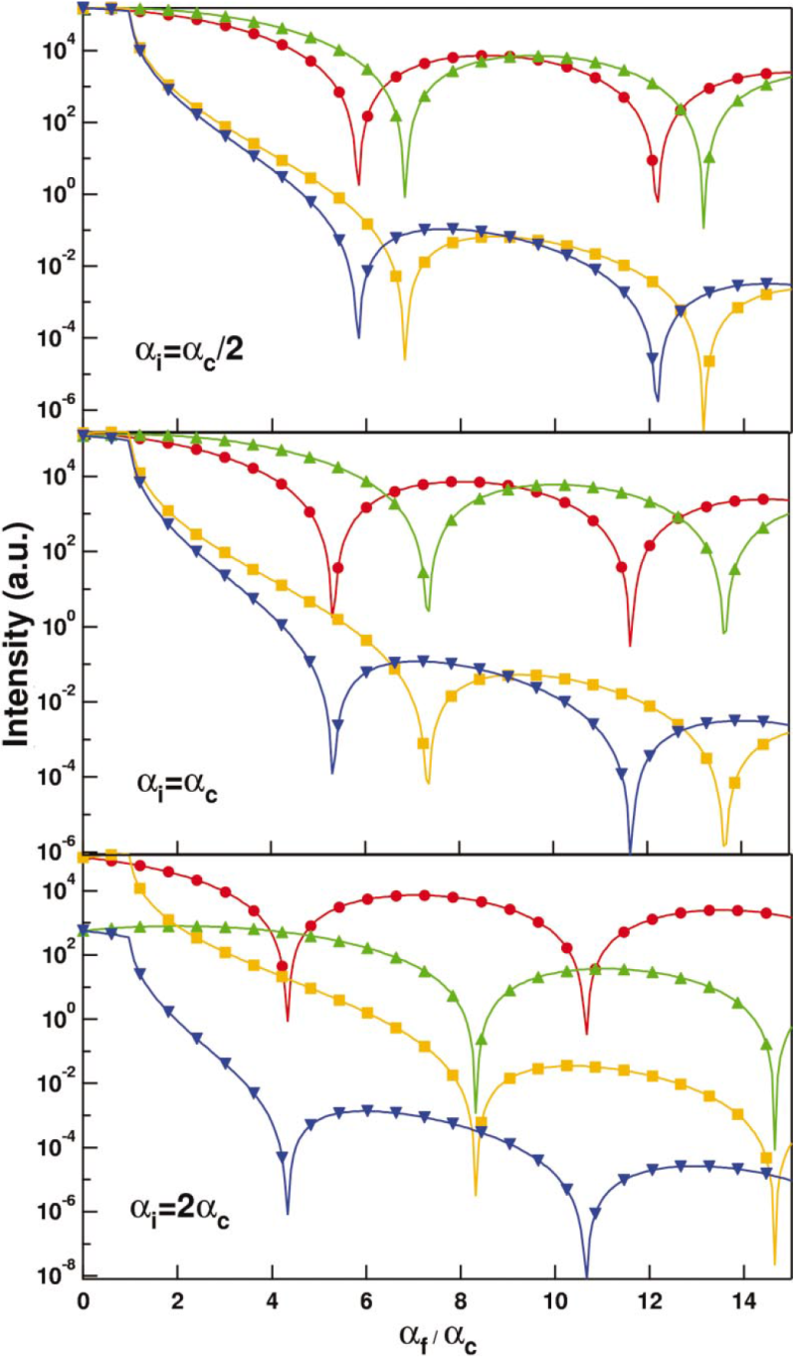
Reflection-refraction effects and the distorted-wave Born approximation
Example of 4 terms contribution
The modulus square of the four terms for a cylinder as function of α_{f}/α_{c} for various α_{i}: term 1 (circles), term 2 (upwards triangles), term 3 (squares), term 4 (downwards triangles)
Cylinder: H=5nm, δ=5x10⁻⁶, β=2x10⁻⁸
Remi Lazzari, J.Appl.Cryst, v.35, 406 (2002)

Slide 39
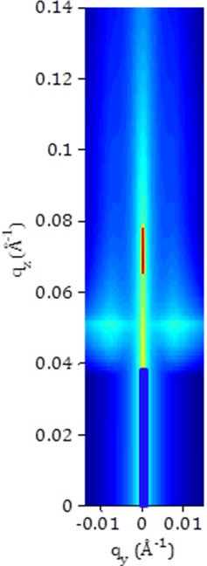
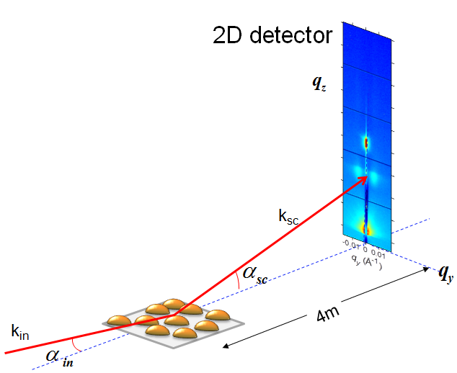
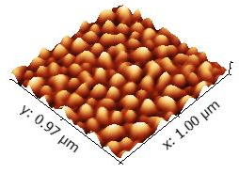
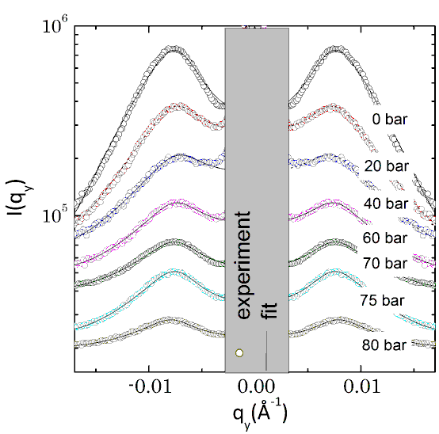
In-situ GISAXS: Polystyrene islands in CO₂ atmosphere
pressurization
d_{C}
H
R
H
R
Islands:
height (H) - 5nm
average distance (d_{c}) 100nm
radius (R) – 22 nm
Conditions:
energy - 22keV
grazing angle – 0.18 deg

Slide 40
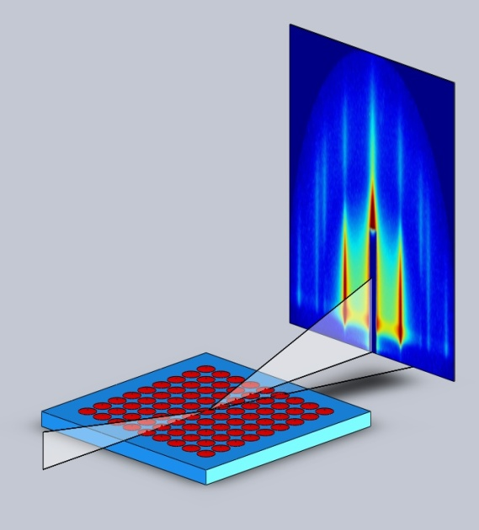
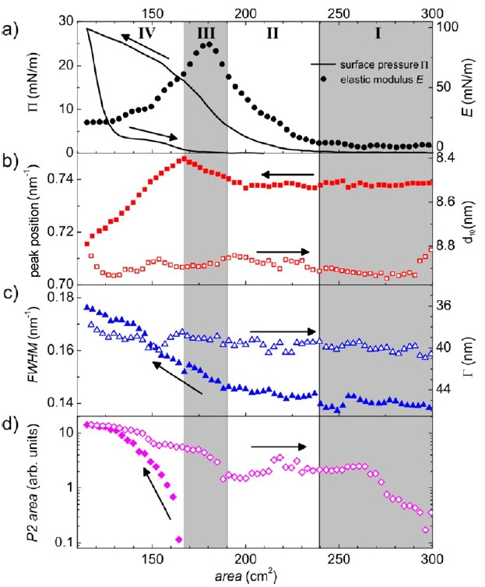
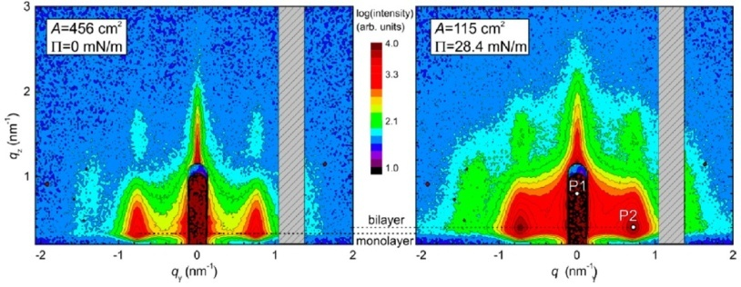
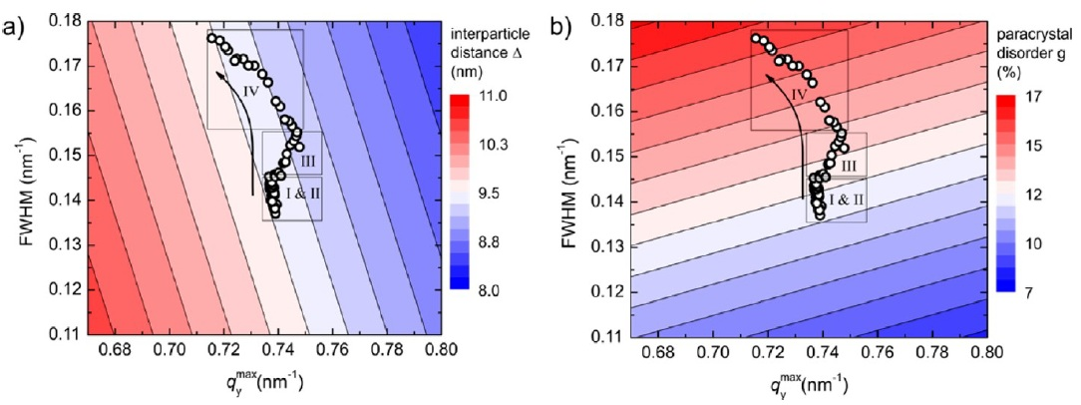
Non-equilibrium compression phase in a NP Langmuir film
Langmuir: Air-liquid interface
GISAXS(t)
PILATUS 300K
Δt=1.9s
v=1.5 mm/s
y(t)
online data analysis
Ag NPs, Ø7nm
π(t)
paracrystal “landscape”
I - coalescence
II - re-ordering
III - paracryst.disorder
IV -2D – 3D transition
K. Vegso, et al., Langmuir 28, 10409 (2012)
Notes:
In stage I of the nanoparticle film compression, we do not observe any increase in the surface pressure. The isolated self-assembled nanoparticle islands coalesce into larger domains, forming a compact percolated network of nanoparticles. Stage II is accompanied by a steady increase of surface pressure. The mechanical stress induced at the boundaries of the coalesced nanoparticle islands leads to a re-ordering and densification of the percolated network and a slight increase in the paracrystal disorder while the interparticle distance remains constant. As a result, a homogenous self-assembled nanoparticle monolayer forms. A further increase in the surface pressure (stage III) results in the paracrystal disorder increasing by 1% and the mean interparticle distance decreasing by 0.2 nm. This effect can be attributed to a compression of the organic nanoparticle shell and formation of a previously unobserved transient phase far from equilibrium that could be observed solely due to our fast tracking GISAXS scheme. A further increase in the surface pressure (stage IV) leads to an irreversible 2-D to 3-D transition and the second layer formation that is accompanied by a relief of the stress accumulated in the first layer. Simultaneously, the voids and defects in the first layer are formed that results in a significant increase of the paracrystal disorder by 2% and relaxation of the interparticle distance back to the initial value.
The in situ observation of the non-equilibrium phases in the nanoparticle Langmuir film compression by conventional imaging and scanning probe techniques like SEM, TEM, STM or AFM is principally impossible. The newly-observed non-equilibrium compression phase documents unique potential of the synchrotron-based time-resolved X-ray scattering measurements in tracking fundamental properties of matter at the nanoscale.

Slide 41
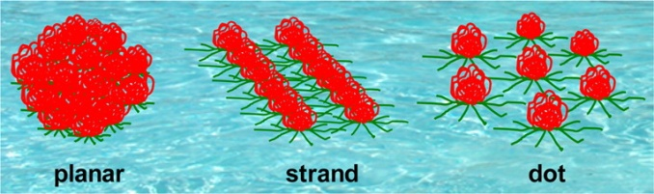



hAmphiphilic Block Copolymer Nanoscale assembly at the Air Water Interface
Effect on structure of
interface free energy ?
blocks length ratio ?
area per block ?
PS-PMMA: blocks length ratio →
X-ray Reflectivity
GISAXS
Samples:
PS-PMMA (1:1) & (2:1)
α_{i}
The best 2D order at:
PS-PMMA (1:1)
π=12 mN/m
G. Li Destri , O.Konovalov, Langmuir 2015, 31, 8856

Slide 42

controlled nanostructure
NANOSTRUCTURING OF ULTRATHIN POLYMER FILMS WITH HORIZONTAL AND VERTICAL CHEMICAL CONTROL
DEPOSITION OF A HIGHLY ORDERED MONOLAYER OF SiO₂ NANOPARTICLES
SPIN COATING OF P3HT
G.Li-Destri et al., RSC Advances,v.6, p. 9175, 2016

Slide 43


controlled nanostructure
NANOSTRUCTURING OF ULTRATHIN POLYMER FILMS WITH HORIZONTAL AND VERTICAL CHEMICAL CONTROL
DEPOSITION OF A HIGHLY ORDERED MONOLAYER OF SiO₂ NANOPARTICLES
SPIN COATING OF P3HT
REMOVING THE SILICA NANOPARTICLES TO OBTAIN A HIGHLY ORDERED MONOLAYER OF P3HT NANOPORES

Slide 44




controlled nanostructure
NANOSTRUCTURING OF ULTRATHIN POLYMER FILMS WITH HORIZONTAL AND VERTICAL CHEMICAL CONTROL
DEPOSITION OF A HIGHLY ORDERED MONOLAYER OF SiO₂ NANOPARTICLES
SPIN COATING OF P3HT
GRADUAL LOSS OF CONTRAST WITH INCREASING THE AMOUNT OF ADDED BCBM WITHOUT LOSS OF LATERAL ORDER
REMOVING THE SILICA NANOPARTICLES TO OBTAIN A HIGHLY ORDERED MONOLAYER OF P3HT NANOPORES
PCBM 4.5 mg/ml
PCBM 3.0 mg/ml
PCBM 4.5 mg/ml
GRADUAL FILLING OF THE PORES WITH PCBM

Slide 45
controlled nanostructure
NANOSTRUCTURING OF ULTRATHIN POLYMER FILMS WITH HORIZONTAL AND VERTICAL CHEMICAL CONTROL
step 1
step 1
GISAXS
DEPOSITION OF A HIGHLY ORDERED MONOLAYER OF SiO₂ NANOPARTICLES
step 2
SPIN COATING OF P3HT
step 3
REMOVING THE SILICA NANOPARTICLES TO OBTAIN A HIGHLY ORDERED MONOLAYER OF P3HT NANOPORES
step 4
GRADUAL FILLING OF THE PORES WITH PCBM
G.Li-Destri et al., RSC Advances,v.6, p. 9175, 2016

Slide 46
Structural tuning of nanoparticle-surfactant assemblies at liquid-liquid interfaces
G. Li Destri, L. Costa, O. Konovalov, D. Pontoni

Slide 47

GOAL OF THIS STUDY
Hexane
Water
Notes:
The system comprises charge-stabilized silica NPs having an average diameter of 2R=5.4 nm, a relatively large size polydispersity of 30% and a mass density of 2.1 g/cm3. They are suspended in ultrapure deionized water (resistivity 18.2 MΩ∙cm) at 0.1% concentration by weight, yielding a bulk NP number density of ~ 6x1020 NPs per liter. Approximately one hour before creating a macroscopic (64 x 74 mm2) horizontal interface with bulk liquid hexane at room temperature (22 C), the bare, negatively charged, hydrophilic NPs are rendered interfaceactive by adding the cationic surfactant hexadecyltrimethylammonium bromide (CTAB) in the submillimolar φc range 0.005 to 0.75 mM, corresponding respectively to ~0.5 and ~75 CTAB molecules per NP within the bulk aqueous dispersion. Therefore even at the highest φc studied, the average silica surface available in bulk for CTAB adsorption (~1.2 nm2 per headgroup) is considerably larger than the CTAB headgroup packing limit of 0.32 nm2. As a consequence it is reasonable to assume that all CTAB molecules have already adsorbed on the silica NPs before OWI creation. In addition, the NP organic coating can be considered as particularly sparse and soft, and therefore prone to considerable rearrangements during interfacial absorption as predicted by computer simulations and increasingly found in experimental work. Following previous practice, CTAB adsorption onto the silica NP surfaces is further promoted by addition of NaCl. Although this work is not focused on surfactant counterion exchange and silica surface charge effects, we investigated three NaCl concentrations (0.1, 1, and 10 mM) in order to assess CTAB versus NaCl in terms of interfacial NP charge screening effects by comparing the corresponding IDs.

Slide 48

Gisaxs: SILICa NPs at THE hexane/water INTERFACE
GISAXS DATA
ID
- Interparticle Distance
Q_{p}/ΔQ_{p} ≈ 4 NPs
The broad structure factor
reveals that the correlation
length in the monoalyers is low
The interparticle distance is
obtained by the peak positon fitting
Q_{p}

Slide 49




EFFECT OF CTAB CONCENTRATION (NP: 0.1%wt; NaCl: 1mM)
EFFECT OF CTAB CONCENTRATION
DILUTED PHASE
Predominant electrostatic repulsions
Gradual decrease of the interparticle distance with increasing CTAB
I
II
III
CONTACT PHASE (D=10.7nm)
Steric hindrance between the CTAB molecules prevents further approaching
Strong reorganization of CTAB at the NP surface
I
II
INTERDIGITATION PHASE (D=9.8nm)
Flocculation due to the attractive interactions between nanoparticles
Nanoparticles are already aggregated in bulk
III
SiO₂ NP: Ø = 5.4 nm
CTAB: L= 2.77nm=2.17nm+0.6nm
10.94= Ø +2L
Notes:
CTAB CONCENTRATION AFFECTS THE INTER-PARTICLE DISTANCE
IMAGING SILICA NANOPARTICLE MONOLAYERS AT DIFFERENT CTAB CONCENTRATIONS
Phase-I Less than one surfactant molecule available per NP in the bulk aqueous suspension
Region I seems to be dominated by charge repulsion. This is confirmed by varying the NaCl concentration φs, which alters the screening of the NP surface charges.

Slide 50

EFFECT OF salt CONCENTRATION
TUNING THE NP SPACING VIA THE IONIC STRENGTH
The role of NaCl is to promote the adsorption of CTAB onto the nanoparticles surface and to screen electrostatic repulsions
AT LOW SURFACTANT CONCENTRATIONS THE SALT AMOUNT STRONGLY AFFECTS THE CTAB ADSORPTION
At Low CTAB Concentrations the NaCl Concentration Drastically Alters the Electrostatic Repulsions and the Interparticle Distance
At High CTAB Concentration the Surfactant Itself Screens the Electrostatic Repulsions and the Salt Effect Is Less Marked
Notes:
Region I seems to be dominated by charge repulsion. This is confirmed by varying the NaCl concentration φs, which alters the screening of the NP surface charges.
CTAB has more pronounced charge screening effects than NaCl at the OWI.

Slide 51
CONCLUSIONS
GISAXS and XRR allows a full structural characterization of nanoparticles at buried interfaces
XRR confirms the formation of monolayers, however differences in the curves suggest different positioning of the particles at the interfaces
The interparticle distance can be tuned with nanometre precision by controlling the adsorption of the surfactant
Different interactions are involved
The interparticle interactions are mediated by the surfactant
At low CTAB concentration electrostatic interactions are predominant and tunable
The lower interparticle distance limit is determined by the surfactant interdigitation
The nanoparticles never go into close contact before collapsing from 2D monolayer to 3D powder

Slide 52













In-situ study of the formation mechanism of two-dimensional superlattices from PbSe nanocrystals
?
☺
Ex-situ TEM
In-situ GISAXS/WAXS
Monte Carlo simulations
Jaco J. Geuchies et al., Nat. Mater. 15, 1248–1254 (2016)

Slide 53

Sample preparation precedure
PbSe nanocrystals with low polydispersity
4-7 nm in diameter / Truncate cubes
Stabilized by oleic acid surfactants

Slide 54


Experimental setup at ID10: online Simultaneous GISAXS & GIWAXS
SAXS
WAXS
Particles are unstable in ambient conditions
10 keV (< Pb and Se absorption edges)
α_{i} = 0.3º (critical angle PbSe)

Slide 55






stages of the self-assembly process: towards an oriented attached PbSe NC superlattice
1 nm⁻¹
1 nm⁻¹
1 nm⁻¹
1 nm⁻¹
1 nm⁻¹
1 nm⁻¹
1 nm⁻¹
1 nm⁻¹
16 min
27 min
30 min
43 min
Left: Right:
GIWAXS GISAXS
Scoop after experiment:
GISAXS scale bar = 1nm⁻¹
Notes:
1:3^0.5:2 hexagonal lattice

Slide 56


Quantitative analysis of the GISAXS and GIWAXS data
FWHM in-plane {200} reflection
Individual NCs
FWHM = 1.2º (5.3 nm)
In-situ measurements
0.8-0.5º (9-12 nm)
Clicking together of 2-3 NCs!
(lower limit)
Hexagonal phase
q = 0.74 nm⁻¹
NC-NC = 9.07 nm
Square phase
q = 0.83 nm⁻¹
NC-NC = 7.57 nm
16.6% decrease in NC-NC distance

Slide 57


Schematic mechanism of the consecutive phase transitions during the reactive self-assembly of the PbSe NCs
Topview
Sideview
Notes:
Upon (reactive) self-assembly, the PbSe NCs undergo a phase transition from a hexagonal to a square superlattice.

Slide 58
Grazing Incidence Diffraction
(Two dimensional crystals)
k_{i}
Z
Q
α
Q_{z}
Q||
k_{f}
β
ψ

Slide 59


GID: Diffraction from 2D array of rodlike molecules
GID: Diffraction from 2D array of rod-like molecules
Real space
Reciprocal space
Rod like
molecule
F – Form factor
2D lattice
S – Structure factor
t
F*S
a*
b*

Slide 60


GID: Lipidic monolayer (DPPC) on the air/water interface at 30 mN/m
A
B
Q||=1.47 A⁻¹
(10)(01)
B
Q||=1.36 A⁻¹
q_{z}¹
(11)
A
q_{z}²
q||¹
q||²
q||¹, q||² - 2D cell lattice parameters: a, b, γ.
q||¹, q||², q_{z}¹, q_{z}² - molecular tilt (θ) and the tilt azimuth (ψ)
Output: Lattice parameters, tilt angle & azimuth, correlation length and molecular length

Slide 61


GID: Behenic acid (C₂₂) phase diagram
◊
□
☼
○
○
◊
□
☼
Kaganer et al., Reviews of Modern Physics, 71 (1999) 779
Kenn, et al., The Journal of Physical Chemistry, Vol. 95, No. 5, 1991

Slide 62




GID: 2D protein crystals, Towards atomic resolution
Streptavidin
Behenic acid
a=55.5 Å
b=110.4 Å
γ=106.4º
(02)
(11)
19 Bragg rods
Reflections intensity ratio
orientation of the backbone planes
Bragg rod profiles
conformation defects
in the hydrocarbon chain
⇦ Bragg rod (-12)
P.-F. Lenne et al.,Biophysical Journal, v. 79, 496 (2000)
J. Pignat et al., Thin Solid Films, 515, 5690, (2007)
Notes:
Basically, the intensity ratio between the (02) and (11) reflections is very sensitive to the orientation of the backbone planes whereas the Bragg rod profiles along the vertical are sensitive to the conformation defects.

Slide 63



Charged magnetic nanoplates at Air-liquid interface
SrFe12O19: (P63/mmc)
c -axis : easy magnetization
μ
Variable conditions
pH
Surfactant
Charge sign
Charge density
Concentration
Magnetic field
+
+
~5 nm
+
+
+
+
+
+
+
+
+
+
+
~100 nm
XRR
DPPG (-), pH=5, π=25mN/m
GID
PFTD (-), pH=3.8, π=25mN/m

Slide 64


In situ, real time observation of polymer-fullerene blend crystallisation for organic photovoltaics
P3HT:PCBM /1:0.5 & 1:0.8
P3HT:PCBM /1:2
M. Sanyal, et al., Macromolecules 44, 3795 (2011)
Notes:
Polymer solar cells are very promising as light–weight and potentially low cost devices for solar energy conversion. Most polymer solar cells are based on the bulk heterojunction device structure, in which a polymer (donor) and a fullerene-derivative (acceptor) are deposited from a common solvent. As solvent evaporates, crystallisation and phase separation take place and give rise to an interpenetrating network of donor and acceptor materials. The energy conversion efficiency depends critically on the nanomorphology that develops dynamically during solidification of the wet film. Hence, there is need to gain knowledge of the phase behaviour and crystallisation of polymer/fullerene blends as basis for a rational search of material combinations and fabrication methods.
Researchers have developed a novel setup at ID10B for the real-time observation of film crystallisation from solution. They obtained structural information by in situ grazing incidence X-ray scattering (GIXS) and monitored simultaneously the film thickness evolution by laser reflectometry as schematically depicted in Fig. 4.2-14a. By this powerful approach authors were able to investigate the dynamics of bulk heterojunction blend crystallisation in conjunction with the evolution of solvent fraction during film drying. They studied the wellknown material combination of P3HT:PCBM dissolved in o-dichlorobenzene and probed the influence of parameters such as blending ratio and drying conditions.
The GIXS real–time study presented here reveals a remarkable effect of the PCBM content in the development and evolution of P3HT ordering during blend drying. Fig. shows the time evolution of the mosaicity obtained from the (100) reflection which provides information about the orientation distribution of P3HT crystallites. For the P3HT:PCBM ratios of 1:0.5 and 1:0.8, the mosaicity increases considerably during the solvent evaporation, for the blend with highest PCBM content studied here, i.e. a P3HT:PCBM blend ratio of 1:2, the small angular distribution of the initially nucleated P3HT crystallites remains constant during crystallisation. It was suggested that disorientation provides increased hole mobility perpendicular to the substrate as required for efficient solar cells. Additionally GIXS reveals that PCBM hinders the development of P3HT interlayer π–π stacking for the P3HT:PCBM blend with 1:2 ratio. The lack of π–π packing is identified here a possible cause for the reported poorer power conversion efficiency for 1:2 blends.

Slide 65
X-Ray Standing Waves (XSW)
Standing-Wave X-Ray Fluorescence
Grazing incidence X-Ray Fluorescence (TRXF)

Slide 66





XSW generation by crystal & total reflection from mirror
mirror

Slide 67





GIXF: Specific ion adsorption and short-range interactions at the air aqueous solution interface
KCl 0.1M
depleted layer 3.77 A
π_{elec} > π_{solv}
d
Concentration profiles
α_{i}⁻¹(I_{f}/I_{e})/(I_{f}/I_{e})_{bulk}
α_{i} nm⁻¹
KCl 0.1M + KI 0.1M
CsCl 0.1M + CsI 0.1M
V. Padmanabhan et al., Phys. Rev. Lett. 99, 086105 (2007)
Notes:
There is a broad range of phenomena in biology, environmental, and physical sciences where ions of the same valency like Cl and Br have a dramatically different effect. Since the seminal work of Hofmeister on protein stability in 1888, such ‘‘ion specific’’ effects have been illustrated by many examples ranging from enzymatic activity and amyloidosis to humics stability and halide heterogeneous chemistry in the atmosphere. Ion specific effects generally follow direct or reverse order of the so-called Hofmeister series, which for anions is SCN > ClO4 I > Br > Cl > F. For example, the surface tension and the surface potential of aqueous solutions (decreased by HCl and increased by NaCl) follow the series in reverse order.
3.1. Specific ion adsorption and short-range interactions at the air aqueous solution interface
The study of aqueous salt solutions continues to attract various research groups because of their fundamental importance in various physicochemical, biological and atmospheric processes. The air/water interface plays a crucial role in such processes and differs to a large extent when compared to bulk. To further understand the role of the interface, direct access to the surface excess or the knowledge of the concentration profiles of ions will not only improve our present understanding but also help to predict the properties associated with it. Ions, though of the same valency, tend to interact differently with proteins (salting in or salting out as predicted by Hofmeister) or differ in their degree of adsorption at the air-water interface. In recent times, there have been considerable efforts by various research groups using different sophisticated surface sensitive probes to understand the organisation of the ions and its impact on the solvent features and also through molecular dynamic simulation.
We have employed grazing incidence X-ray fluorescence to investigate an electrolyte solution under ambient conditions (Figure 1) at beamline ID10B. The X-ray fluorescence from the ions (chemical sensitive) is registered as a function of the angle of incidence (depth sensitive). Systematic investigations on acids, salts and their mixtures at different bulk concentrations yield quantitatively their surface excess. Theoretical analysis using a hyper-netted chain approximation to predict the concentration profile (Figure 2) invoke the necessity to include the short range surface-ion interaction potential in addition to the dispersion and the long range electrostatic interactions. Furthermore, the competition in ion adsorption for a mixture of 0.1 M KCl and 0.1 M KI reveal clearly the enhancement of iodide relative to chloride anion (Inset of Figure 2). We could apply this approach of analysis to 20 different experiments using 4 fit parameters. The strength of the effective potential deduced from such analysis were, -4.0 kBT, -4.7 kBT, -4.4 kBT and -3.15 kBT, for Cl-, Br-, I- and H+ (at contact), respectively. Our studies highlight the importance of the short range interactions at the interface of aqueous electrolyte solutions[1].
The resolution of the experiment is at least 1 ion in 300 nm^3

Slide 68


Simultaneous GIXF, XRR, and GISAXS/WAXS
GIXF & XRR:
Ion specific gelation of charged sugars (localization accuracy: ∆z = ± 3 Å).
→ Unraveling how bacteria survives against drugs
GISAXS & GIXF:
Localization & correlation of drugs and protein NPs on membranes
→ Unraveling where drugs and proteins function
Schneck,..Konovalov, .. Tanaka, PNAS (2010).
Abuillan, ..Boroviev,.. Tanaka, J. Chem. Phys. (2012)
Abuillan,.. Konovalov,. Tanaka, Phys. Rev. E (2013)

Slide 69

Depth Localization with Near-Angstrom Precision of Biologically Important Chemical Elements in Molecular Layers
Multilayers: 20x(Ni/Al ), 20 nm period, surface: single crystal sapphire Al oxide terminated
Lipid Single Monolayers on Al oxide
Symbols:
experiment. Solid lines: model
Sulfoglycolipids (SGS)
abundant in nerve system and thylakoids
SGS: S at tip of saccharide headgroup (hg)
fit: sharp S distribution (σ < 10 Å)
center set as z_{S}= 0 (solid surface)
Phospholipids
dominant lipid class in animals
DSPC: P in inner hg region
fit: z_{P} = 4 ± 2 Å
different hg structure
Phospholipids + PEG lipids
5% PEG lipid, N = 114
fit: z_{P} = 3 ± 2 Å
no PEG layer below monolayer
E. Schneck et al., PNAS (2016)
Notes:
Experimental results on lipid single monolayers on bare Al oxide: An SGS monolayer (top), a DSPC monolayer (middle), and a DSPC / PEG-lipid mixed monolayer (bottom). (A) Chemical details highlighting the elements of interest P and S. (B) Measured angle-dependent P and S fluorescence intensities (symbols) together with the simulated intensities (solid lines)
corresponding to the best-matching models. Vertical dashed lines indicate the Bragg condition. (C) Sketches of the layers studied. The axis perpendicular to the sample surface is denoted with z. (D) Illustration of the best-matching P and S distributions according to Eq. 2, where the width parameter σj was set equal to the topographic surface roughness σtop , see text.
We work with representatives of the three most important classes of biomolecules: lipids, saccharides in the form of glycolipids, and proteins. Lipids with phosphatidylcholine (PC) headgroups are among the most abundant lipid classes in eukaryotic cells and the dominant class in animals (17). Glycolipids bearing a sulfate group, such as the sulfoglycolipid SGS, are found in eukaryotic cell membranes, especially in the nerve system and in photosynthetic membranes (18, 19). Element-specific studies as presented here can thus reveal the structural details of biological multicomponent membranes.

Slide 70



Acknowledgements / conclusion
ID10
Giovanni Li Destri
Jaco Geuchies
Karim Lhoste
Diego Pontoni
Numerous collaborators and users
Thank you
X-ray surface sensitive technique is a powerful tool to study broad spectrum of science at surfaces and interfaces
gas-liquid
liquid-liquid
liquid-solid
Contact: Oleg Konovalov, konovalov@esrf.fr

