Slide 1
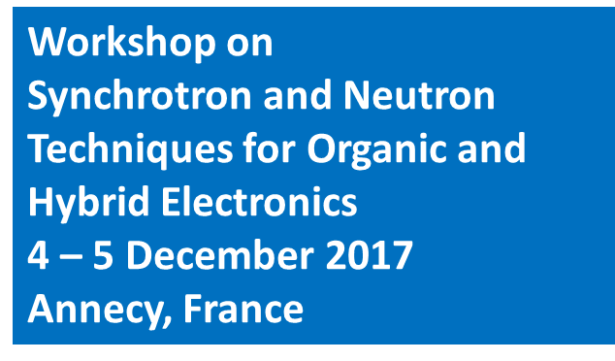

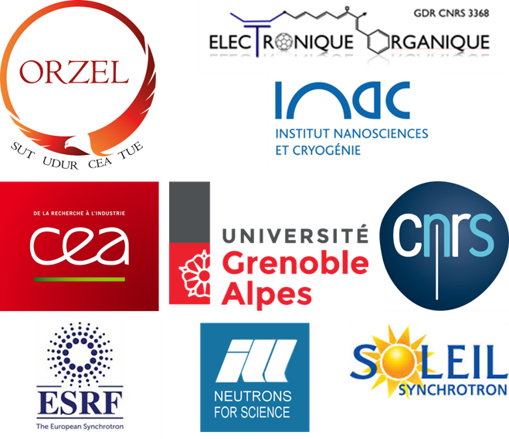

Slide 2

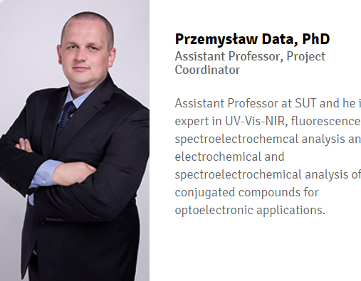

Slide 3

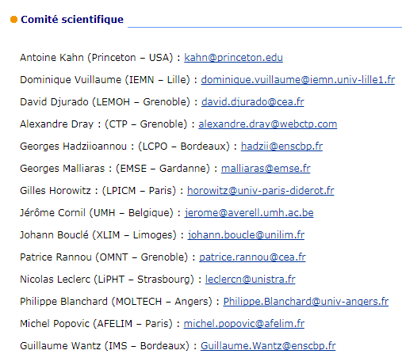
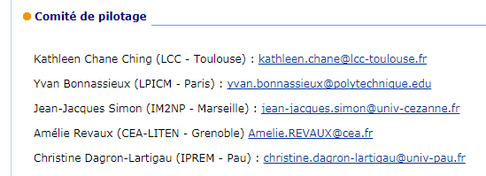



Slide 4
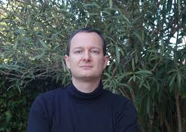



FOR ANY INFORMATION & HELP …
JEROME
Faure-Vincent
STEPHANIE
Pouget
DAVID
Djurado

Slide 5
How large facilities can help to face
the numerous challenges lifted
by organic and hybrid electronics?
A general introduction.
David
DJURADO
INAC
CNRS – CEA Grenoble

Slide 6
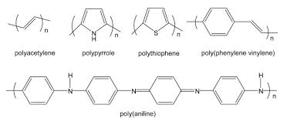
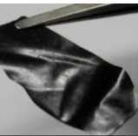
ORGANIC ELECTRONICS?
Late 80’s, early 90’s
Doped conjugated polymers
Essentially research of stable metal-like materials by doping the conjugated polymers
Structure-conductivity relationship
Static and dynamic disorder effects
(Structural defects, crystallinity, preferred orientation but also vibrations, local dynamics and lattice dynamics contributing to charge carrier scattering)
X-rays and neutrons have been used
In 1989, we did the first measurements
of neutron scattering on oriented (CH)_{x} (structure and dynamics).
D. Djurado, J. Ma, N. Theophilou, J.E. Fischer, Synth. Metals 30 (1989) 395
J.L. Sauvajol, D. Djurado, A.J. Dianoux, N. Theophilou, J.E. Fischer Phys.Rev. B 43 (1991) 14305.
Powders or Free Standing films.

Slide 7

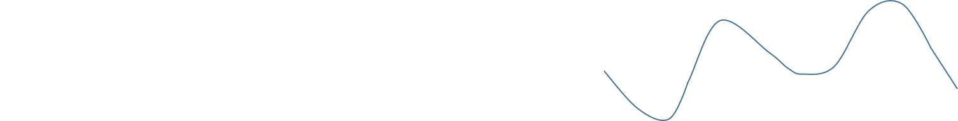
Transport of electrical current, defects, static disorder, lattice vibrations
DELOCALIZED ELECTRON
0 K
APPLIED VOLTAGE
LATTICE VIBRATION
BAND TYPE CONDUCTION
SCATTERED ELECTRON
T
ELECTRON LOCALIZED BY DEFECTS OR DISORDER
CONDUCTION BY HOPPING
LATTICE VIBRATION
Notes:
Quand les états électroniques sont localisés, la température et les vibrations du réseau qu’elle engendre n’agissent plus vraiment comme dans le cas d’un métal. Assistée par les vibration du réseau cette propoagation s’appelle conduction par sautsDans le cas le plus général, la conduction dans un fil moléculairen’est pas vraiment de la conduction par sauts, ce n’est pas non plus une conduction cohérente; c’est un processus intermédiaire dans lequel les vibrations du réseau favorisent et gênent à la fois la conduction.

Slide 8

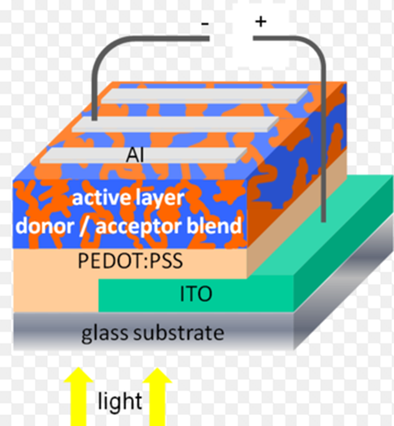

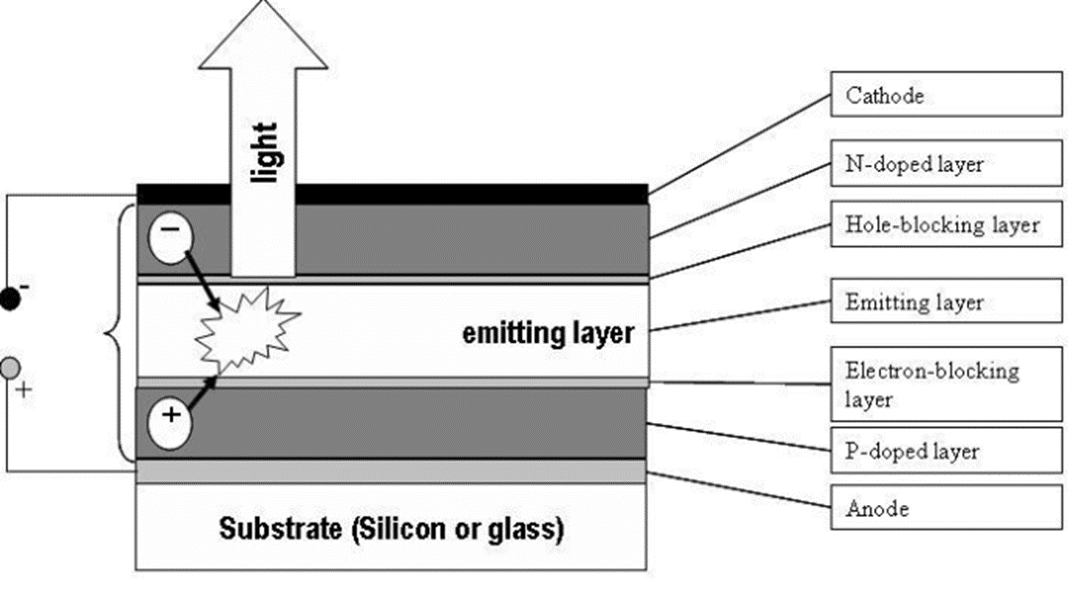
NOWADAYS
Solar cells
We think more and more directly in terms of electronic components, electronic devices, taking profit of n and p type semiconducting properties of conjugated polymers and small molecules.
OLED

Slide 9
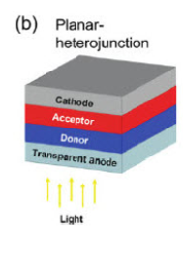
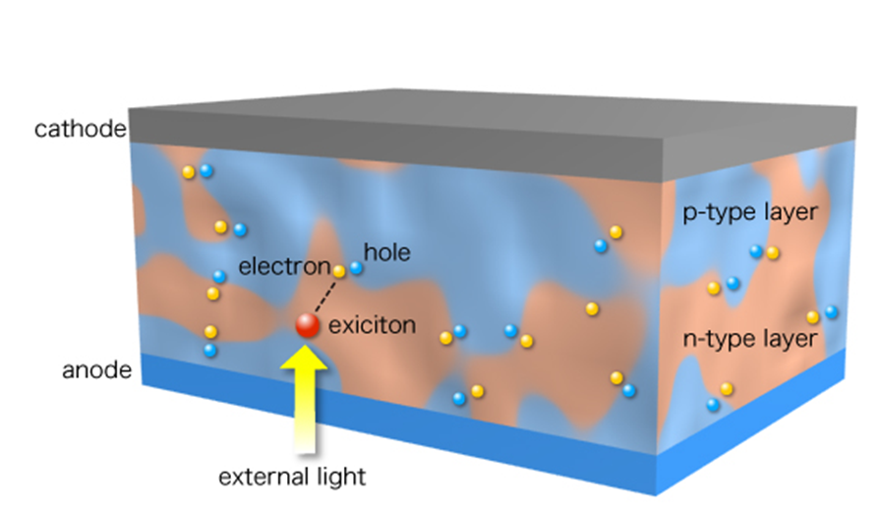
The most complex arrangements are often the most effective in terms of devices performances
Bulk Heterojunction
3
2
Nanomorphology
1
Interfaces uneasy to be electronically and structurally characterized are involved and many other parameters have to be controlled.

Slide 10
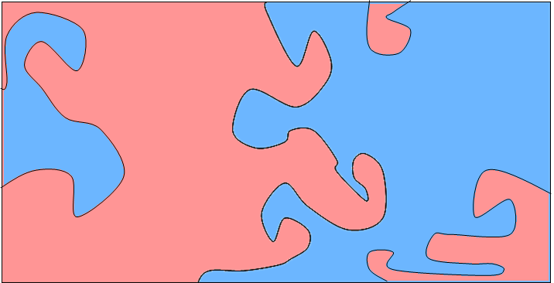

Bulk-heterojunction solar cells (BHJ)
Photo-induced charge transfer
Creation
of exciton
Photon absorption
-
+
Transport of e⁻
Charges separation
Cathode
Anode
Transport of h⁺
P-type semiconductor
N-type semiconductor
Photo-induced charge transfer < 10⁻¹² s
All the effects at interfaces are critical
Electrode/active material: injection of charges
N-type semiconductor/ P-type semiconductor: quality of charge separation
Minimizing charges recombination.
Heeger et al.Science, 1992, 258, 1474.

Slide 11
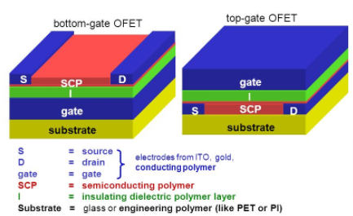

p-type, n-type or ambipolar organic field effect transistors
Stacked layers with 50 < total thickness < 200 nm.
The substrate can be rigid or flexible.
That gave birth to flexible electronics which can be fabricated using printing processes (ink jet, roll to roll,…)

Slide 12
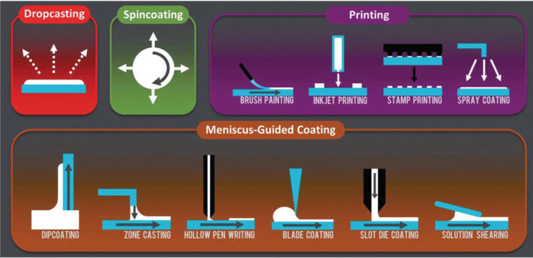
Bottom-up processes of fabrication
Very important to master the solution phases, deposition and casting processes
For polymers the control of the molecular mass and the orientation of chains are often decisive for obtaining good performances of devices.

Slide 13

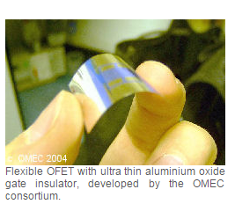
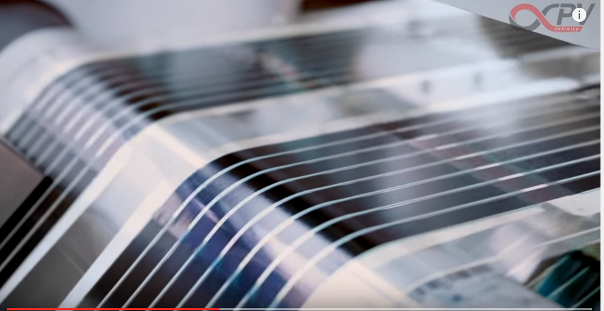

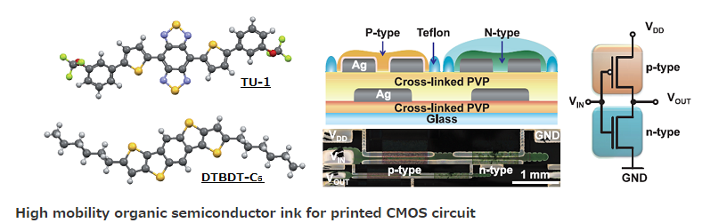
Nowadays, large scale production of flexible printed circuits included in various devices is a reality.
Roll to roll process of fabrication of
flexible organic solar cells.
OLEDs based TV sets and flexible displays for smartphones

Slide 14
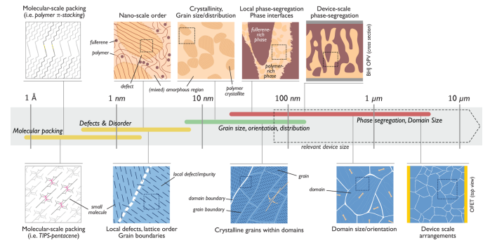
This is definitively a multiscale story!!!
OPV
OFET
J. Rivnay et al., Chem. Rev. 112 (2012) 5488.

Slide 15
It turns out that X-rays and Neutrons are radiations/particles which allow to explore the structure and the dynamics of matter in a very broad range of lengths and times.
Techniques of choice using these radiations are well adapted to the study of materials and devices of interest in the field of organic and hybrid electronics.
Let see in few minutes some basic aspects in order to feel better (?.. maybe….) when our speakers will show us more details……

Slide 16
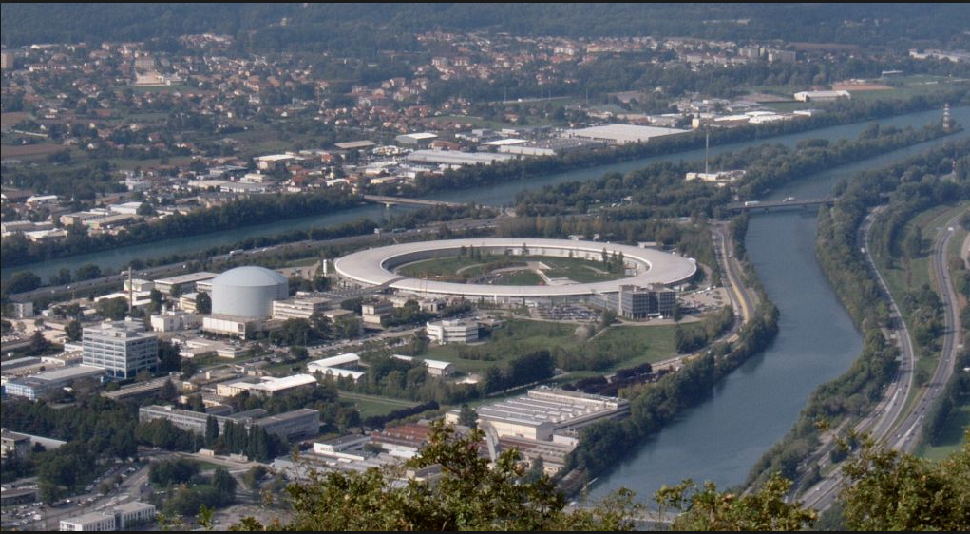
EPN Campus : ESRF, ILL, EMBL

Slide 17
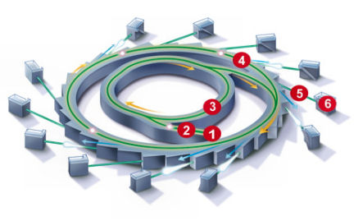
Synchrotron principle
1-2: Linear accelerator (LINAC)
3: Booster
4: Storage ring
5-6: Optics and experimental stations

Slide 18
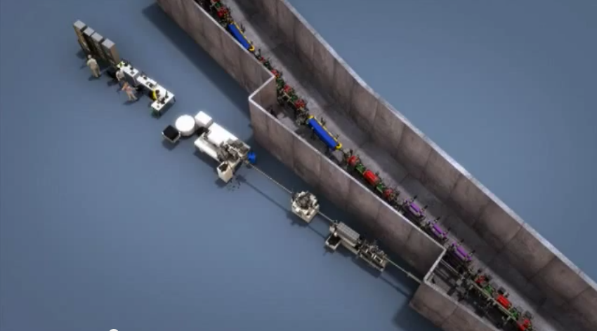
Insertion devices
Bending
Magnets
Control Hutch
Focusing
Magnets
Experimental Hutch
Undulators
Optics Hutch

Slide 19
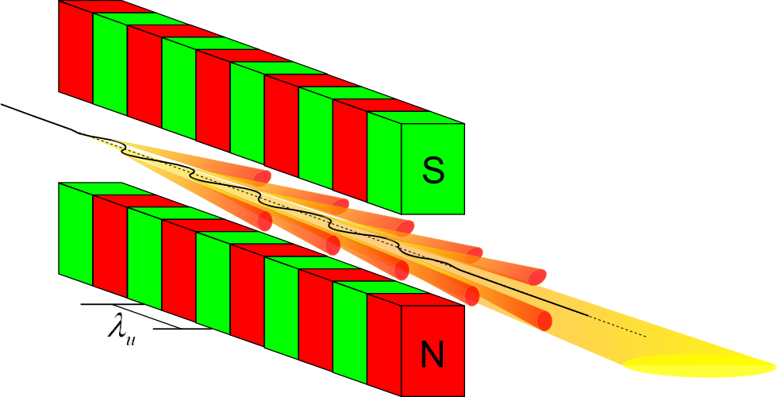
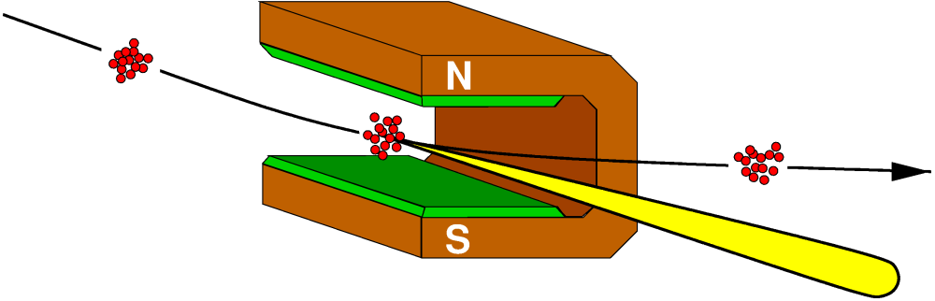
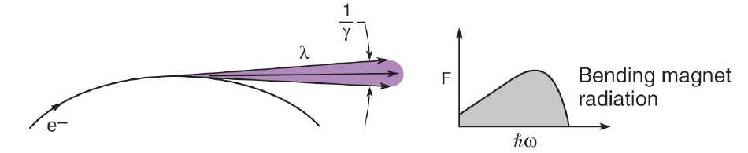
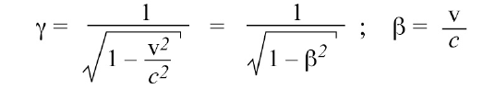
Insertion devices
Bending magnet
Undulator

Slide 20
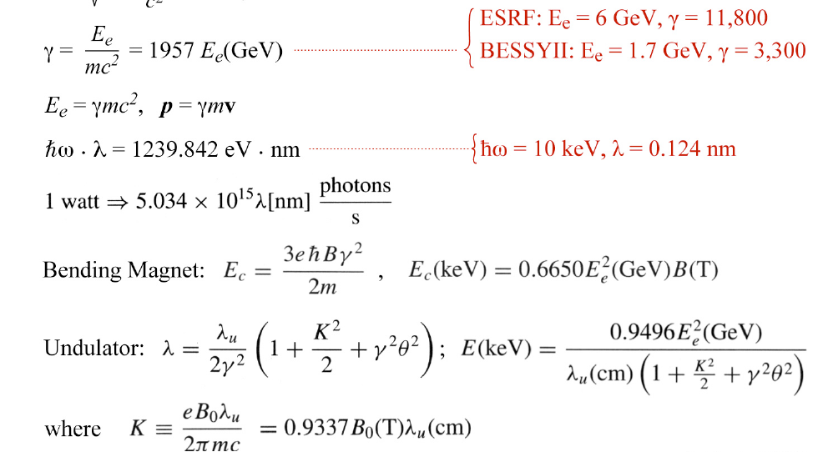
Some useful formulas for SR

Slide 21
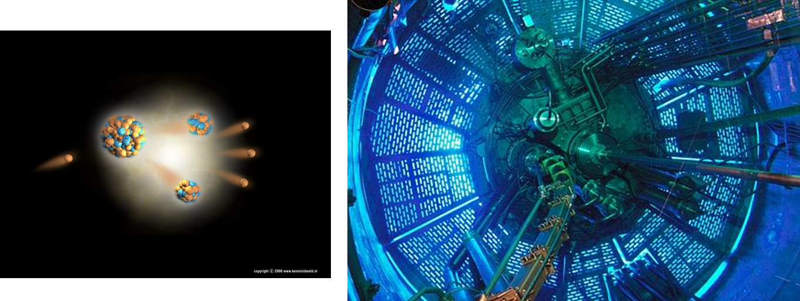
Production of neutrons
Nuclear reactor
(ILL Grenoble, Orphée Saclay, Berlin, Munchen)
Fission products
n
n
n
n
Energy release 1-2 MeV
Fission reaction Of ²³⁵U
Power of a scientific reactor is much smaller than that of nuclear electricity plant.
ILL 48 MW to be compared with 800 MW of each of 6 reactors in Fukushima.
Created neutrons are moderated in heavy water D₂O
Energy is decreased from 1 MeV to few meV after several dm.
Depending on energies we speak about hot (≥ 100 meV), thermal (25 meV) or cold neutrons (≤ 10 meV)
Blue Cherenkov Emission.
Neutrons are produced as a continuous flux with a Maxwell distribution in energy.

Slide 22

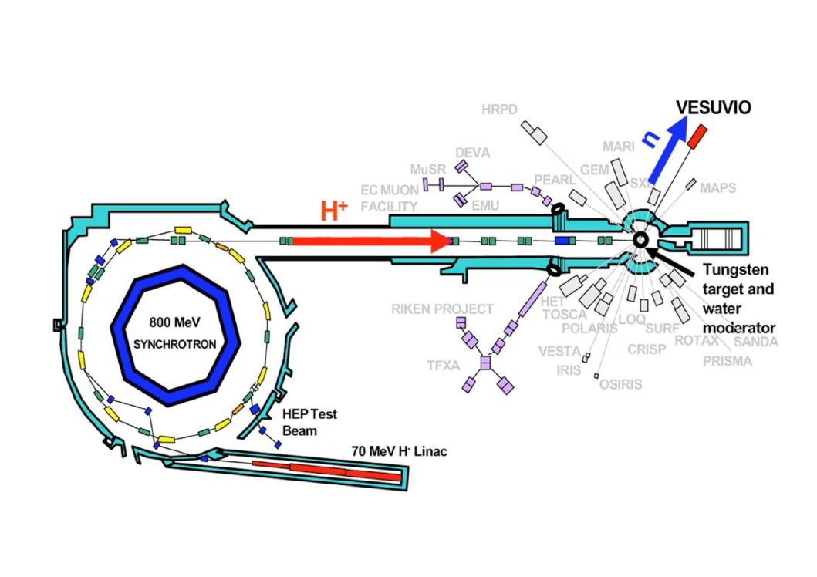
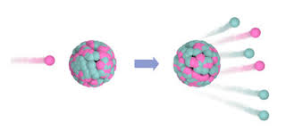
Production of neutrons
Spallation sources
ISIS GB, SINQ CH, ESS to come in Lünd Sweden
n
(few MeV)
W nucleus
P
(1GeV)
p
n
p
Also these produced neutrons need to be moderated
Muons and other particles are also produced.
Neutrons come on samples as a white pulsed beam
n
n

Slide 23
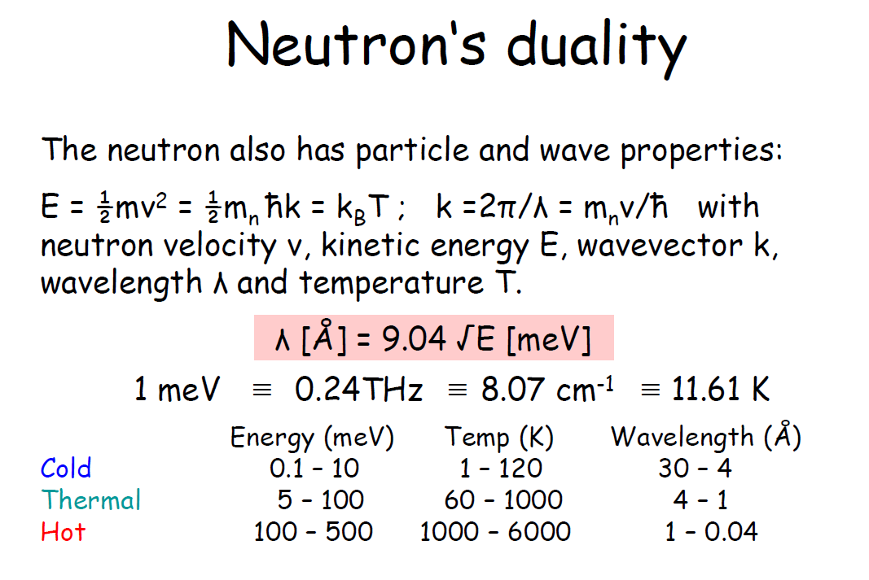
Courtesy: F.W. Kuhs – Hercules course

Slide 24



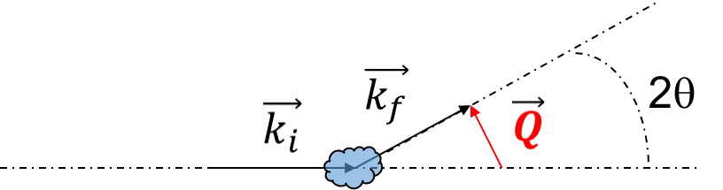
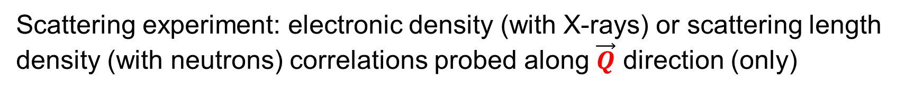
Detector
source
Scattering experiment: electronic density (with X-rays) or scattering length density (with neutrons) correlations probed along $\vec{Q}$ direction (only)
Courtesy: S. Pouget

Slide 25
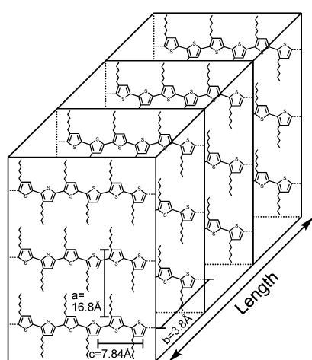
θ
2θ
A large majority of fibrils are in the same orientation respectively to the substrate

Slide 26
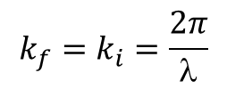
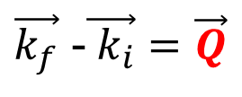




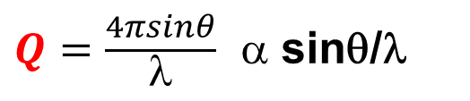
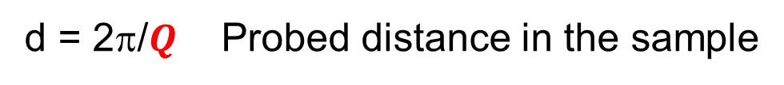

Scattering experiment - basics
Detector
2θ
Source
Bragg relation $λ=2d\sin{θ}$ gives
d = 2π/$Q$ Probed distance in the sample
= 0,05 deg => d ~ 100 nm
θ = 20 deg => d ~ 2 Å
Small Angle X-rays or neutron scattering
λ=1,54 Å
Wide Angle X-rays or neutron scattering
Synchrotron sources: λ=0,1 – 100 Å (100 – 0.1 keV)
Neutron sources: λ=0.04 - 30 Å (500 – 0.1 meV)
Courtesy: S. Pouget

Slide 27
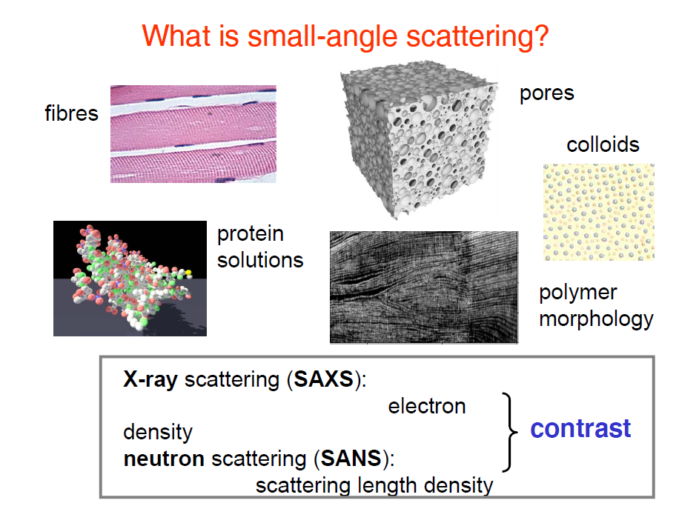
d
(nm)
Q
(nm⁻¹)
1
1
100
0,01
Courtesy: M. Müller – Hercules 2014

Slide 28
Grazing incidence X-ray diffraction measurements (GIXRD)
Principle
2θ
α
In reflection (out-of-plane geometry)
This is a side view
The layer to be probed is typically from (30 to 400 nm thick)

Slide 29
Grazing incidence X-ray diffraction measurements (GIXRD)
2θ
α
α
In-plane geometry
This is a TOP view – q is contained in the plane
The detection plane is parallel to the plane of the sample

Slide 30
Grazing incidence X-ray diffraction measurements (GIXRD)
Crystallinity of the deposited layer
Preferred orientation of the deposited layer long axis ordering of polymers or molecules)
Mosaics : distribution in-plane or out-of-plane of chain or molecules orientation
Depth profiling of a given layer: evolution of the stacking mode of molecules from the first molecular layers on the substrate to the very surface
Q
(Å⁻¹)
1
0,03
d
(Å)
1
30

Slide 31
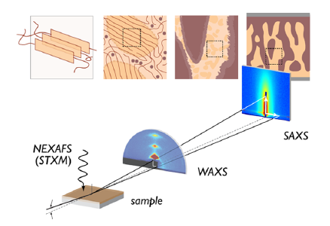

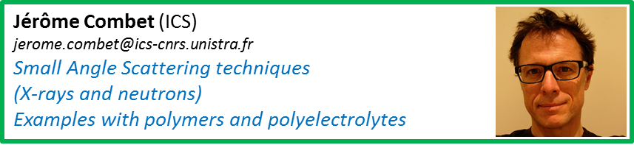
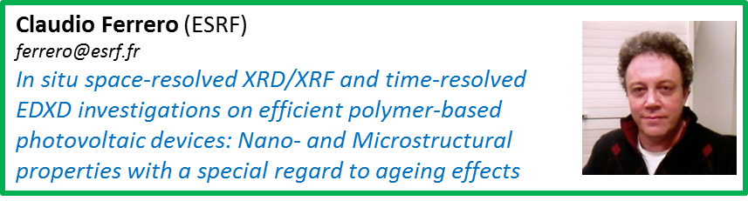
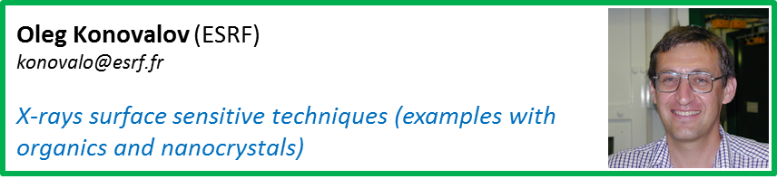

To travel through a multiscale world follow the guides !!!
Almost exclusively based on radiation scattering/diffraction
Measurements in the Q space.
J. Rivnay et al., Chem. Rev. 112 (2012) 5488.

Slide 32
Synchrotron radiation properties
High energies (up to 500keV) ==> High penetration of X-rays in matter, non destructive bulk studies .
High flux, high brightness (10⁹-10¹⁰ ratio compared to lab. X-rays sources) ==> Fast data acquisition < 5 ms (240 frames/s), can study fast and irreversible transformations (chemical kinetics, phase transitions…).
Very broad energy spectrum possible from IR to High energy X-rays, IR, UV, Raman spectroscopy possible.
Tunable incoming energy ==> Possibility for distinguishing chemical elements, x-rays absorption spectroscopy (XANES & EXAFS), anomalous scattering, tomography.
Very small spatial divergence of X-ray beam.
Can focus the X-rays beam to very small size (nowadays perspective is < 20 nm) ==> diffraction mapping, microscopy.
Polarized beam.
Temporal structure (in the storage ring different modes of filling are possible and packets of accelerated electrons are more or less numerous➔ possibility to do kinematical studies)

Slide 33
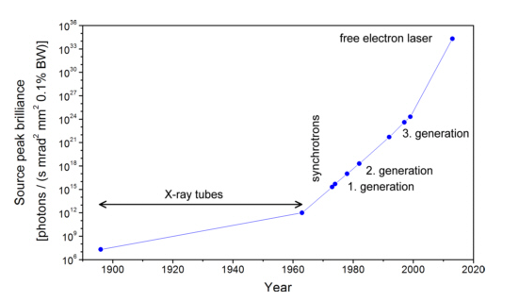
Historical evolution of X-rays sources brilliance

Slide 34
Synchrotron radiation properties
High energies (up to 500keV) ==> High penetration of X-rays in matter, non destructive bulk studies .
High flux, high brightness (10⁹-10¹⁰ compared to lab. X-rays sources) ==> Fast data acquisition < 5 ms (240 frames/s), can study fast and irreversible transformations (chemical kinetics, phase transitions…).
Very broad energy spectrum possible from IR to High energy X-rays, IR, UV, Raman spectroscopy possible.
Tunable incoming energy ==> Possibility for distinguishing chemical elements, x-rays absorption spectroscopy (XANES & EXAFS), anomalous scattering, tomography.
Very small spatial divergence of X-ray beam.
Can focus the X-rays beam to very small size (nowadays perspective is < 20 nm) ==> diffraction mapping, microscopy.
Polarized beam.
Temporal structure (in the storage ring different modes of filling are possible and packets of accelerated electrons are more or less numerous➔ possibility to do kinematical studies)

Slide 35

To travel through a multiscale world follow the guides !!!
To probe the material at distances longer
than 50 nm with different resolutions and
to image in the real space nano-or
micromorphology in 2D or 3D, other
experiments are possible :
Tomography
Phase contrast imaging
µ-fluorescence
Full field diffraction imaging
Coherent scattering (ptychography)
Resonant scattering of soft X-rays
Moreover, the possibility to tune the incident
energy allows to develop different
spectroscopies as:
X-rays absorption spectroscopy
X-rays emission spectroscopy
X-ray Raman scattering
Chiara Cavallari (ESRF)
chiara.cavallari@esrf.fr
X-rays spectroscopy
J. Rivnay et al., Chem. Rev. 112 (2012) 5488.

Slide 36

To travel through a multiscale world follow the guides !!!
To probe the material at distances longer
than 50 nm with different resolutions and
to image in the real space nano-or
micromorphology in 2D or 3D, other
experiments are possible :
Tomography
Phase contrast imaging
µ-fluorescence
Full field diffraction imaging
Coherent scattering (ptychography)
Resonant scattering of soft X-rays
Moreover, the possibility to tune the incident
energy allows to develop different
spectroscopies as:
X-rays absorption spectroscopy
X-rays emission spectroscopy
X-ray Raman scattering
Julie Villanova (ESRF)
julie.villanova@esrf.fr
X-rays nanotomography

Slide 37

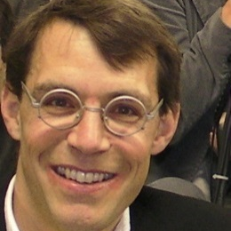

To travel through a multiscale world follow the guides !!!
To probe the material at distances longer
than 50 nm with different resolutions and
to image in the real space nano-or
micromorphology in 2D or 3D, other
experiments are possible :
Tomography
Phase contrast imaging
µ-fluorescence
Full field diffraction imaging
Coherent scattering (ptychography)
Resonant scattering of soft X-rays
Moreover, the possibility to tune the incident
energy allows to develop different
spectroscopies as:
X-rays absorption spectroscopy
X-rays emission spectroscopy
X-ray Raman scattering
Peter Reiss (INAC)
peter.reiss@cea.fr
In situ measurement of crystal growth
of nanocrystals and perovskites layers at ESRF
Tobias Schülli (ESRF)
tobias.schulli@esrf.fr
Bragg diffraction based imaging techniques
Tao Zhou (ESRF)
tao.zhou@esrf.fr
The new full field diffraction x-ray microscope at ID01:
new possibilities for in situ and operando experiments

Slide 38
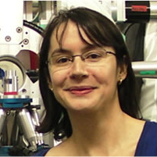
To travel through a multiscale world follow the guides !!!
To probe the material at distances longer
than 50 nm with different resolutions and
to image in the real space nano-or
micromorphology in 2D or 3D, other
experiments are possible :
Tomography
Phase contrast imaging
µ-fluorescence
Full field diffraction imaging
Coherent scattering (ptychography)
Resonant scattering of soft X-rays
Moreover, the possibility to tune the incident
energy allows to develop different
spectroscopies as:
X-rays absorption spectroscopy
X-rays emission spectroscopy
X-ray Raman scattering
Marie-Ingrid Richard (ESRF)
marie-ingrid.richard@esrf.fr
X-rays coherent scattering and its future developments
J. Rivnay et al., Chem. Rev. 112 (2012) 5488.

Slide 39
Synchrotron radiation properties
High energies (up to 500keV) ==> High penetration of X-rays in matter, non destructive bulk studies .
High flux, high brightness (10⁹-10¹⁰ compared to lab. X-rays sources) ==> Fast data acquisition < 5 ms (240 frames/s), can study fast and irreversible transformations (chemical kinetics, phase transitions…).
Very broad energy spectrum possible from IR to High energy X-rays, IR, UV, Raman spectroscopy possible.
Tunable incoming energy ==> Possibility for distinguishing chemical elements, x-rays absorption spectroscopy (XANES & EXAFS), anomalous scattering, tomography.
Very small spatial divergence of X-ray beam.
Can focus the X-rays beam to very small size (nowadays perspective is < 20 nm) ==> diffraction mapping, microscopy.
Polarized beam.
Temporal structure (in the storage ring different modes of filling are possible and packets of accelerated electrons are more or less numerous➔ possibility to do kinematical studies)

Slide 40

To travel through a multiscale world follow the guides !!!
To probe the material at distances longer
than 50 nm with different resolutions and
to image in the real space nano-or
micromorphology in 2D or 3D, other
experiments are possible :
Tomography
Phase contrast imaging
µ-fluorescence
Full field diffraction imaging
Coherent scattering (ptycography)
Resonant scattering of soft X-rays
Moreover, the possibility to tune the incident
energy allows to develop different
spectroscopies as:
X-rays absorption spectroscopy
X-rays emission spectroscopy
X-ray Raman scattering
Nicolas Jaouen (SOLEIL)
nicolas.jaouen@synchrotron-soleil.fr
Soft X-rays (coherent) resonant scattering
and its potential in the field of
polymers and organic electronics
J. Rivnay et al., Chem. Rev. 112 (2012) 5488.

Slide 41

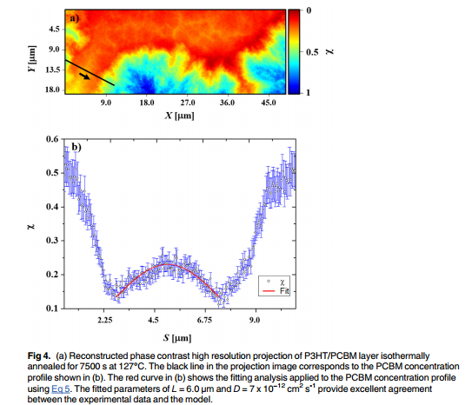
X-Ray Imaging -> back to real space
P3HT/PCBM blend
Coherent diffraction imaging
(PCBM concentration)
PCBM concentration distribution
Phase contrast imaging
High resolution (>10nm)
Long counting time…
hν=6.2 keV
Patil N, et al. (2016) X-Ray Nanoscopy of a Bulk Heterojunction. PLoS ONE 11(7): e0158345. doi:10.1371/journal.pone.0158345
Courtesy: S. Pouget

Slide 42
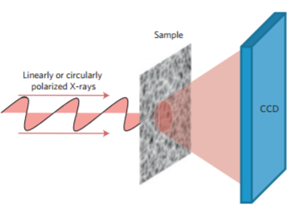
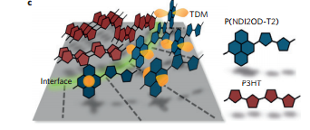



P-SoXS
Donor/acceptor blend P3HT/P(NDI2OD-T2)
Resonent scattering of polarised soft X-Ray (P-SoXS)
=> Energy tuning at a value characteristic of Carbon π orbital
=> Playing with beam polarization
hν=C1s->π*=285.3 eV
Relative molecular orientations at the donor/acceptor interface deduced from P-SoXS data.
300
100
D=2π/q (nm)
Collins B.A. et al, Nature Mater. 11, 536-543 (2012)

Slide 43

Structure
Multi-scale character
Dynamics
NEUTRONS
Incoherent quasi-elastic and inelastic neutron scattering are very good probes to study the proton and lattice dynamics in the 10⁻¹³ – 10⁻⁹ s time range.
It can be said that this dynamic disorder is also quasi-intrinsic to organic media and it is, in my view, impossible to ignore the electron-phonon coupling effects to fully understand the properties of materials involved in organic and hybrid electronics

Slide 44
A quasi-elastic neutron scattering experiment
Time of flight spectrometer
Detector
Detector
Q
2
Inelastic Scattering
k
2
E
>
E
k
>
k
Q
2
0
2
0
Q
1
k
Elastic Scattering
k
0
E
=
E
0
k
=
k
k
1
0
Inelastic Scattering
Sample
E
<
E
k
<
k
1
0
1
0
Incoming Neutrons
Energy
E
0

Slide 45
The number of scattered neutrons as a function
of the energy exchange is measured.
One spectrum in energy is obtained for each value of Q (or θ).

Slide 46

Mohamed Zbiri (ILL)
zbiri@ill.fr
Introduction to Quasielastic and Inelastic Neutron
Scattering, and Role of Atomistic Simulations

Slide 47

Anne Guilbert (Imperial College)
a.guilbert09@imperial.ac.uk
Insight in the dynamics of organic photovoltaic active
layer: a combined approach of neutron scattering and
atomistic simulations
Anne A.Y. Guibert et al.,
Chem. Mater. 2015, 27, 7652 - 7661
Osiris
IN16

Slide 48

I declare
open !!!!

