Slide 1
In situ space-resolved XRD/XRF investigations on polymer-based photovoltaic devices: Nano- and Microstructural properties with a special regard to ageing effects
Barbara Paci, Jon Wright, Claudio Ferrero

Slide 2
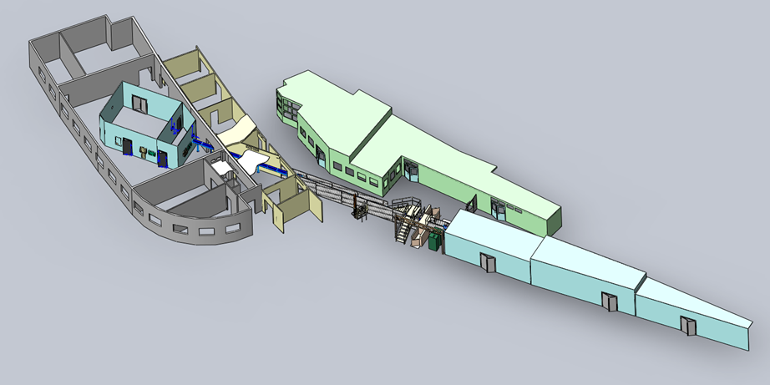
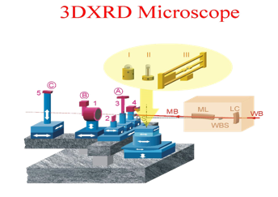
ID11 Materials Science beamline
High Resolution / sub-micron beams
Heavy duty
ID11 is a beamline dedicated to moderate to high energy diffraction and/or imaging studies of a variety of systems of interest for their physical, mechanical, or chemical properties. Very high spatial (<100 nm) and time (1 ms) resolution are available.

Slide 3
ID11 Materials Science beamline
X-ray source
The light source at ID11 is provided by an in-vacuum undulator, of which there are two available which differ in period and magnetic lattice. The coherence and source size of the beam has been measured as ~18.5 micron FWHM vertically.
Primary optics
Energy selection: ID11 uses a double bent crystal monochromator operating in horizontal Laue geometry to select the energy / wavelength of the beam. The maximum energy range available is from 18 – 140 keV, though operationally, ID11 is optimized to work at energies above 35 keV.
Focusing: To focus the beam, ID11 has an in vacuum transfocator, which consists of 8 cylinders with 1, 2, 4, 8, 16, and 32 Be lenses, 32 and 64 Al lenses, and one with a pinhole. By combining these sets of lenses it is possible to focus throughout the entire energy range in high resolution hutch (smallest focal spot size ~50x220 microns), and up to 70 keV in the heavy duty hutch (focal spot ~ 7x45 microns).

Slide 4
ID11 Materials Science beamline
ID11 is a multidisciplinary beamline, offering a range of diffraction techniques (from high speed 1D point scans to 3D crystallographic reconstructions) whilst working with a wide variety of materials (from nano-crystalline glasses to metal samples).
ID11 is principally a diffraction beamline but it offers a number of techniques under this heading. Samples analysed here range from the amorphous (use e.g. the PDF technique), to powder (powder XRD), poly-crystals (3D-XRD and DCT techniques) and single crystals.
Sample size can vary from nano, micro, to large scale samples and take the form of individual crystallites, films or bulk materials. Tomography detectors are also available at the beamline so X-ray contrast tomography techniques are also available, though these are usually only offered in conjunction with other diffraction techniques.

Slide 5
ID11 Materials Science beamline
Applications
Structural materials
Energy materials
Hydrogen storage materials
Batteries
Fuel Cells
Engineering materials
Microelectronics materials
Metallurgy
Automotive
Aviation
Functional Materials
Techniques
XRD - X-ray diffraction (single crystal)
Powder diffraction
Diffraction contrast tomography
Diffuse X-ray scattering
XRI – X-ray Imaging
XRF – X-ray fluorescence
Pair-distribution function (PDF) analysis
Energy range
18.0 - 140.0 keV
Beam size
Minimum (H x V) : 0.2 x 0.07 µm²
Maximum (H x V) : 1200.0 x 1000.0 µm²

Slide 6
ID11 Materials Science beamline
Sample environments
Nanometre precision translations
Nitrogen cooling airgun
Helium cooling airgun
Moderate temperature oven
High temperature oven
Stress rig
Detectors
FReLoN2k with fibre-optic coupling
FReLoN4m with fibre-optic coupling
FReLoN4m with high resolution microscope
Quantix imaging detector
Sensicam imaging detector
3D detector system
Technical details
Following the upgrade of the beamline to add a nano-resolution station at 100m, it is now possible to carry out very high spatial resolution simultaneous diffraction and imaging studies, allowing the mapping of materials with better than 100 nm resolution. Time resolution to 1 ms is available.

Slide 7
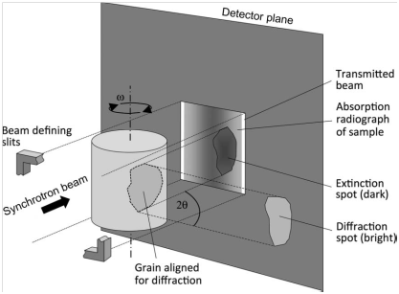
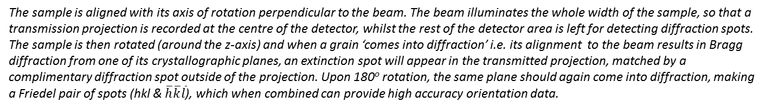
Diffraction Contrast Tomography (DCT)
DCT is a near-field diffraction-based imaging technique that provides high-resolution grain maps of polycrystalline materials. For each individual grain, the technique can provide orientation and average elastic strain tensor components with an accuracy of a few times 10⁻⁴. The technique combines the concepts of image reconstruction from projections (tomography) and X-ray diffraction imaging (topography).
The sample is aligned with its axis of rotation perpendicular to the beam. The beam illuminates the whole width of the sample, so that a transmission projection is recorded at the centre of the detector, whilst the rest of the detector area is left for detecting diffraction spots. The sample is then rotated (around the z-axis) and when a grain ‘comes into diffraction’ i.e. its alignment to the beam results in Bragg diffraction from one of its crystallographic planes, an extinction spot will appear in the transmitted projection, matched by a complimentary diffraction spot outside of the projection. Upon 180º rotation, the same plane should again come into diffraction, making a Friedel pair of spots (hkl & $\overline{h}\overline{k}\overline{l}$), which when combined can provide high accuracy orientation data.

Slide 8
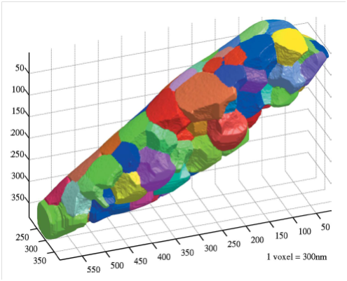
DCT – Data reduction
The DCT "grain tracking" is a complete package, capable of generating DCT maps from raw diffraction data. The complexity of the data reduction (and therefore of the degree of user 'involvement') is very much dependant of the condition of the sample

Slide 9
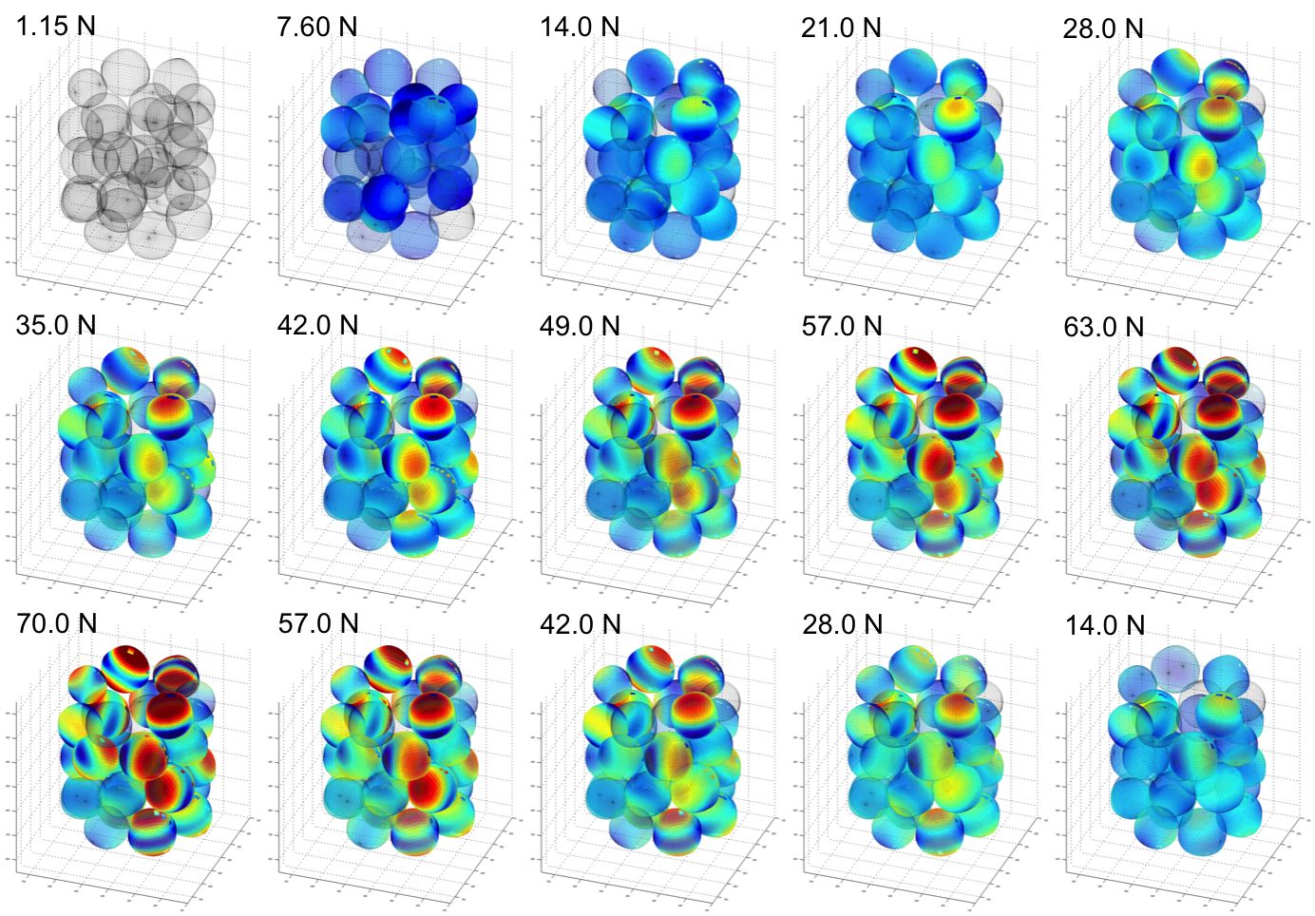
Diffraction Contrast Tomography - Synthetic quartz spheres
DCT is a near-field diffraction-based imaging technique that provides high-resolution grain maps of polycrystalline materials. For each individual grain, the technique can provide orientation and average elastic strain tensor components with an accuracy of a few times 10⁻⁴. The technique combines the concepts of image reconstruction from projections (tomography) and X-ray diffraction imaging (topography).
By polishing synthetic quartz spheres the internal structures could be removed to give clean data. Images show the surfaces of the spheres found from tomography coloured according to their strain tensors. Force chains are clearly evident.

Slide 10
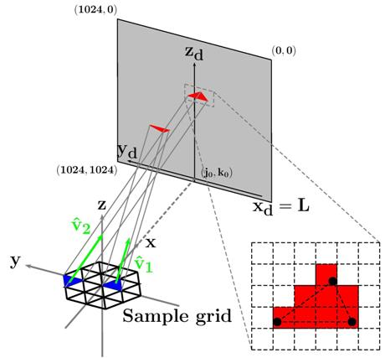
Grain mapping : data processing
Crystallographic information, unit cell + space group are input
3DXRD :
“tracking” principle
Index and reconstruct
2D layers
DCT :
Segmentation of spots
“Index” discrete orientations
Reconstruction of 3D volume
HEDM :
Forward projection
Supercomputer solves for voxel by voxel orientations
2D layers
Topo-Tomography :
Align on diffraction
Inclined axis
Reconstruct as for computed laminography
Schmidt et-al, Riso
Suter et-al, Carnegie Mellon
Ludwig et-al, INSA Lyon/ESRF
Notes:
Different groups have different software. All work well in expert hands.

Slide 11
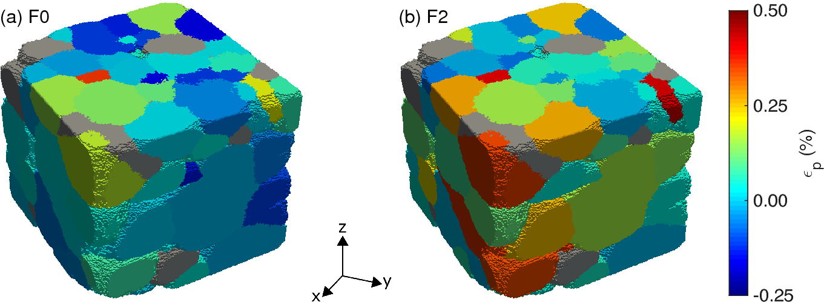
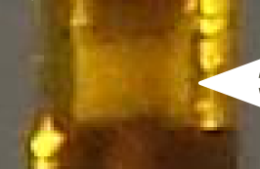
Majkut et al. J Am Ceram Soc 2016; 100: 393–402
Near field grain map for the same sample
Thermal annealing strains Electrically poled

Slide 12
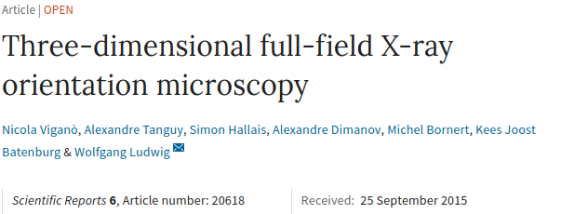
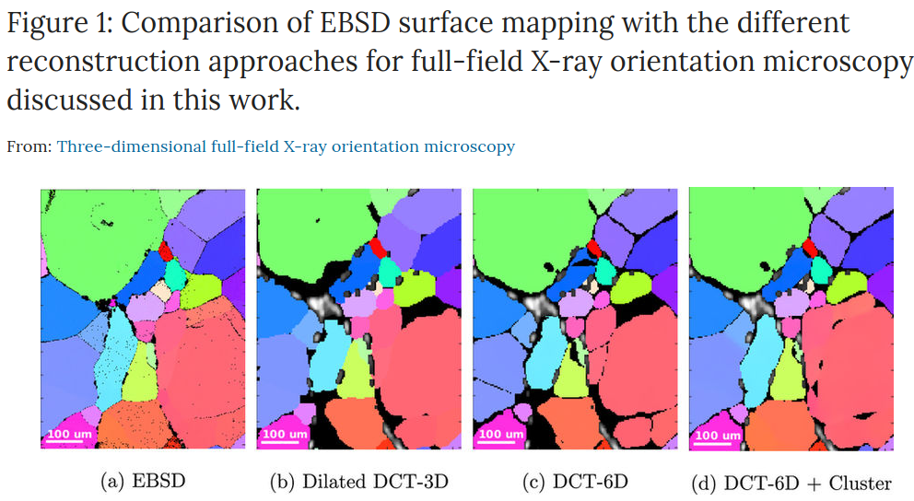

Slide 13
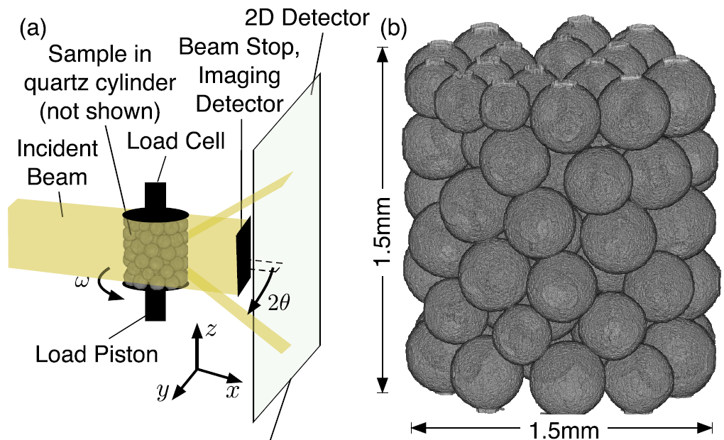
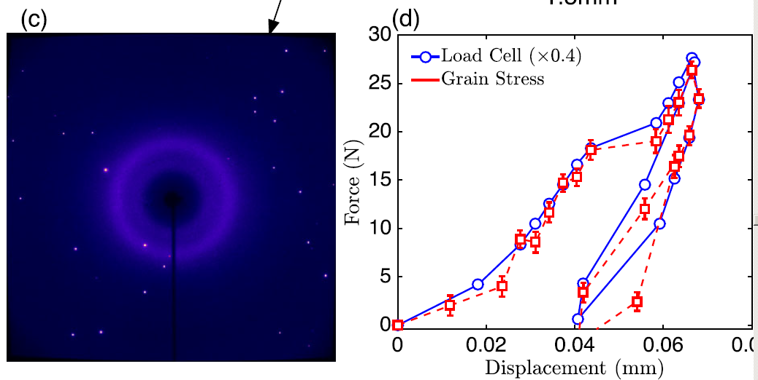
Larger system – Collaboration with Steve Hall, Ryan Hurley, Jose Andrade
Analysis of strain tensors
Solve inversion problem
Determined contact forces

Slide 14
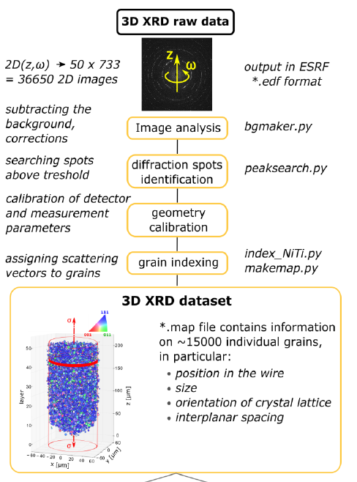
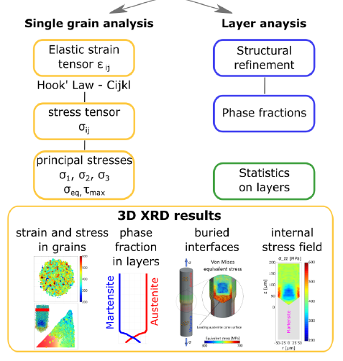
Workflow

Slide 15
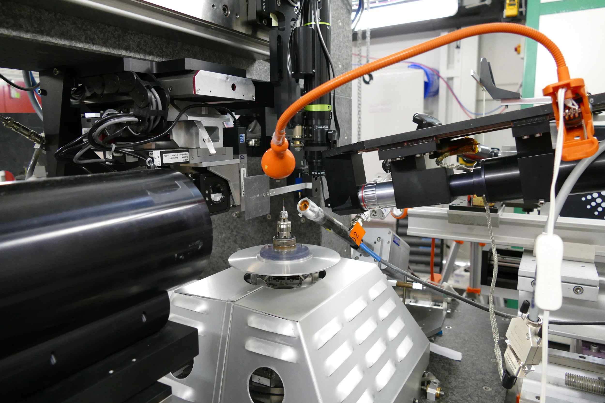
Nanofocus endstation

Slide 16
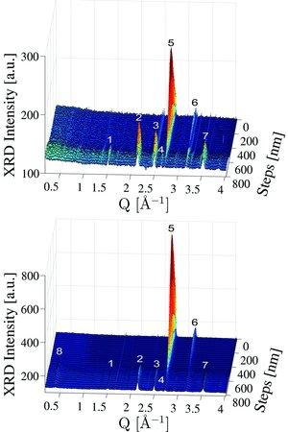
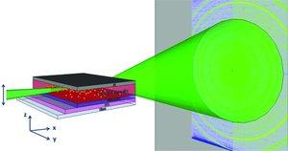
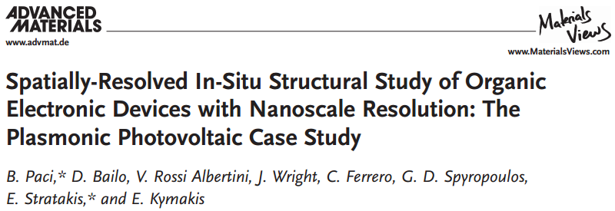
Higher real space resolution, smaller beams
Organic solar cells
Doped with Gold nanoparticles
Where is the Gold in the thin film
device ?

Slide 17
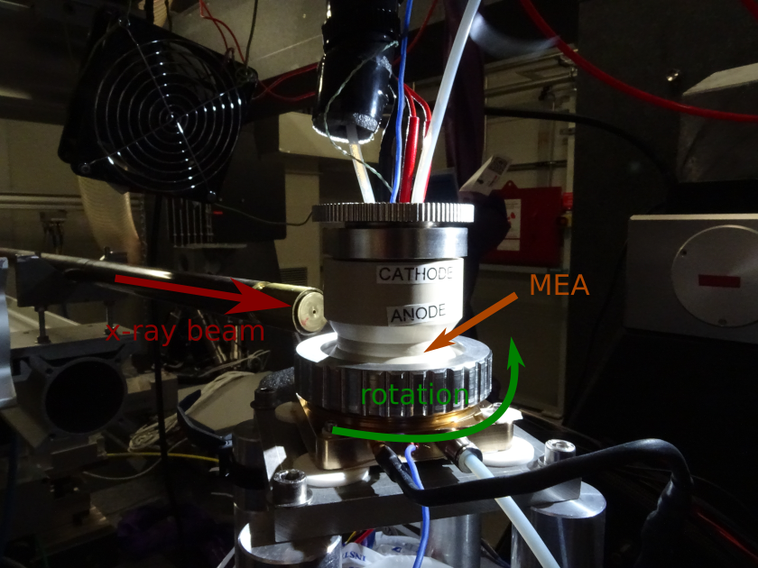
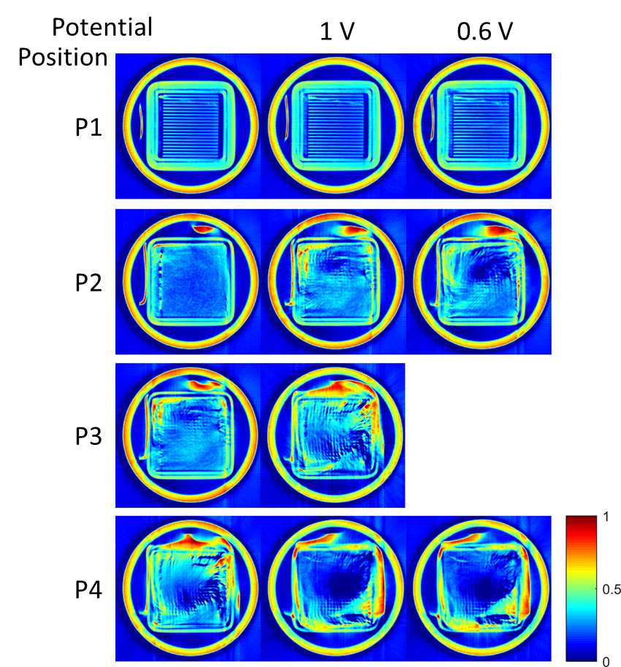
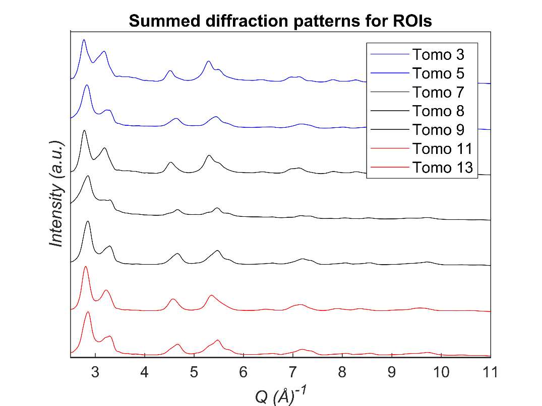
Proton Exchange Membrane (PEM) Fuel Cell studies - Jakub Drnec et al, ID31.
In-operando studies
Images of Pt diffraction peak at different heights (P1-P4) for three potentials (OCP, 1V, 0.6V).
Can also analyze carbon support, water, and Nafion membrane etc.
In operando : processes leading to the cell passivation.

Slide 18
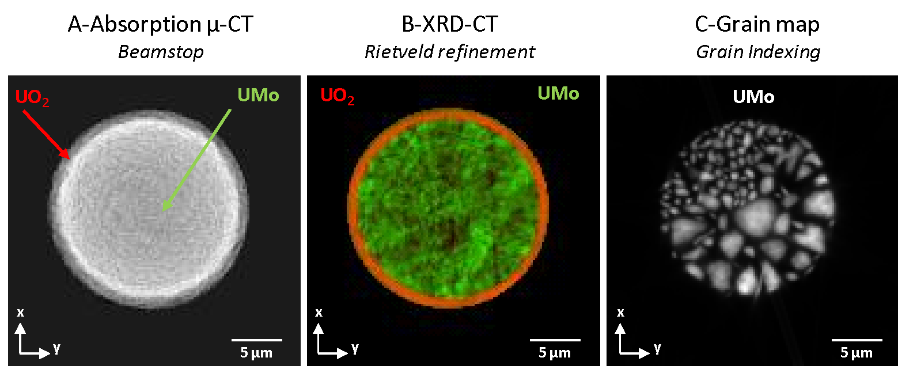
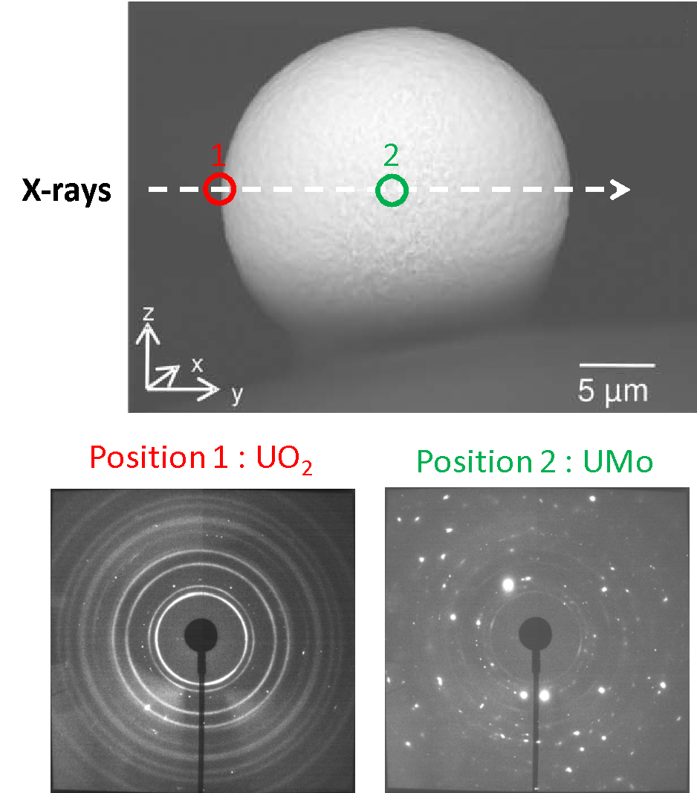
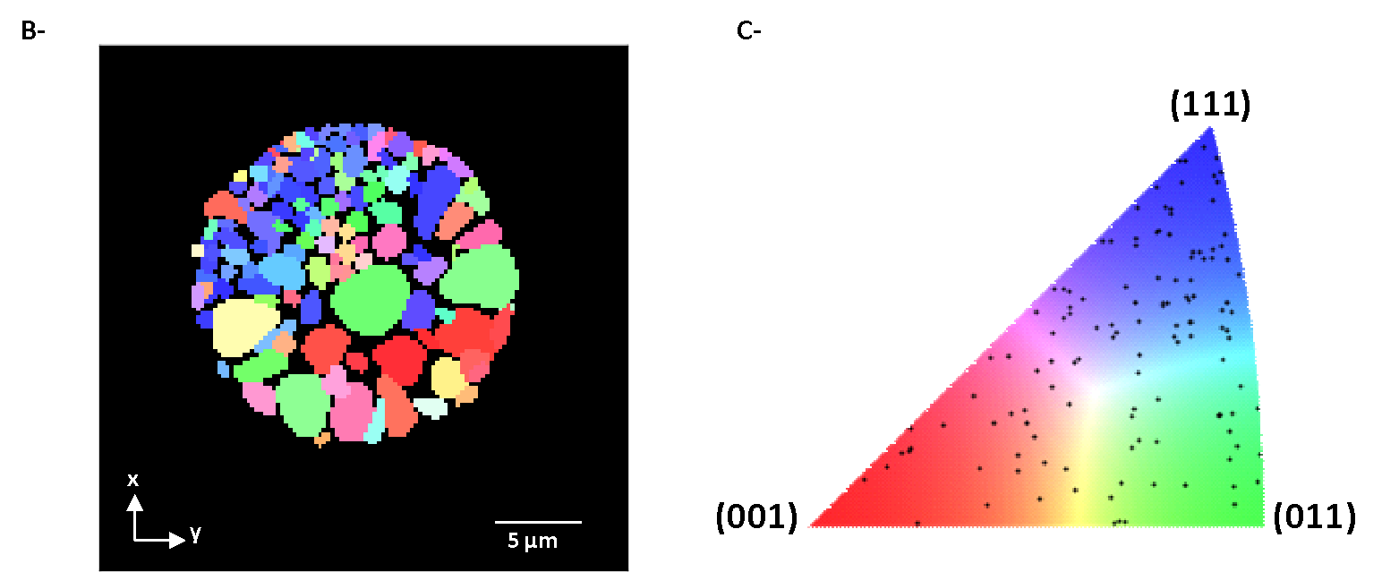
Index individual spots and reconstruct grain shapes
Impurity precipitation in atomized particles evidenced by high resolution diffraction tomography
Anne Bonnin, Jonathan Wright, Rémi Tucoulou, and Hervé Palancher,
APPLIED PHYSICS LETTERS 104, 121910 (2014)
Notes:
Comparison of the different modes on the top left:
A absorption
B powder diffraction XRD-CT
C grain map using indexing from ImageD11/fable
Bottom shows pole figure and colors according to orientation.
Fine grained UO2 on surface gives rings versus spotty UMo (big spots) and U(C,O) small spots.
Note the strong gradient in grain size distribution across the inside of the grain – all the small ones are on one side.
Initial aim was to link surface porosity to grain structure. Absorption was not quite there to do that.

Slide 19
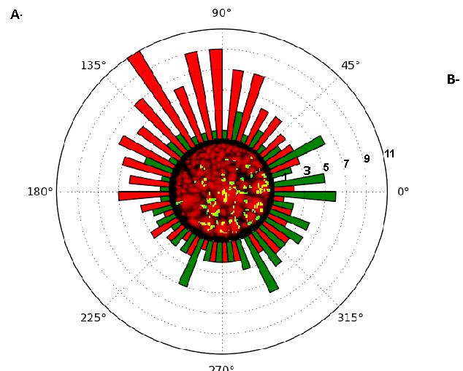
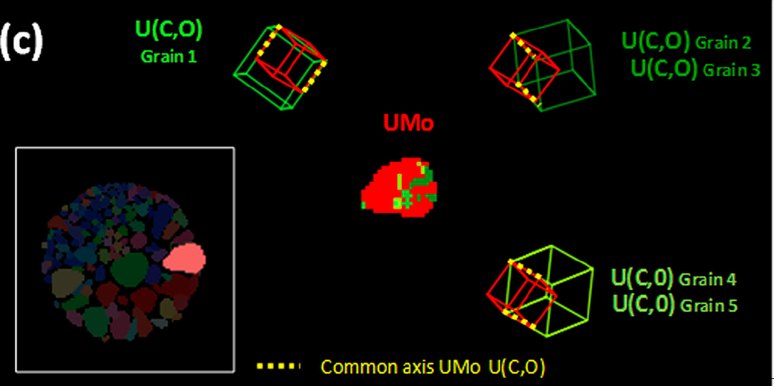
Trace impurity phase mapped out
1 wt% impurity phase
Clear orientation relationship between U(C,O) and UMo
Multiple U(C,O) domains in single UMo grain
Mainly found in larger UMo grains
Impurity precipitation in atomized particles evidenced by high resolution diffraction tomography
Anne Bonnin, Jonathan Wright, Rémi Tucoulou, and Hervé Palancher,
APPLIED PHYSICS LETTERS 104, 121910 (2014)
Notes:
Map out the trace impurity U(C,O) phase as well as the UMo.
Find the lattices are coherent with each other – shared axis, sqrt(2)xsqrt(2) for the other directions.
Within a single UMo grain we find all three directions for the smaller grains.
Tells that they form as a precipitate during solidification as opposed to acting as nucleation sites.
Present since you pour molten UMo onto a spinning graphite disk under vacuum.
Impurity is mainly associated to larger grains of UMo. Could be due to grain size and detection limit, or also cooling rate.
Mapped out the spatial location and role of a trace impurity phase. Detailed crystallographic information about orientation relationships.
Could not do this with EBSD as they do not succeed to cleave/polish the sample.

Slide 20
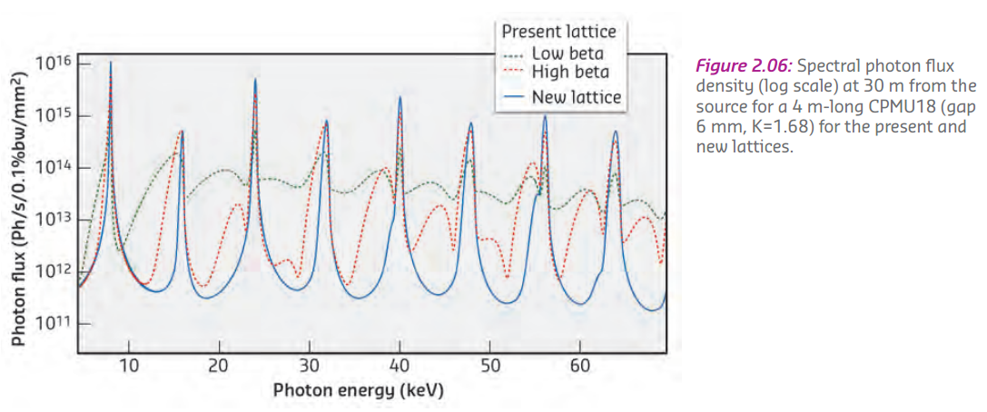
ESRF Upgrade Phase II : new machine
~40X more photons at ID11 after CRL optics
Cleaner spectrum (no need for monochromator?)

Slide 21

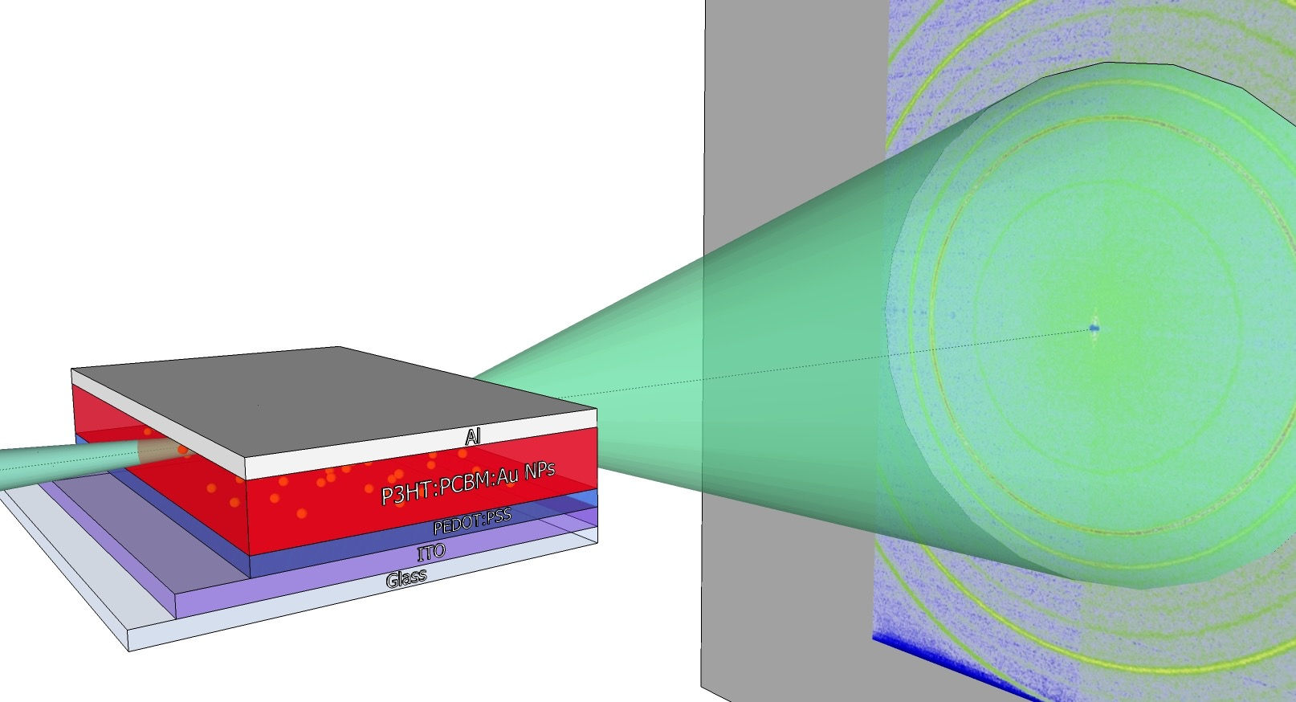

A NOVEL original approach to probe, in-situ bulk and interface properties of organic devices at the nanoscale:
Novel high spatial resolution (100nm) synchrotron X-ray diffraction stratigraphy technique performed in-situ onto an integrated plasmonic NPs-based organic photovoltaic device.
Demonstrating the capability of nanoscale probing the structural properties of each separate layer as well as the various interfaces comprising an organic electronic device
B.Paci et.al. Adv. Mater.
2013, 25, 4760–4765

Slide 24

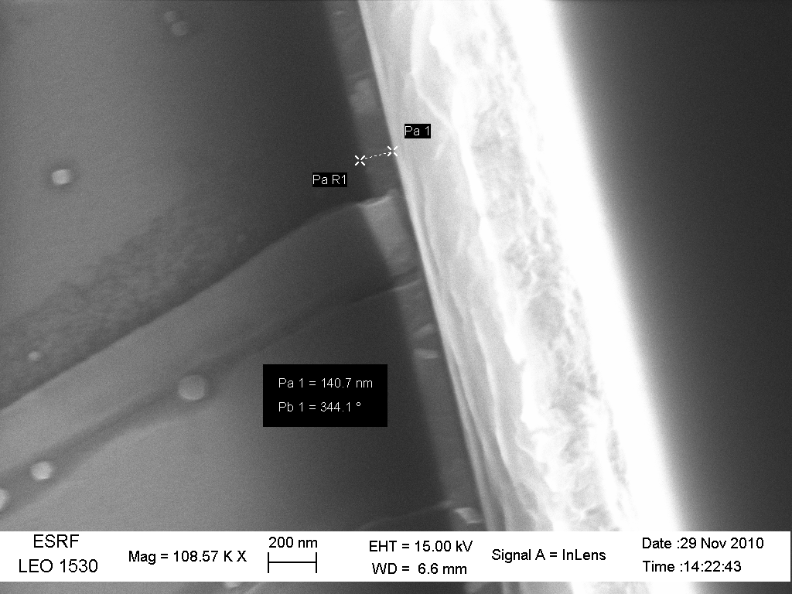
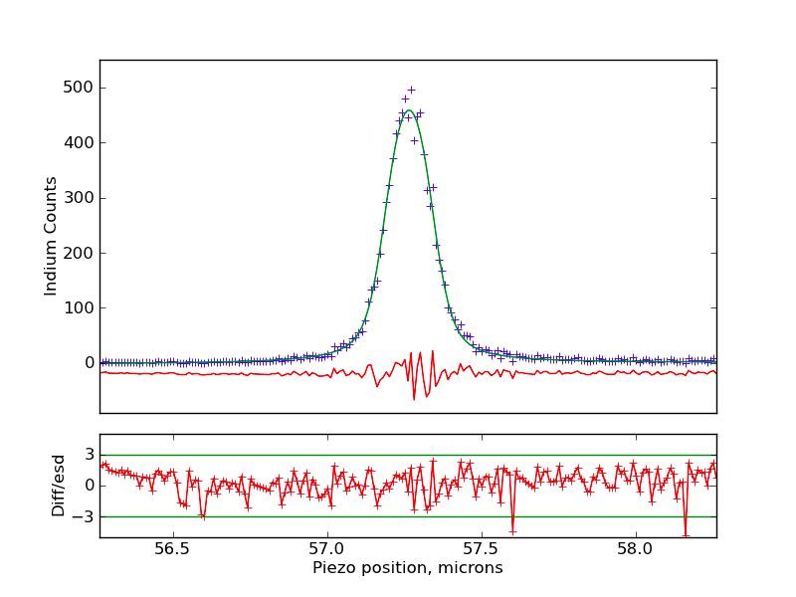
X-ray probe beam characteristics:
The incident beam spatial profile was measured recording In fluorescence
as a function of the position of the ITO film with respect to the beam.
A FWHM of 166(3) nm was calculated; SEM measurements indicate ITO thickness is 140nm, contributing significantly to the measured profile.
In fluorescence line as a function of ITO film position, with respect to the beam.
SEM: ITO layer thickness is 140 nm
We obtained a beam of FWHM of 89(5) nm. High spatial resolution !!!

Slide 25
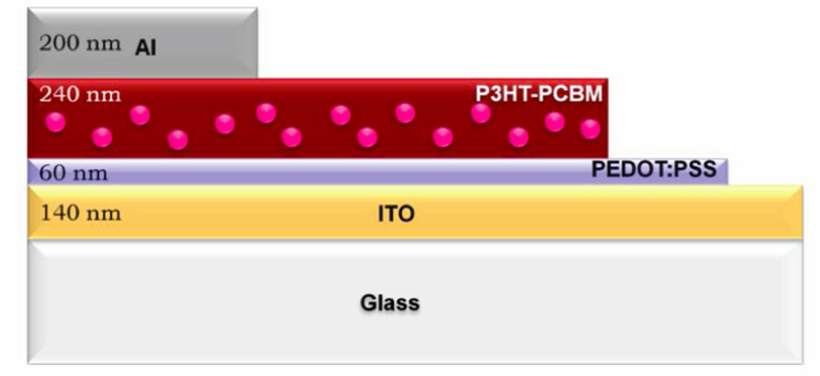
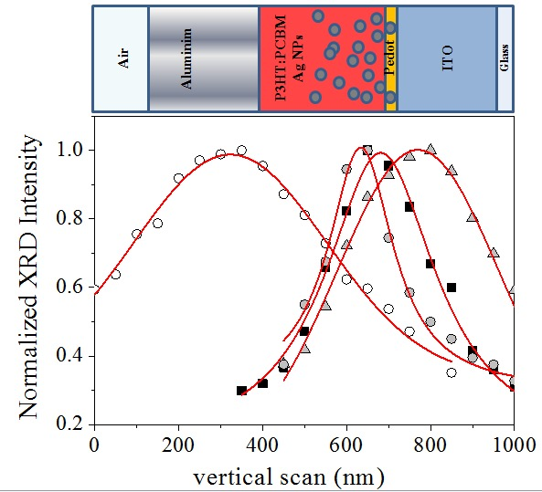
Local structure of organic devices:
In-situ spatially-resolved study:
An unprecedented approach combining X-ray diffraction (XRD) and fluorescence (XRF) with nanometre resolution.
By scanning the OPV cross-section with a ~100 nm focused X-ray beam, the structural properties of the different layers and interfaces comprising the device as well as the NPs distribution were in-situ monitored and investigated.

Slide 26
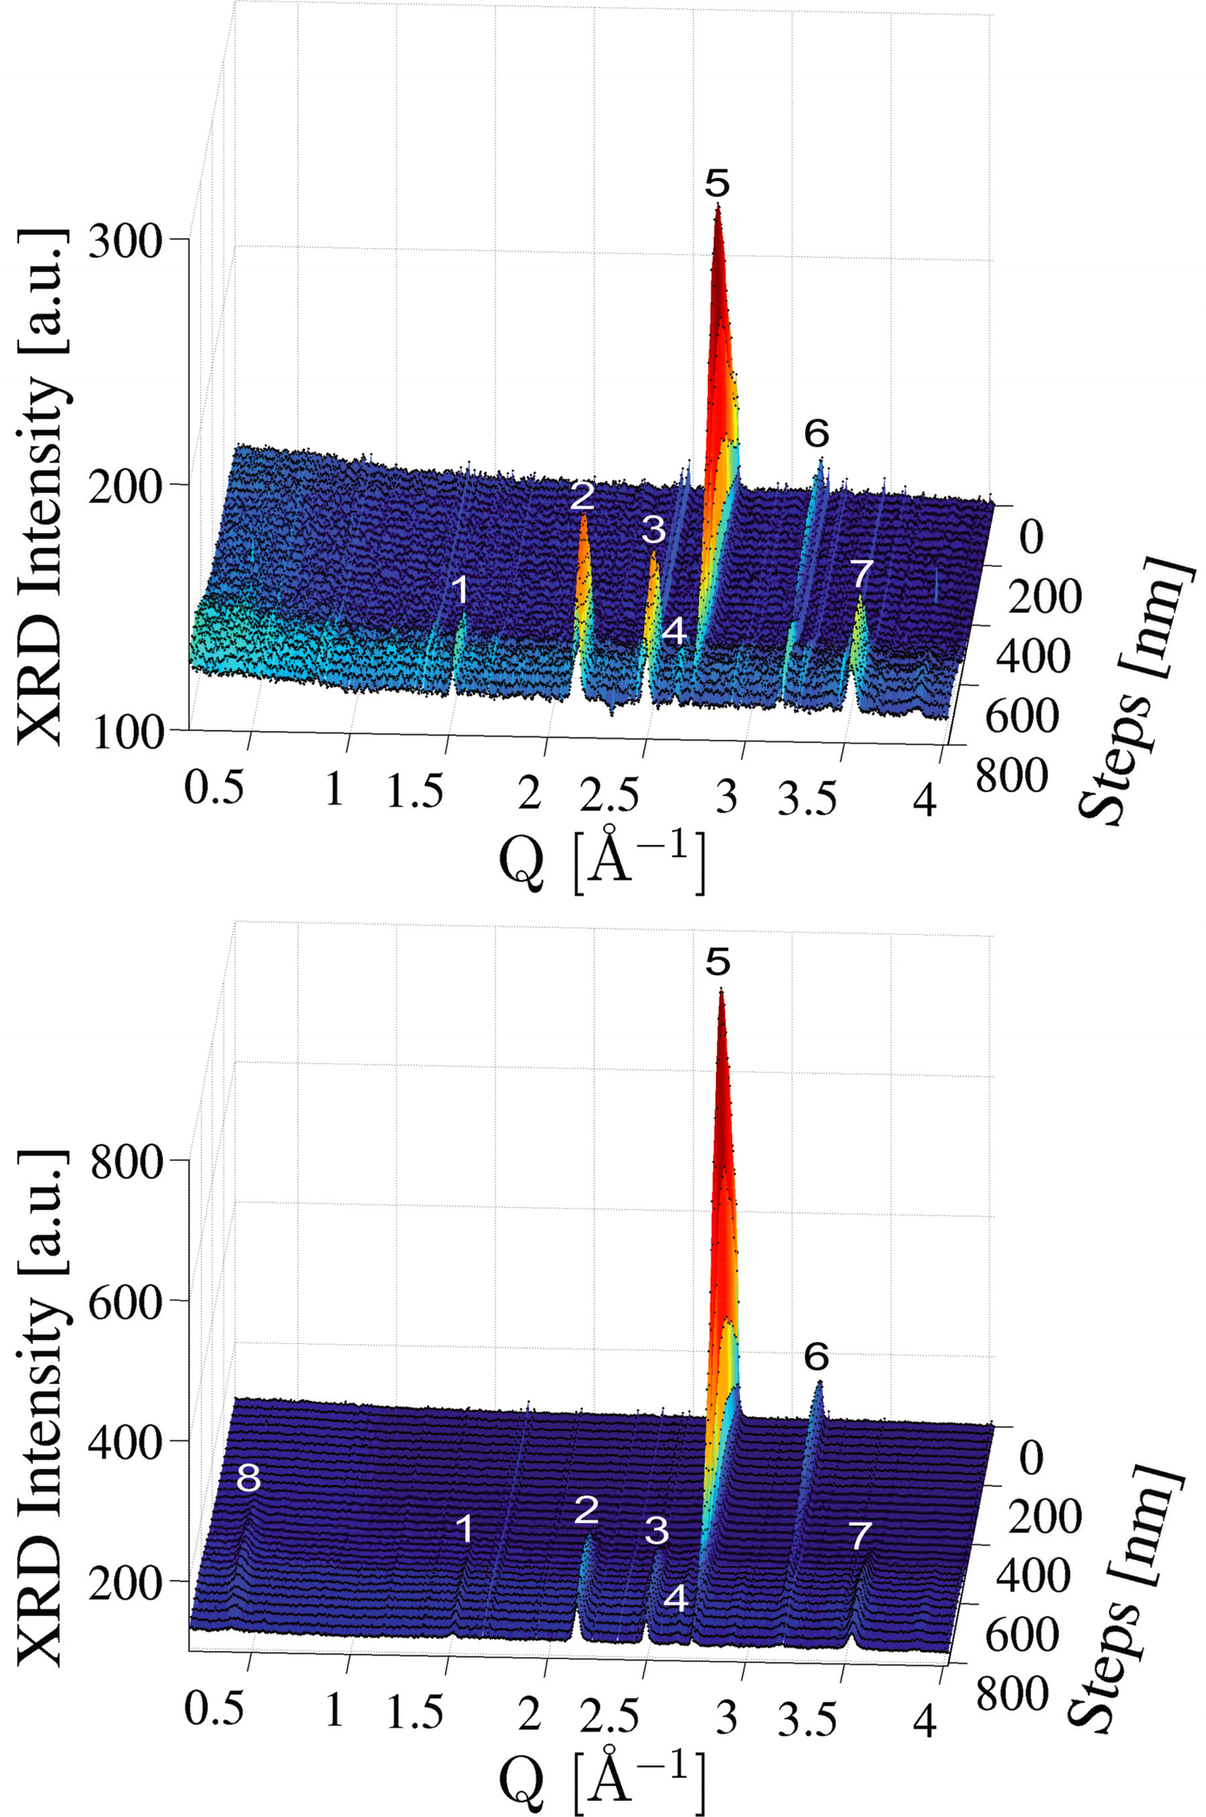
Local structure of organic devices: in-situ spatially-resolved study
Looking inside an organic device:
The measurements provided an accurate space-resolved description of the molecular ordering of the polymer component of the photo-active layer.
Such information is of significant importance, since the photovoltaic energy conversion rate strongly depends on the nanoscale phase separation during the donor/acceptor heterojunctions formation as well as the nanomorphology of the interfaces formed between the active and the charge-collecting layer.
The waterfall diagrams of XRD patterns

Slide 27
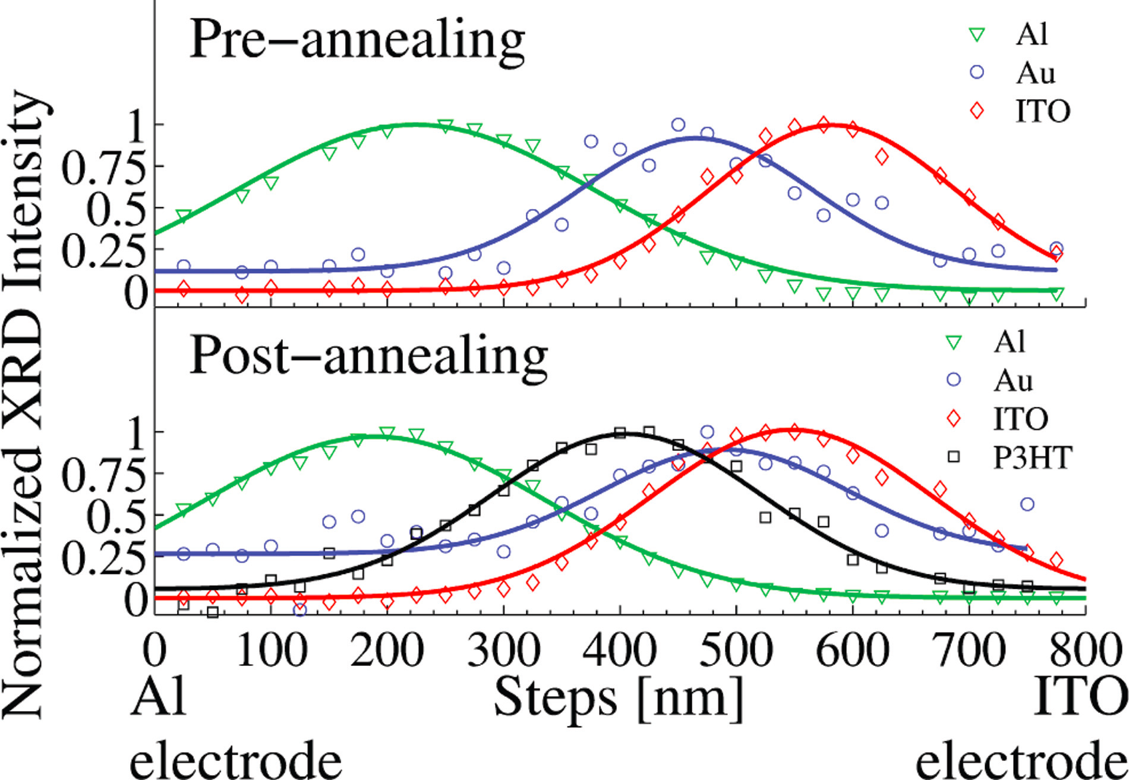
Nanoscale in-situ structural/morphological analysis of
plasmonic organic photovoltaic devices
The effect of in-situ annealing:
Thermal annealing performed in-situ during the X-ray experiment allowed monitoring as a function of the device depth the modification induced in the NPs distribution and on the structural properties of the organic layer.
The results uncovered the chemical-physical phenomena (i.e. modification of the local nanostructure and organization, interface effects, interdiffusion processes…) which occur as a consequence of the annealing process that is usually undergone to optimize organic solar cell effectiveness.
Normalized XRD Intensities versus the vertical scann

Slide 28
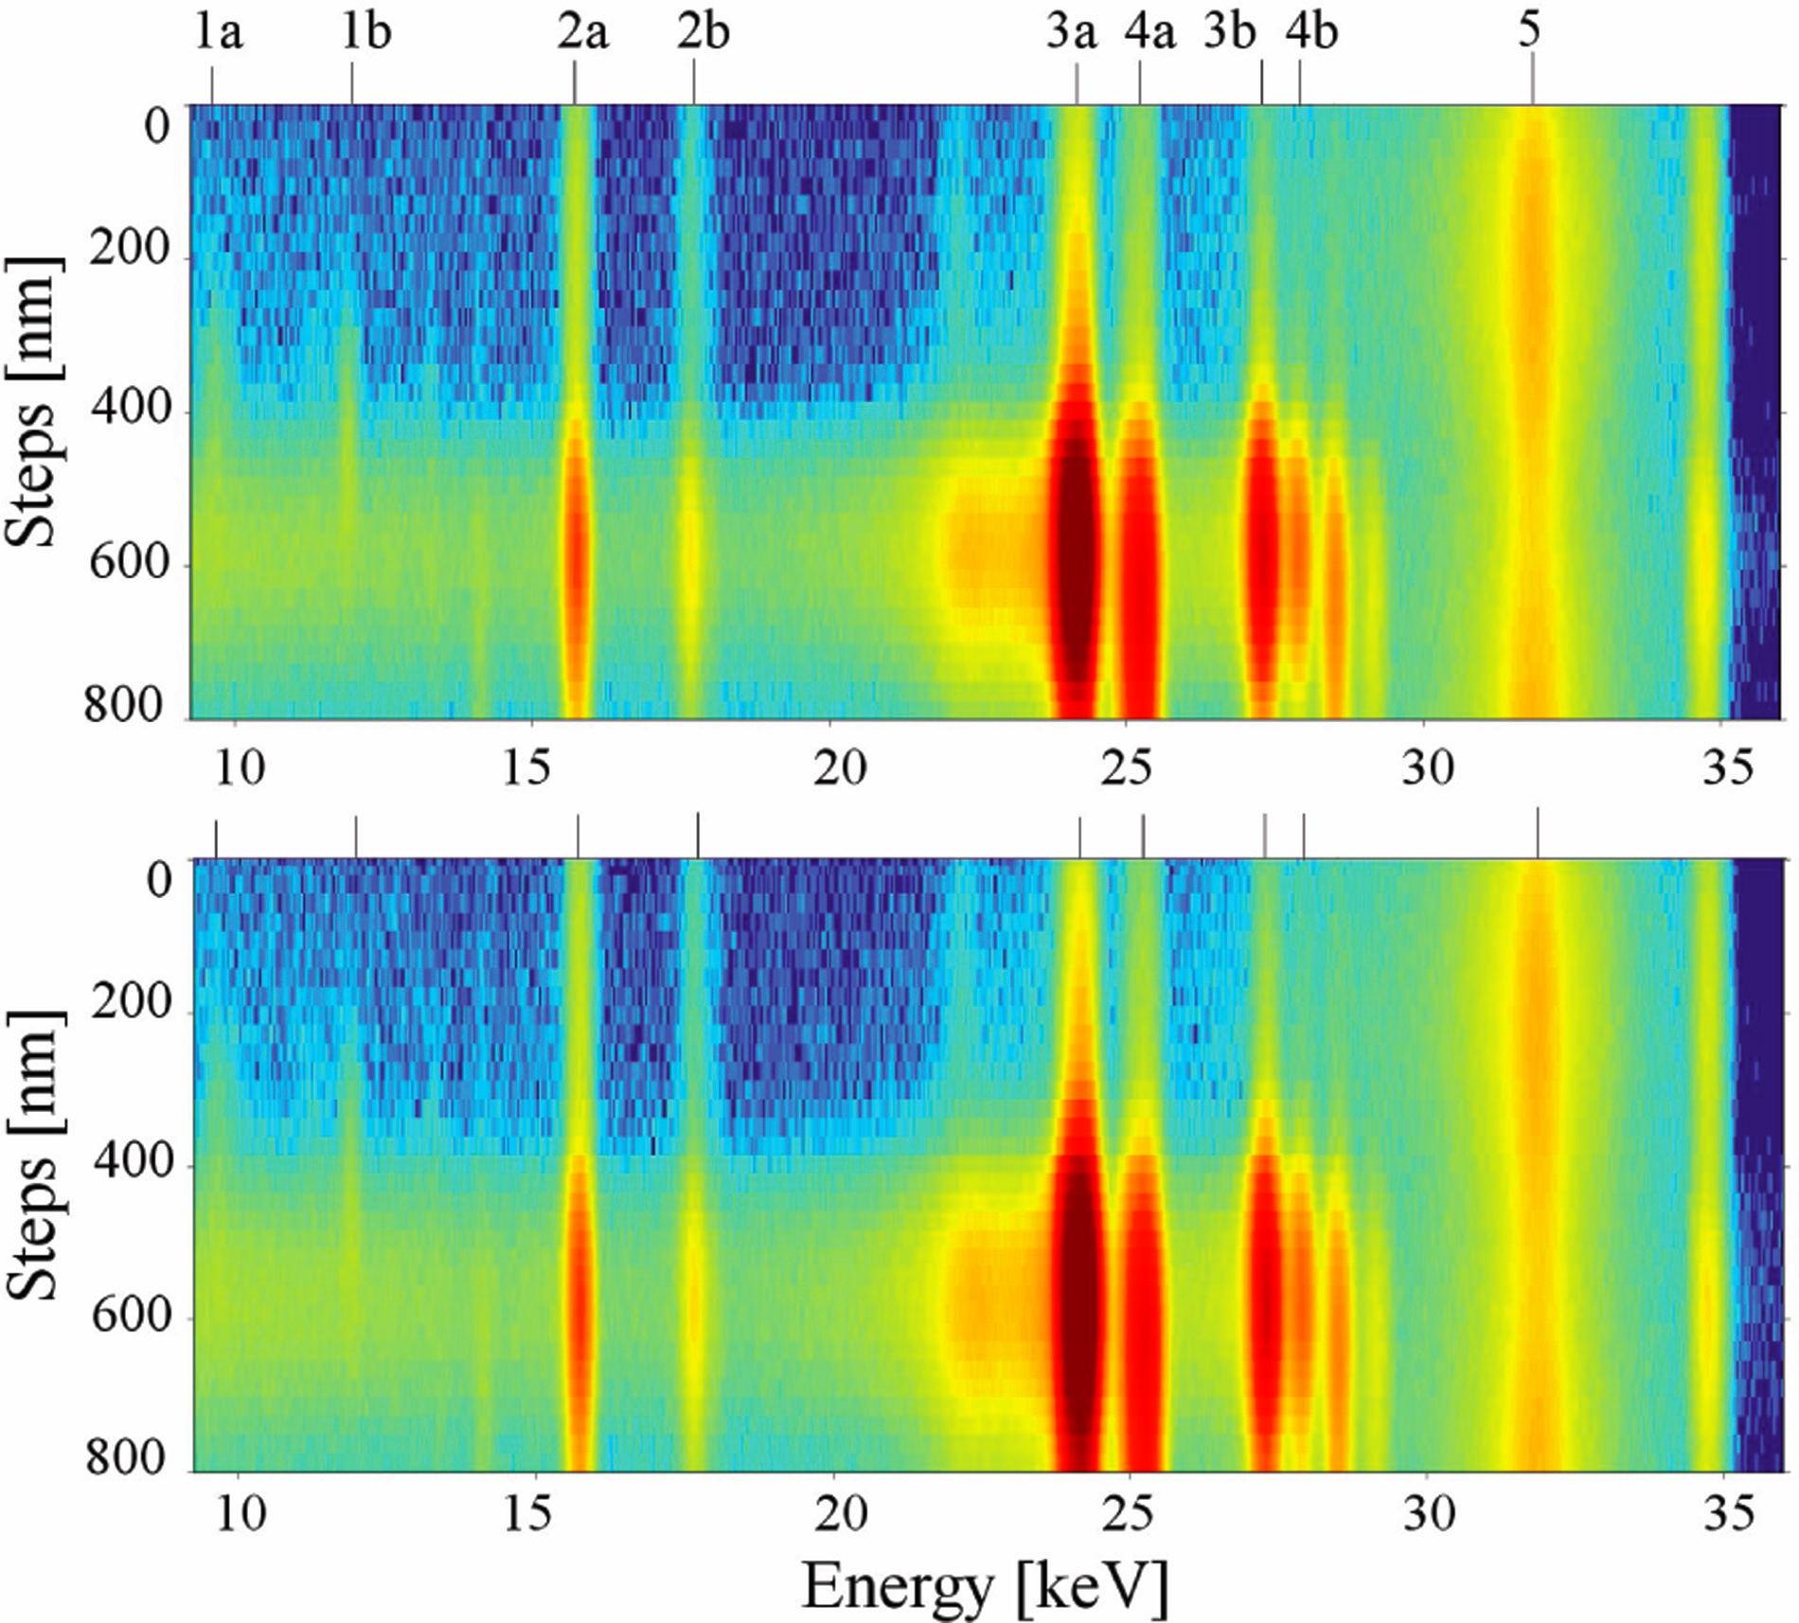
Nanoscale in-situ structural/morphological analysis of
plasmonic organic photovoltaic devices
Tracking NP dispersion ruling plasmonic effects:
The experimental accuracy made it possible to measure the NPs distribution profile across the device thickness.
Discriminating the Au NPs distribution inside the active layer and at its buried interface is essential to understand the contribution of Localized Surface Plasma Resonace to enhancing the device efficiency.
Fluorescence data acquired during the cross-sectional scan of the OPV device, tracking the different layers’ constituents.
Results for the pristine (top) and annealed states (bottom).

Slide 29
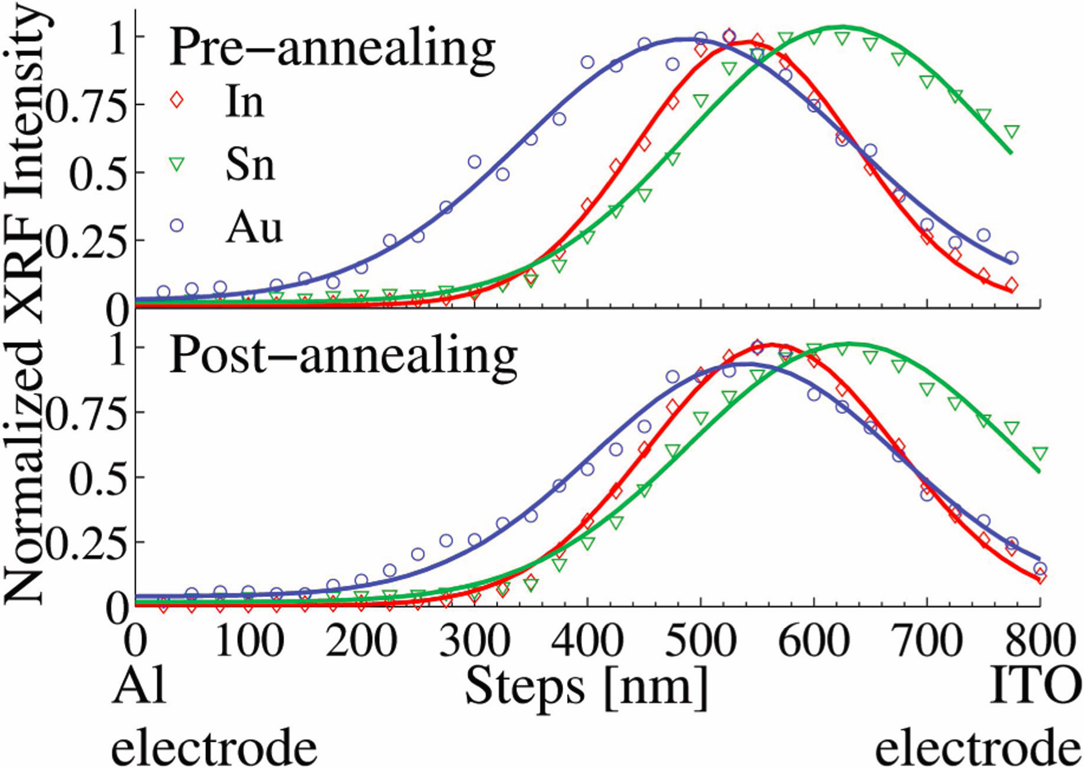
Nanoscale in-situ structural/morphological analysis of
plasmonic organic photovoltaic devices
Tracking the metallic elements in the device:
The XRF measurements performed simultaneously are consistent with XRD findings and corroborate them.
Another interesting effect of the thermal annealing is the detection of interdiffusion from the ITO into the PEDOT:PSS layer, in agreement with the existing literature.
From the present observations one infers that In diffusion may take place within ~15 nm from the ITO/PEDOT:PSS interface.
The fluorescence line intensities versus the vertical scanning step for each metallic element in the OPV.

Slide 30
Plasmonic Ag nanoparticles incorporated in the photoactive film.
Experiment: XRD vertical rapid scans of the integrated OPV device via a nm-sized X-ray beam, during in-situ annealing (70 ⁰C-> close to the polymer glass transition temperature)
Sample: BHJ thickness = 230 nm as determined by EDXR; OPV device fabricated on ITO glass substrate (20 mm x 15 mm). Buffer layer: PEDOT-PSS; Al -electrodes
Advantage: localized surface plasmon resonance (LSPR) from smaller-sized NP surface electrons + multiple light scattering by large-sized NPs

Slide 31
Current–voltage characteristics of the PV output of the reference P3HT:PCBM (black curve) and P3HT:PCBM-AgNP (red curve) devices. (b) IPCE spectra of the reference (black curve) device and of the device incorporating Ag NPs (red curve).
IPCE = Incident Photon to Current Efficiency
Beamline Setup: X-ray Energy = 35 keV; planar Si CR-lenses used to produce vertical line focus; 1 mm pinhole between CRLs and sample to remove background scatterimg.
CCD area detector (FreLON): 50x50 µm² pixel size; in addition a fluorescence detector was used to track the different elements in the device
Attained beam size: 89±5 nm (assuming a Gauss profile). Aignment error better than 0.02 deg, corresponding to 35 nm across a 100 µm X-ray path

Slide 32
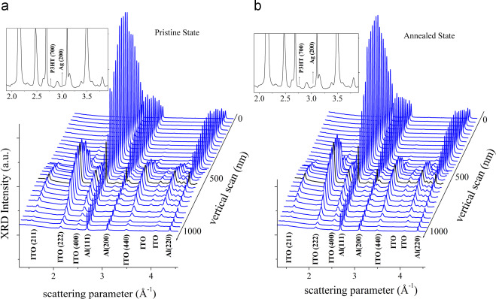
Sequence of diffraction patterns collected during the vertical scan of the integrated device upon annealing at T=70 °C: (a) first sequence referring to the pristine state (at t=0 h) and (b) last sequence referring to the annealed state of the sample (at t=5 h). The different contributions arising from the various layers composing the solar cell are identified. The pattern corresponding to a 750 nm vertical scan, i.e. the central part of the BHJ layer, is highlighted in the inset.

Slide 33
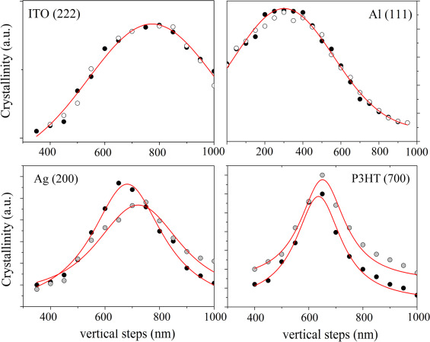
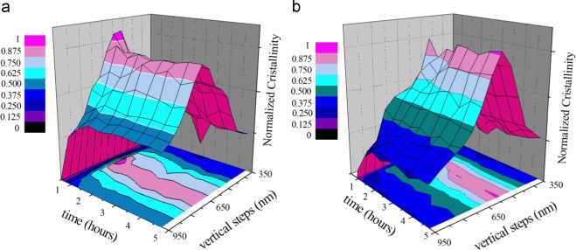
Main results:
Annealing effect: comparison of the space resolved distributions of the crystallinity for the ITO electrode, the Al electrode, the Ag NPs and the P3HT in the pristine state (full circles) and in the annealed state of the device (empty circles)
3D maps of the time-space resolved distribution of the crystallinity for Ag NP (a) and P3HT (b) during in situ annealing as functions of time and of the vertical steps of the device stratigraphy.

Slide 34
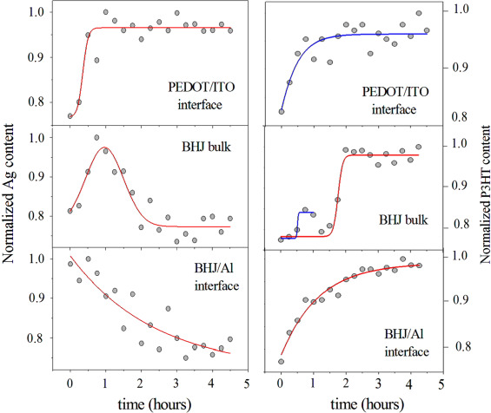
Conclusions of the ageing study:
ITO and Al → no change
Ag NPs → migration inside the BHJ toward the PEDOT:PSS/ITO interface
P3HT → decrease of the average grain size from 11 to 9 (±0.5) nm, i.e. occurrence of a
crystallization process in the polymer
Dynamics:
Normalized peak intensity of the Ag (200) reflection (left) and normalized P3HT crystallinity as a function of the annealing time, tracking the space distribution of the crystalline material amount in time.
The explanation for Ag NP behaviour could be that polymer chain softening consequent on heating (close to the BHJ glass transition temperature) allows for enhanced mobility of the NPs incorporated in the BHJ.
The BHJ structural properties are more stable at the PEDOT:PSS/ITO interface than at the BHJ/Al interface, due to the key role played by the NPs in inhibiting the thermal induced degradation pathways. Specifically, during annealing NPs migrate toward the bottom part of the BHJ and hinder the polymer chains motion. As a result, the glass transition temperature of the BHJ blend is increased, inhibiting P3HT crystallization.

Slide 35
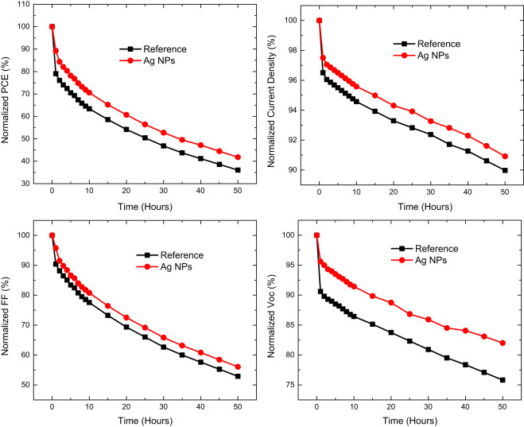
P3HT crystallization process and NP segregation do not compromise the device performances. Even more: NP doping allows for a better preservation of the PV performance over time.
The main factor that is affected after the incorporation of the Ag NPs in the OPV device is the V_{oc} because of the morphological changes after the prolonged illumination
Comparison of the PV parameters׳ decay versus time for both Ag NP doped and reference devices.
Summary: important decrease of the PCE degradation over damp heat of the plasmonic device compared to the reference one. The plasmonic device significantly retains its PCE (Figure of merit is Voc) at the first hours of damp heat. After the initial stage of the devices degradation, the two individual cells seem to keep the same degradation rate, with a slightly higher degradation rate for the reference device. As a result, after an initial stage there is a constantly higher lifetime value of ~7% for the plasmonic device compared to the reference one

Slide 36
Results of the ESRF investigations published in:
B. Paci, A. Generosi, J. Wright, C. Ferrero, A. Di Carlo, F. Brunetti, "Planar Perovskite Solar cells: Local Structure and Stability Issues", Solar RRL 2017, 1, 1700066
F. Silvestri, A. Generosi, M. Guaragno, V. Rossi Albertini, C. Ferrero, G. Susanna, F. Brunetti, I. Davoli and B. Paci, “In situ space-resolved X-ray diffraction and time-resolved EDXD on efficient polymer-based photovoltaic devices: Microstructural properties and aging effects”, Journal of Materials Research, DOI: https://doi.org/10.1557/jmr.2016.500, 24 January 2017
B. Paci, G. Kakavelakis, A. Generosi, J. Wright, C. Ferrero, E. Stratakis, E. Kymakis, “Improving stability of organic devices: a time/space resolved structural monitoring approach applied to plasmonic photovoltaics”, Solar Energy Materials & Solar Cells 159(2017)617–624
B. Paci, G. Kakavelakis, A. Generosi, V. Rossi Albertini, J.P. Wright, C. Ferrero, D. Konios, E. Stratakis, E. Kymakis, “Stability enhancement of organic photovoltaic devices utilizing partially reduced graphene oxide as the hole transport layer: nanoscale insight into structural/interfacial properties and aging effects”, RSC Adv., 2015, 5, 106930-106940
B. Paci, D. Bailo, V. Rossi Albertini, J. Wright, C. Ferrero, G. D. Spyropoulos, E. Stratakis, and E. Kymakis, “Spatially-Resolved In-Situ Structural Study of Organic Electronic Devices with Nanoscale Resolution: The Plasmonic Photovoltaic Case Study”, Adv. Mater. 2013,
DOI: 10.1002/adma.201301682

Slide 37
Thank you for your attention!
Merci pour votre attention
Dziękuję bardzo za uwagę

