Slide 1




Structure and dopant engineering in PEDOT thin films for thermoelectric applications
Liten:
Dr. Alexandre CARELLA
Dr. Etienne YVENOU
Amélie Schultheiss
Dr. Nicolas MASSONNET
Sophie BRENET
Dr. Anass BENAYAD
Dr. Jean-Pierre SIMONATO
INAC:
Dr. Jérôme FAURE-VINCENT
Dr. Stéphanie POUGET
Dr. François RIEUTORD
Dr. Hanako OKUNO
Dr. Renaud DEMADRILLE
Magatte Niang GUEYE
PhD student
magatte.gueye@cea.fr
December 4., 2017

Slide 2
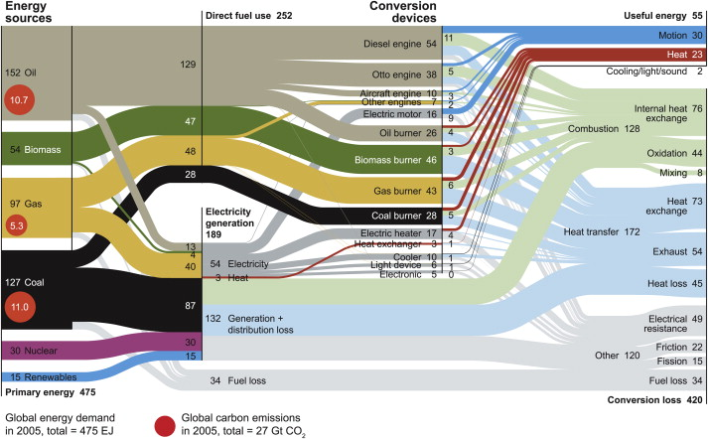
Plenty of energy is wasted…
J Cullen et al., Energy, 2010, 35, 2059
Around 90% of primary energy is first converted to heat

Slide 3
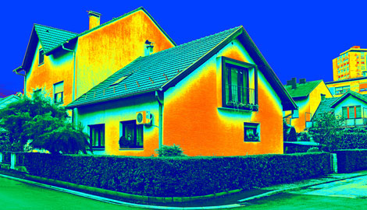
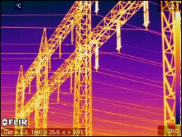
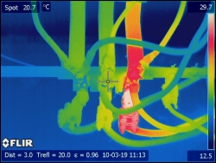
Mostly at t below 100 °c
C. Forman et al., Renew. Sust. Energ. Rev., 2016, 57, 1568-1579
60 % of heat losses are at temperature below 100°C

Slide 4

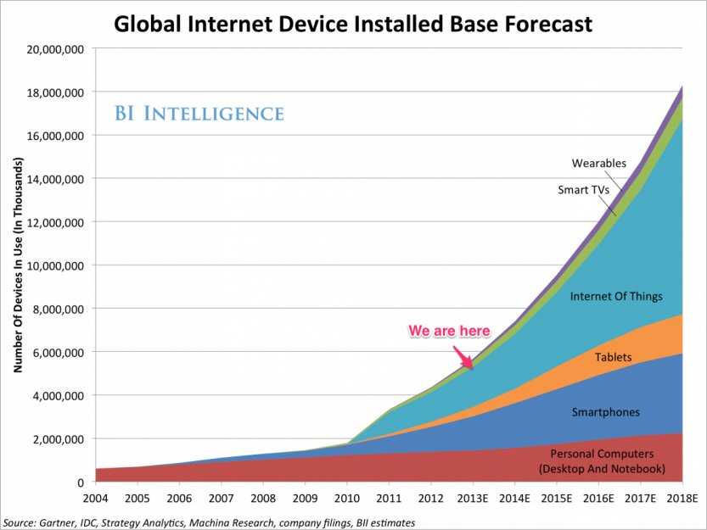
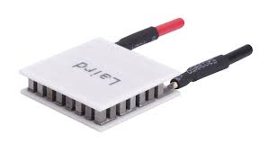
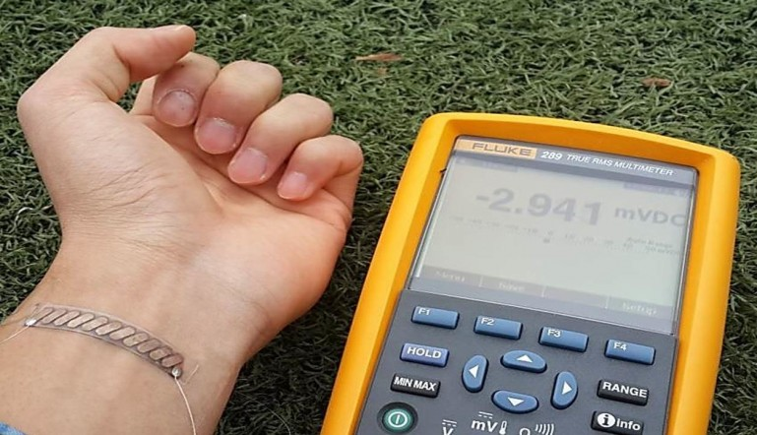
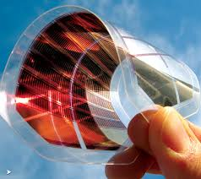
motivation
Why is it important to harvest such energy (lost anyway) ?
Possible with thermoelectric devices

Slide 5
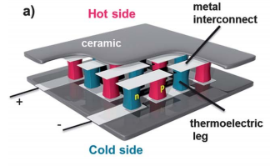


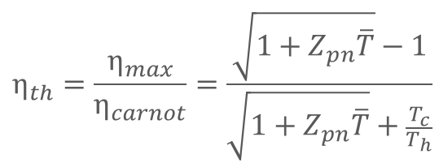

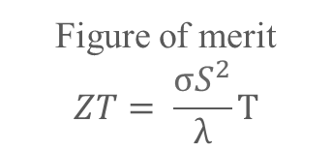


Thermoelectric devices
$$∆V>0$$
$$∆V=0$$
+
+
+
+
+
+
+
+
+
+
+
$$\vec{∇ }T$$
ΔV = S ΔT > 0 for a p-type and < 0 for an n-type semiconductor
$$η_{th}=\frac{η_{max}}{η_{carnot}}=\frac{\sqrt{1+Z_{pn}\overline{T}}−1}{\sqrt{1+Z_{pn}\overline{T}}+\frac{T_{c}}{T_{h}}}$$
Figure of merit
$$ZT= \frac{σS^{2}}{λ}T$$
  Requirements for a good efficiency
      A high Seebeck coefficient S
      A high electrical conductivity σ
      A low thermal conductivity λ
      S = Seebeck coefficient (ΔV/ΔT)
      σ = electrical conductivity
      λ = thermal conductivity

Slide 6
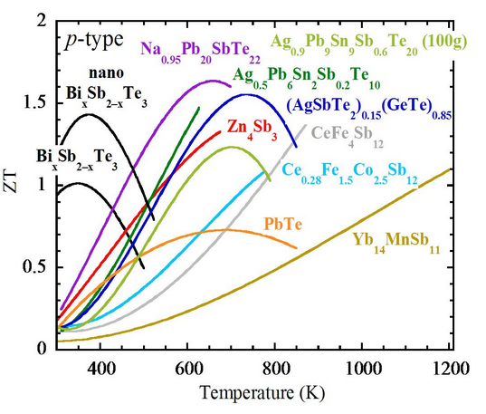
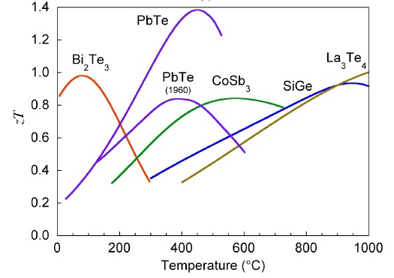
Thermoelectric materials
  Intrinsic thermoelectric properties → specific temperature range of utilization
  RT performant thermoelectric materials: Te based
      Scarce
      Toxic
      Expensive (material & process)
  Need of new alternatives
  → Organic materials
n-type
p-type

Slide 7
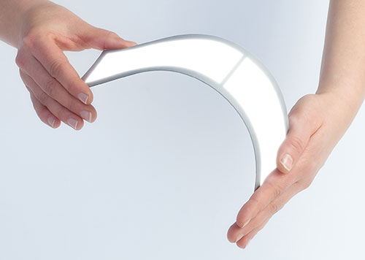
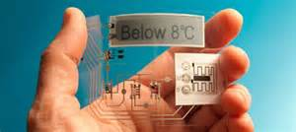
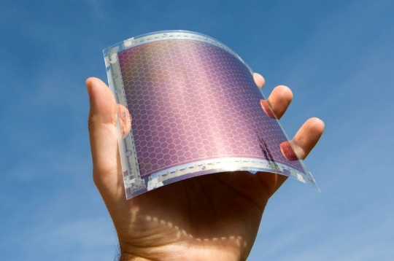
Organic semiconductors
Organic Thin Film Transistor (OTFT)
Organic Light Emitted Diode (OLED)
Main applications
Organic Photovoltaics
(OPV)

Slide 8

Organic and Hybrid Materials as ThErmoelectric Materials
Widely tunable thermopower
Possibility of adding thermoelectric inclusions
Limited temperature range
(<200 °C)
$$\overline{ZT}=\frac{{σ S}^{ 2 }\overline{T}}{λ}$$
Moderate electrical conductivity
Low thermal conductivity
(0.2 – 0.5 W.m⁻¹.K⁻¹)
Insulators
Semiconductors
Metals
S
σ
S²σ
S, σ, S²σ
10¹⁴ 10¹⁵ 10¹⁶ 10¹⁷ 10¹⁸ 10¹⁹ 10²⁰ 10²¹ 10²²
| PAGE 8
4 décembre 2017
Charge carrier concentration (cm⁻³)
CEA | December 4., 2017

Slide 9
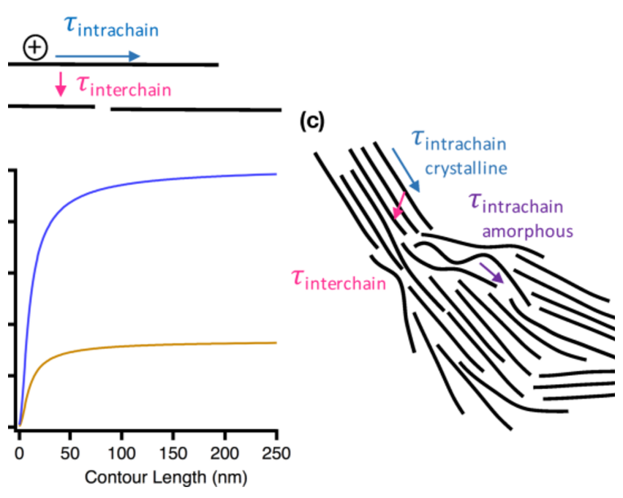
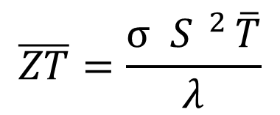
Strategy to improve zt
$$\overline{ZT}=\frac{{σ S}^{ 2 }\overline{T}}{λ}$$
Intrinsically low λ
Given temperature range
Improving the power factor PF = σS²
σ and S linked through the charge carrier concentration
2
1
Improving the Seebeck coefficient
Improving the electrical conductivity
Better ordered structure (mobility)
Reduction (charge carriers)
S. Patel, M. Chabinyc, J. Appl Polym. Sci., 2017, 134, 44403
N. Massonnet, A. Carella et al., J. Mater. Chem. C, 2014, 2, 1278

Slide 10
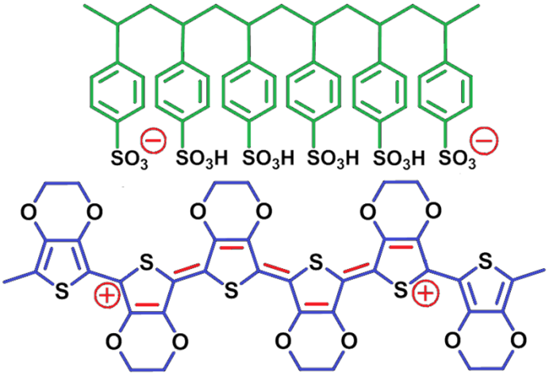
Starting material: PEDOT:PSS as TE material
Poly(3,4-ethylenedioxythiophene)
+
poly(styrene sulfonate)
Dispersion in water (hydrophilic PSS)
Primary doping induced by PSS
Secondary doping by dipping in ethylene glycol (EG) and annealing
σ = 1000 S/cm
Seebeck coefficient : 18 µV K⁻¹

Slide 11

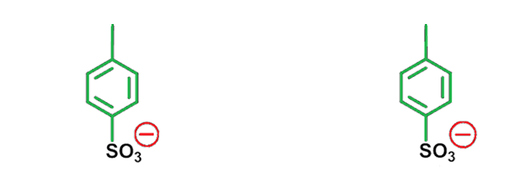
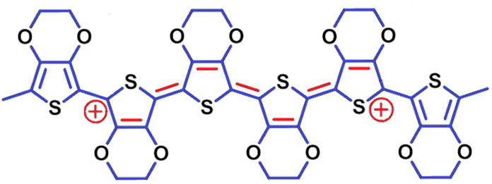
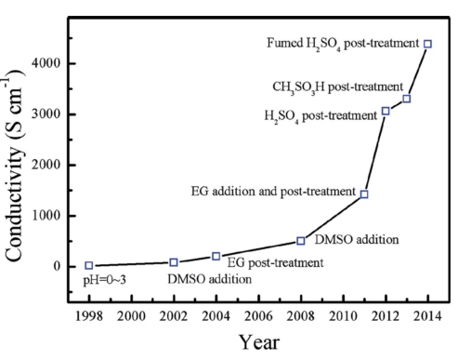
Improving the electrical properties
1
  PEDOT:OTf
      σ = 1218 S.cm⁻¹
  N. Massonnet, A. Carella et al., Chemical Science, 2015, 6, 412
F
F
F
F
F
F
SO3
SO3
Smaller counter ions
2
Solvent treatment
3
Acid treatment
Jingkun Xu et al., Adv. Electron. Mater., 2015, 1, 1500017

Slide 12
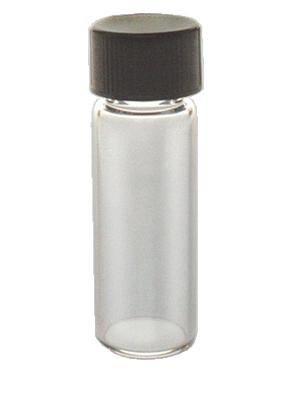
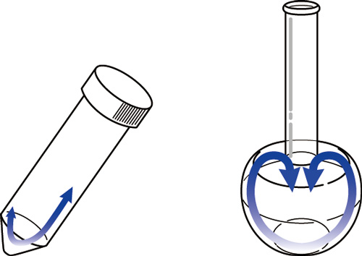
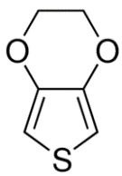
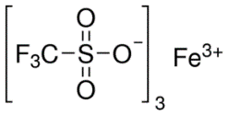
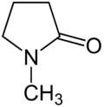

Experiments & characterization
Film deposition
Non fully oxidized deposited film
PEDOT:OTf film
Addition of EDOT
Spin coating
Heating @ 70°C
Oxidative solution
EDOT formulation
Substrate (glass)
Substrate (glass)
Cosolvent addition
Acid treatment
PEDOT:OTf-NMP film
PEDOT:Sulf-NMP film
NMP addition
PEDOT:OTf-NMP film
$$H_{2}{SO}_{4}$$
Oxidative solution
Substrate (glass)
Substrate (glass)

Slide 13
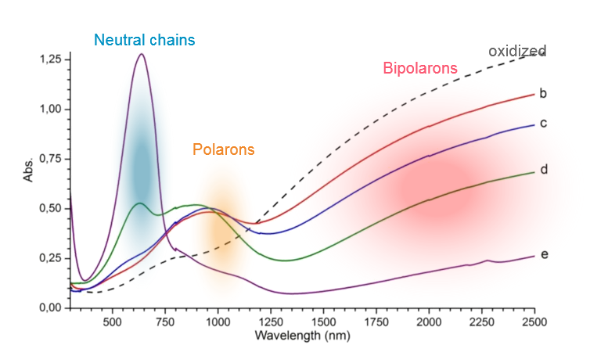
Effect of co-solvent addition
→ Optimum co-solvent concentration
UV-Vis-NIR spectroscopy
UV-Vis-NIR of oxidative solution with and without NMP
Without NMP
With NMP
→ Polymerization rate slowed down

Slide 14
Origin of the increase in σ
Cosolvent addition
NMP addition
PEDOT:OTf-NMP film
Oxidative solution
What about the acid treatment ?
Polymerization rate slowed down
M. Gueye, A. Carella et al., Chemistry of Materials, 2016, 28, 3462

Slide 15
Effect of acid treatment
XPS on
PEDOT:OTf-NMP
PEDOT:Sulf-NMP
Materials | PEDOT:OTf-NMP | PEDOT:Sulf-NMP
Sulf/Thiophene ratio | 39 % | 64 %
Conductivity | 3630 S.cm⁻¹ | 5462 S.cm⁻¹

Slide 16

Origin of the increase in σ
Cosolvent addition
Acid treatment
NMP addition
PEDOT:OTf-NMP film
PEDOT:Sulf-NMP film
PEDOT:OTf-NMP film
$$H_{2}{SO}_{4}$$
Oxidative solution
Substrate (glass)
Substrate (glass)
• Polymerization rate slowed down
• Replacement of triflate ions by sulfate ones
• Redox state ↑
What impact on the structure of the film ?
M. Gueye, A. Carella et al., Chemistry of Materials, 2016, 28, 3462

Slide 17
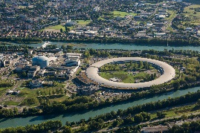
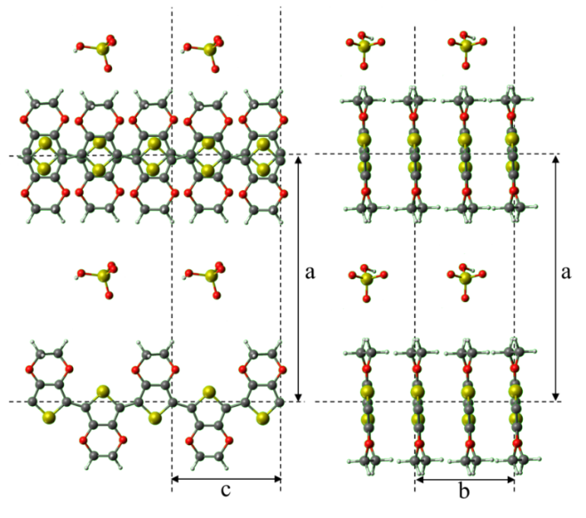
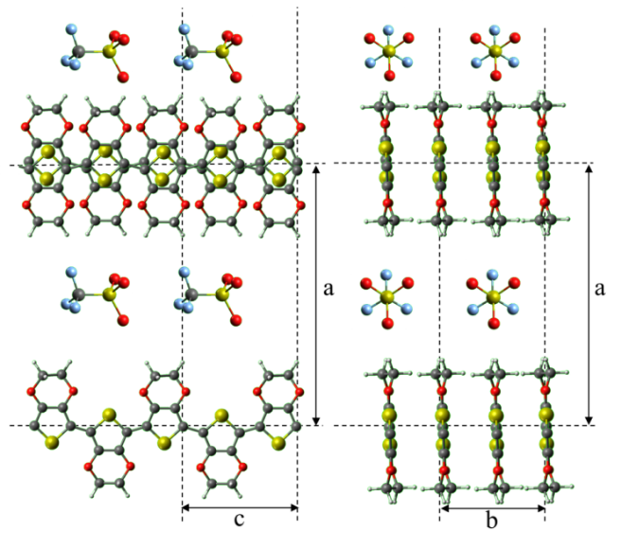
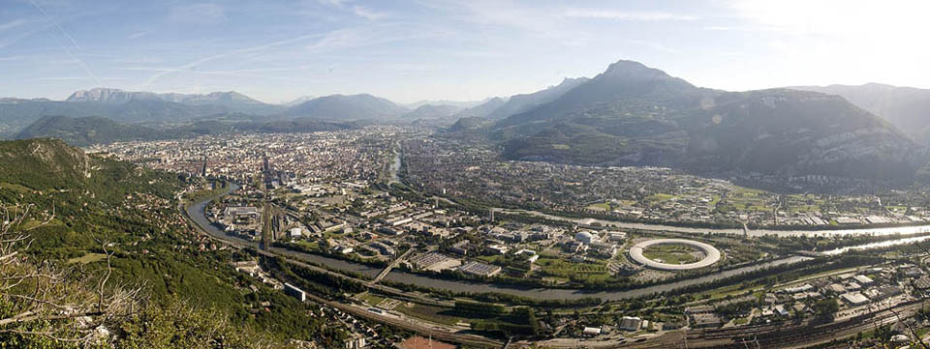

Structure – X rays (ESRF BM 32 – Rigaku)
PEDOT:OTf
PEDOT:OTf-NMP
PEDOT:Sulf-NMP
(020)
q = 1,85 Å-1
d = 3,4 Å
(100)
q = 0,46 Å-1
d = 13,5 Å
(π) stacking
Edge-on
Lamellar stacking
Bigger cristallites are grown (longer chains ?)
The structure is tighter packed
Our lab, somewhere here
Beautiful mountains all around
M. Gueye, A. Carella et al., Chemistry of Materials, 2016, 28, 3462

Slide 18

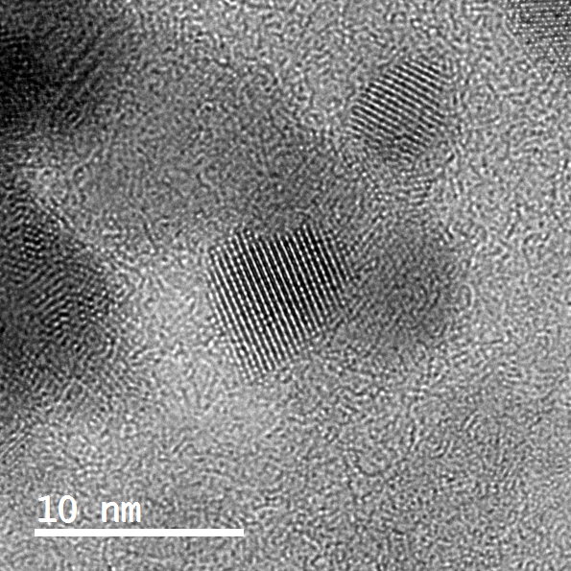
Structure - HRTEM
π-stacking : 3,6 Å
Chain length information
X-rays values verified
M. Gueye, A. Carella et al., Chemistry of Materials, 2016, 28, 3462

Slide 19
Origin of the increase in σ
Cosolvent addition
Acid treatment
NMP addition
PEDOT:OTf-NMP film
PEDOT:Sulf-NMP film
PEDOT:OTf-NMP film
$$H_{2}{SO}_{4}$$
Oxidative solution
Substrate (glass)
Substrate (glass)
• Polymerization rate slowed down
• Replacement of triflate ions by sulfate ones
• Redox state
• Bigger crystallites
• Longer polymer chains
• Better stacking
• Better stacking
How do the chains’ organization and the dopant influence the transport mechanisms ?
M. Gueye, A. Carella et al., Chemistry of Materials, 2016, 28, 3462

Slide 20

Transport properties – σ = f(t)
PEDOT:OTf
PEDOT:Sulf
PEDOT:OTf-NMP
PEDOT:Sulf-NMP
$$\frac{dln(σ)}{dln(T)}$$
Structure + Metallic behavior @ 0 K and RT + charge carrier nature → common VRH → Metallic conduction
Structure + metallic conduction + Disordered region → disordered metallic conduction
Structure + W → 0 → Sheng’s conduction model
Heterogeneous conduction model
M. Gueye, A. Carella et al., Chemistry of Materials, 2016, 28, 3462, 3462

Slide 21
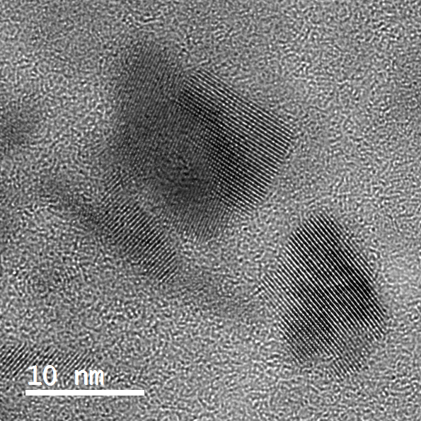
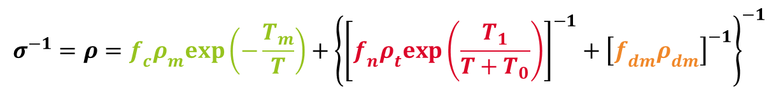

Transport properties – σ = f(t)
Sheng
Metallic
Metallic
Disordered
$$σ^{−1}=ρ=f_{c}ρ_{c}+{[{(f_{n}ρ_{n})}^{−1}+{(f_{dm}ρ_{dm})}^{−1}]}^{−1}$$
$$σ^{−1}=ρ=f_{c}ρ_{m}exp\left(−\frac{T_{m}}{T}\right)+{\left\{{\left[f_{n}ρ_{t}exp\left(\frac{T_{1}}{T+T_{0}}\right)\right]}^{−1}+{\left[f_{dm}ρ_{dm}\right]}^{−1}\right\}}^{−1}$$
PEDOT:OTf
PEDOT:Sulf
PEDOT:OTf-NMP
PEDOT:Sulf-NMP
M. Gueye, A. Carella et al., Chemistry of Materials, 2016, 28, 3462

Slide 22
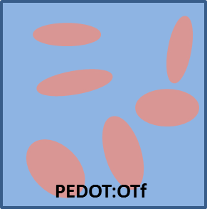
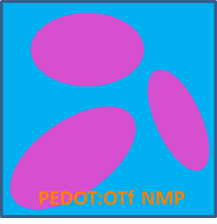

Transport properties – σ = f(t)
PEDOT:OTf
PEDOT:Sulf
PEDOT:OTf-NMP
PEDOT:Sulf-NMP
Quasi 1D metal + Fluctuation Induced Tunneling // Disordered metal
σ=1000 S cm⁻¹
σ=2660 S cm⁻¹ (+166%)
σ cristallites +140%
σ amorphe +167%
σ=4500 S cm⁻¹ (+69%)
σ cristallites -8%
σ amorphe +73%
M. Gueye, A. Carella et al., Chemistry of Materials, 2016, 28, 3462

Slide 23
Origin of the increase in σ
Cosolvent addition
Acid treatment
NMP addition
PEDOT:OTf-NMP film
PEDOT:Sulf-NMP film
PEDOT:OTf-NMP film
$$H_{2}{SO}_{4}$$
Oxidative solution
Substrate (glass)
Substrate (glass)
• Polymerization rate slowed down
• Replacement of triflate ions by sulfate ones
• Redox state
• Bigger crystallites
• Longer polymer chains
• Better stacking
• Better stacking
• The sulfuric acid impacts the disordered domains (increase of oxidation level and replacement of triflate counterions)
• Quasi 1D metallic conduction which increases in the cristallites as well as in the disordered domains
M. Gueye, A. Carella et al., Chemistry of Materials, 2016, 28, 3462

Slide 24
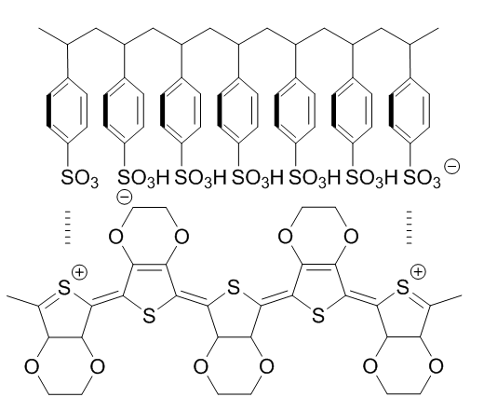
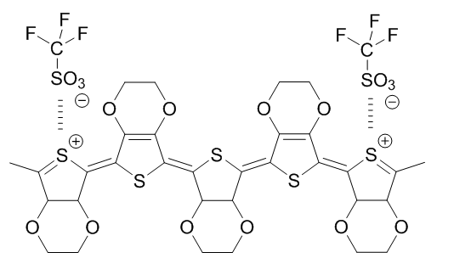
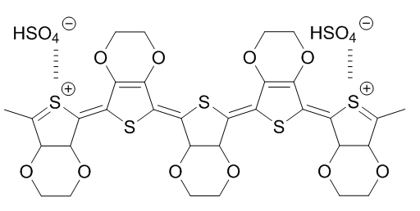
Conclusion
PEDOT:PSS
PEDOT:OTf
PEDOT:OTf-NMP
PEDOT:Sulf-NMP
σ = 0.1 S.cm⁻¹
σ = 1218 S.cm⁻¹
σ = 3630 S.cm⁻¹
σ = 5462 S.cm⁻¹
Big counter-ions
Excess counter-ions
Non treated
Small counter-ions
Slower polymerization rate
Triflate substitution
Oxidation level ↑
      Increase of structural order
      Increase of grain size
      Increase of oxidation level (acid treatment)
      Increase conduction in amorphous PEDOT
      Metallic behaviour + optimized disorder
M. Gueye, A. Carella et al., Chemistry of Materials, 2016, 28, 3462

Slide 25



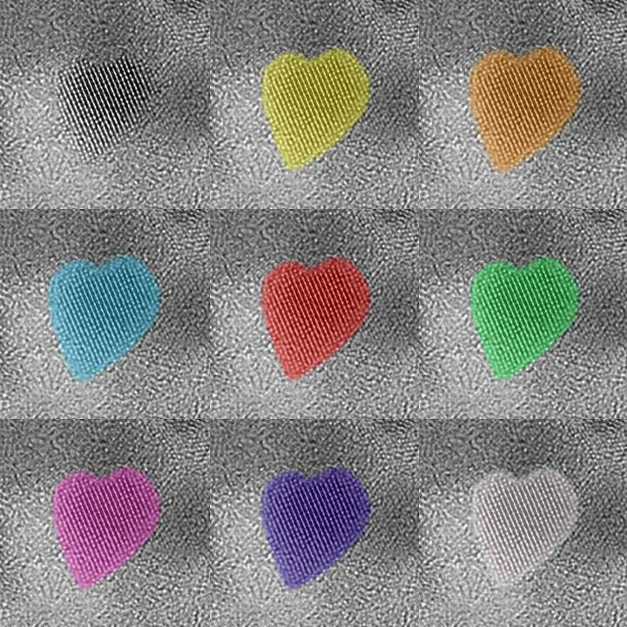

Direction
Département
Service
Thank you !
Questions / comments ?
Liten:
Dr. Alexandre CARELLA
Dr. Etienne YVENOU
Amélie Schultheiss
Dr. Nicolas MASSONNET
Sophie BRENET
Dr. Anass BENAYAD
Dr. Jean-Pierre SIMONATO
INAC:
Dr. Jérôme FAURE-VINCENT
Dr. Stéphanie POUGET
Dr. François RIEUTORD
Dr. Hanako OKUNO
Dr. Renaud DEMADRILLE
Commissariat à l’énergie atomique et aux énergies alternatives
Centre de Grenoble
DRT/Liten/DTNM/SEN/LSIN
Contacts:
Alexandre.carella@cea.fr
Magatte.gueye@cea.fr

Slide 26
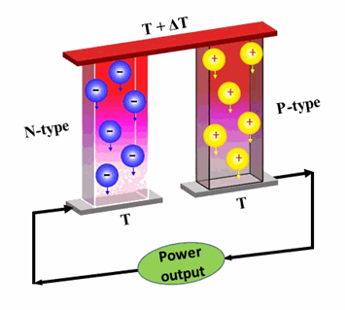
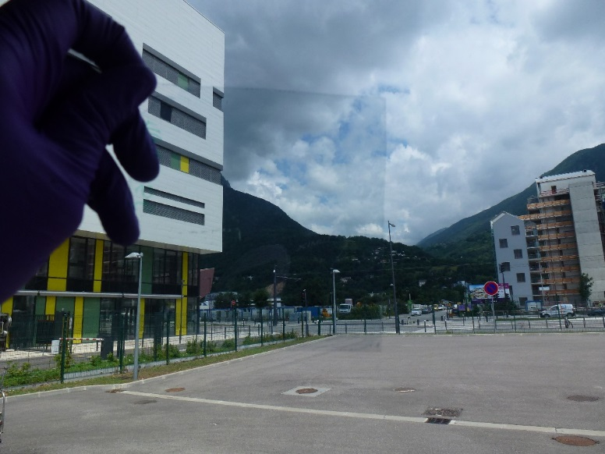
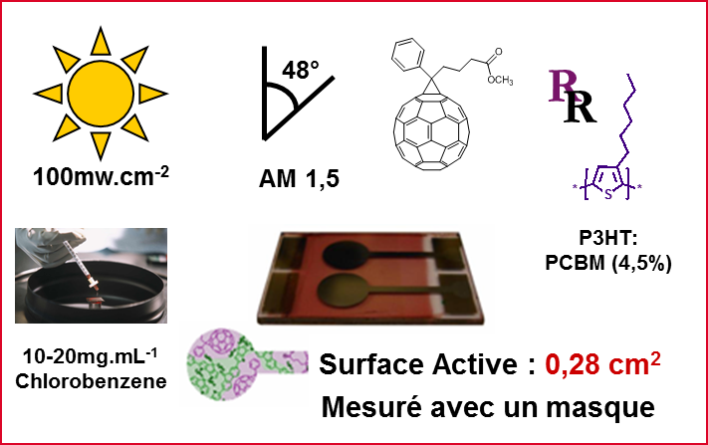
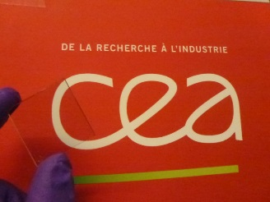
Perspectives
PEDOT:PSS
PEDOT:OTf
PEDOT:OTf-NMP
PEDOT:Sulf-NMP
σ = 0.1 S.cm⁻¹
σ = 1218 S.cm⁻¹
σ = 3630 S.cm⁻¹
σ = 5462 S.cm⁻¹
Organic thermoelectricity
Organic photovoltaics
Transparent electrodes
Power Factor
177 µW.m⁻¹.K⁻²
BH solar cells
PCE : 0.59%, V_{OC} : 0.54 V, J_{SC} : 4.03 mA.cm⁻² , FF 0.27
187 Ω/□ @ 96.9 %, FOM* = 63.5
85 Ω/□ @ 91.7 %, FOM = 50
50 Ω/□ @ 84.9 %, FOM = 44
* J. Coleman et al., ACS Nano, 2010, 4

Slide 27
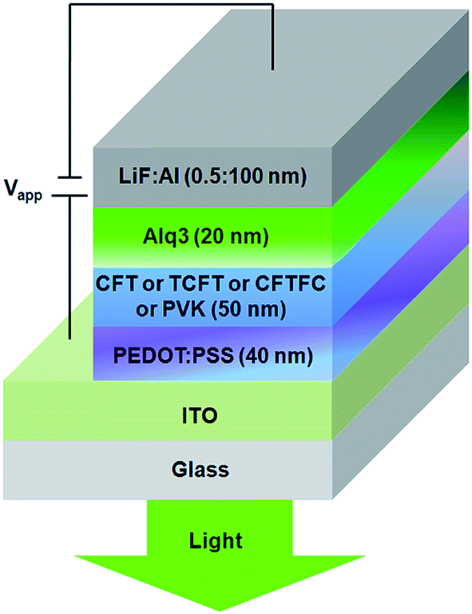
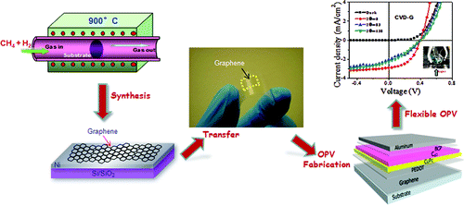
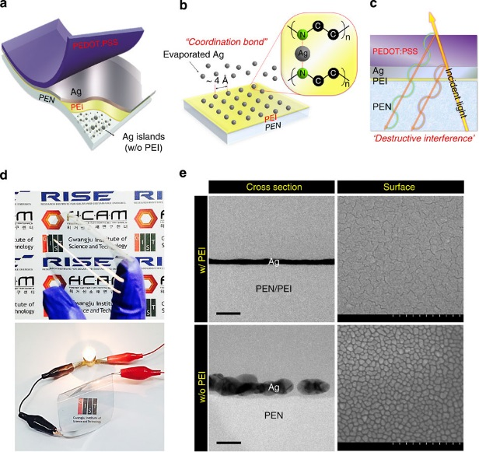

Need of highly conductive PEDOT
L. De Arco et al., ACS Nano, 2010, 4
Ö. Usluer, Journal of Materials
Chemistry C, 2014, 2
  Commonly used in organic electronics
  Dispersible in water & commercial
H. Kang et al., Nature Communications, 2015, 6
X. Crispin et al, Nature Materials, 2011, 10
Notes:
Özlem Usluer, J. Mater. Chem. C, 2014, 2

Slide 28


Effect of acid treatment
Neutral chains
Polarons
Bipolarons
$$FOM= \frac{σ_{DC}}{σ_{OP}}= \frac{Z_{0}\sqrt{T}}{2R_{S}(1−\sqrt{T})}$$
  Increase of bipolaronic charge carriers
      → increase of a semi-metallic behavior
  Crispin et al., Nat. Mater. 2013, 13, 190-194
 | D(020) - Å | D(100) - Å
PEDOT:OTf | 40 | 75
PEDOT:OTf-NMP | 50 | 90
PEDOT:Sulf-NMP | 55 | 100
Film thickness !!

Slide 29







thermoelectricity
Energy harvesting
  Clemens Forman et al., Renew. Sust. Energ. Rev., 2016, 57, 1568-1579
  Three thermoelectric effects
      Seebeck (converting a temperature gradient into a voltage gradient), 1821 Thomas Johann Seebeck
      Peltier (converting a voltage gradient into a temperature gradient), 1834, Jean Charles Athanase Peltier
      Thomson (conductor heating / cooling), 1851, Lord Kelvin

Slide 31


Slide 32



Conjugated polymers
Figure of merit & Power factor
$$ZT= \frac{σS^{2}}{λ}T$$
  Intrinsically low λ (0.1 ~ 0.5 $W.m^{−1}{.K}^{−1}$)
  Tunable S:
      Doping: insertion of charges
  Tunable σ:
      Doping: insertion of charges
      Improvement of carrier mobility
P-type
Toshima, Synthetic Metals, 2007, 157, 467-474
Poudel, Science, 2008, 320, 634-638
Segalman, Nanoletters, 2010, 10,4664-4667
Crispin, Nature Materials, 2011, 10, 429-433
Sun, Advanced Materials, 2012, 24, 932-937
Kim, Energy and Environmental Science, 2013, 6, 788-792
Pipe, Nature Materials, 2013, 12, 719-723
Grunlan, Advanced Materials, 2015
Grunlan, Advanced Energy Materials, 2016
N-type
Sun, Advanced Materials, 2012, 24, 932-937
Yu, Advanced Materials, 2015
Koumoto, Nature Materials, 2015, 14

Slide 33
Effect of co-solvent addition
→ Optimum co-solvent concentration
Without NMP
With NMP
→ Polymerization rate slowed down

Slide 34
Improving the electrical properties
F
F
  PEDOT:OTf
      σ = 1218 S.cm⁻¹
  N. Massonnet, A. Carella et al., Chemical Science, 2015, 6
F
F
F
F
SO3
SO3
Strategy
  Improving the electrical conductivity through :
    Solvent treatment
    Acid treatment
  Material characterization
J. Xu et. Al, Advanced Electronic Materials, 2015, 1

Slide 35

Experiments & characterization
Film deposition
Non fully oxidized deposited film
PEDOT:OTf film
Addition of EDOT
Spin coating
Heating @ 70°C
Oxidative solution
EDOT formulation
Substrate (glass)
Substrate (glass)
Cosolvent addition
Acid treatment
PEDOT:OTf-NMP film
PEDOT:OTf-Ox film
NMP addition
PEDOT:OTf film
$PtCl4$ in CH₃NO₂
Heating @ 70°C
Oxidative solution
Substrate (glass)
Substrate (glass)
Proportions
Oxidative solution without NMP: PEG-PPG-PEG + EtOH (20 + 80 wt. %) + FeOTf₃ (126mg/ml)
Oxidative solution with NMP: add x wt. % NMP (x = 7.75, 8 or 8.5 depending on the humidity level)
PtCl4 : 2.5 M in nitromethane, filtered

